Slide 1

Word/Picture Interaction
Dr. Meghann Meeusen
Western Michigan University

Slide 2
Three Types of Word/Picture Interaction
symmetrical
complementary
contradictory

Slide 3
Symmetrical
  In most picturebooks, illustrators avoid symmetrical relationships the words and the image are absolutely identical.
  Two mutually redundant narratives
  This relationship is found most often in board books for children, where the text “A is for Apple” might appear next to an image of an apple.

Slide 4
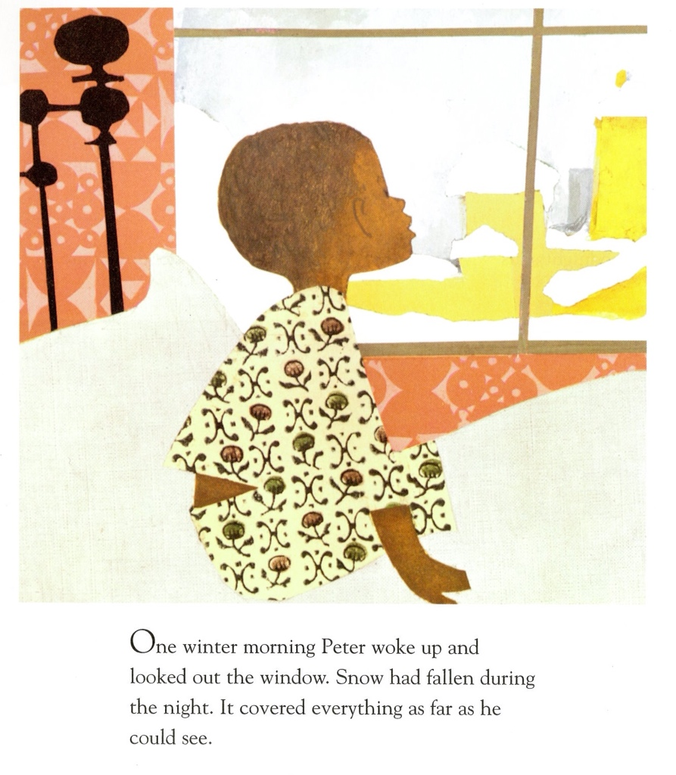

Slide 5
Complementary
Instead, most picturebook creators will allow the text and the image to combine to create a complementary relationship.
Enhancing interaction is significant and dynamic; words and pictures filling each other’s gaps.
Complementary interaction often marks a sign of sophistication in the illustrations, as it requires young readers to synthesize information.

Slide 6
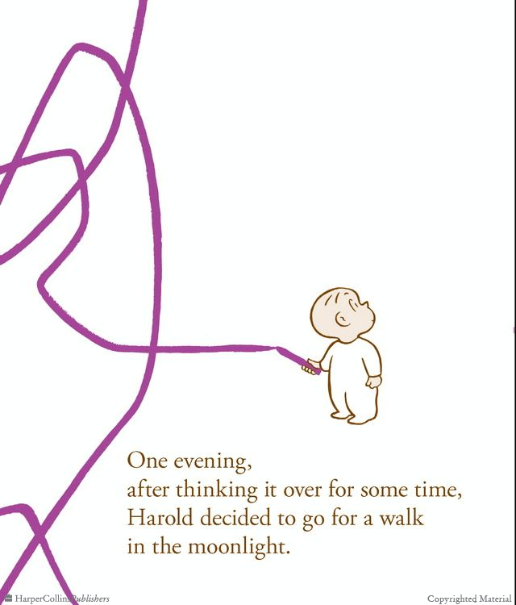

Slide 7
Contradictory
Or illustrators will use contradictory image and words in order to underscore disjunction.
This ambiguity challenges the reader to mediate between the text and pictures to establish a true understanding.
Words and pictures seem to be in opposition to one another.

Slide 8
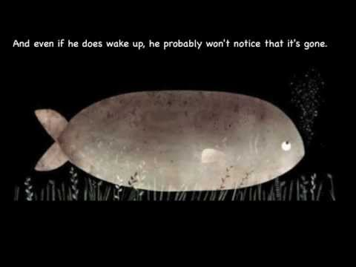

Slide 9
Joseph Schwarcz
Congruency
Elaboration
Specification
Amplification
Extension
Complementation
Alternation
Deviation
Counterpoint

Slide 10
Joanne Golden
The text and pictures are symmetrical (creating a redundancy)
The text depends on pictures for clarification
Illustration enhances, elaborate text
The text carries primary narrative, illustration is selective
The illustration carries primary narrative, the text is selective

Slide 11
Maria Nikolajeva
Uses symmetrical and complementary, but calls contradictory “counterpointing” to specify that there are two mutually dependent narratives.
Adds “expanding” or “enhancing” to denote books where visual narrative supports verbal narrative and the verbal narrative depends on visual narrative. This is a stronger form of complementary.
She also includes sylleptic to consider when there are two or more narrative independent of each other.

Slide 12
Counterpoint (Maria Nikolajeva)
Counterpoint in address: textual and visual gaps are deliberately left to be filled differently by child and adult readers.
Counterpoint in style: serious/humorous, romantic/realistic, realistic/naivistic, historical/acronistic (aka, phones and TVs in Cinderella), artistic/popular
Counterpoint in genre or modality: for example, words may be realistic and images suggest fantasy or vice versa
Counterpoint in perspective: who is speaking versus who is seeing
Counterpoint in characterization: characters are presented differently in words and pictures

Slide 13
Questions to ask…
Do the pictures add substantially to the story?
Are there gaps that the pictures could have filled?
Do the words or pictures carry the main load of the narrative?
Are the pictures decorative or narrative?
What facts and details of the story are not indicated or assumed through only the text? What do these details add to the story?

