Slide 1
Tough Topics in Children’s Lit
Considering Complex and Controversial Issue in Picturebooks: Adapted from “Radical Children’s Literature Now!” by Julia L. Mickenberg & Philip Nel

Slide 2
Julia L. Mickenberg & Philip Nel
We have looked for works that:
  cast aside many of the traditional assumptions about what is appropriate for children,
  acknowledge pressing concerns of the day as relevant to children's lives, and
  refuse to whitewash difficult truths,
  but which also display literary and aesthetic quality and recognize the cognitive and emotional capacities of children.
Such "radical" children's literature models and encourages activism by children as well as adults, and exposes unjust uses of power.
It addresses the reality that the white, middle-class, all-American norm is a myth. Finally, it suggests that it is impossible and unethical to shut children off from the world outside US borders.

Slide 3
Challenges
George Nicholson, literary agent and fifty-year veteran of the children's book business, observes that today: "anything perceived as 'difficult' is avoided at all costs by the major publishers," because "every penny is being watched and the 'dragons' of censorship are stronger than ever in my memory." He describes "Fear of offending sales and marketing, the naysayers in the chains who won't touch anything controversial for retail.”
Patsy Aldana—the founder and president of Toronto's Groundwood Books, which publishes some of the most radical and acclaimed children's books today—has found that demand in the United States for Spanish-language children's books (as opposed to bilingual texts) has diminished dramatically over the last ten years as a result of anti-immigrant sentiment.

Slide 4
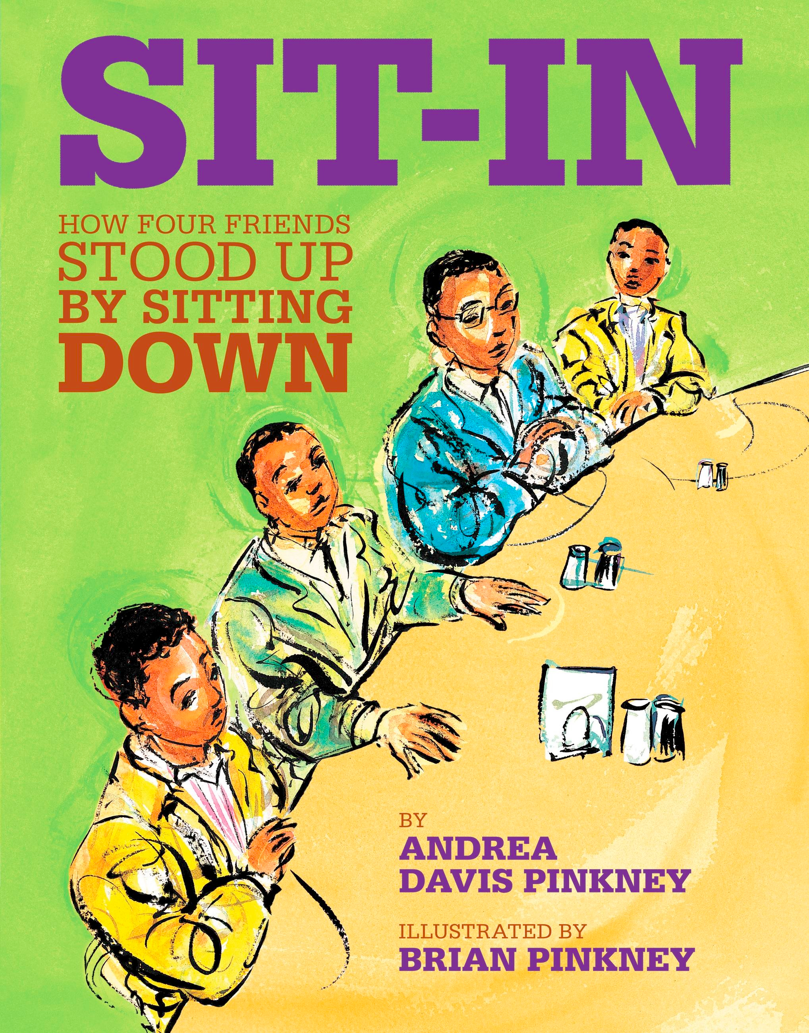
Organize!
Andrea Davis Pinkney and Brian Pinkney's Sit-In: How Four Friends Stood Up by Sitting Down (2010) offers a history lesson in that same power.
A story about lunch-counter sit-ins of the early 1960s, it dramatizes how the Greensboro Woolworth's lunch-counter sit-in sparked more sit-ins and protests in other states.
The fact that it was "kids" who "wouldn't budge" adds to the boldness of Sit-In's message.

Slide 5
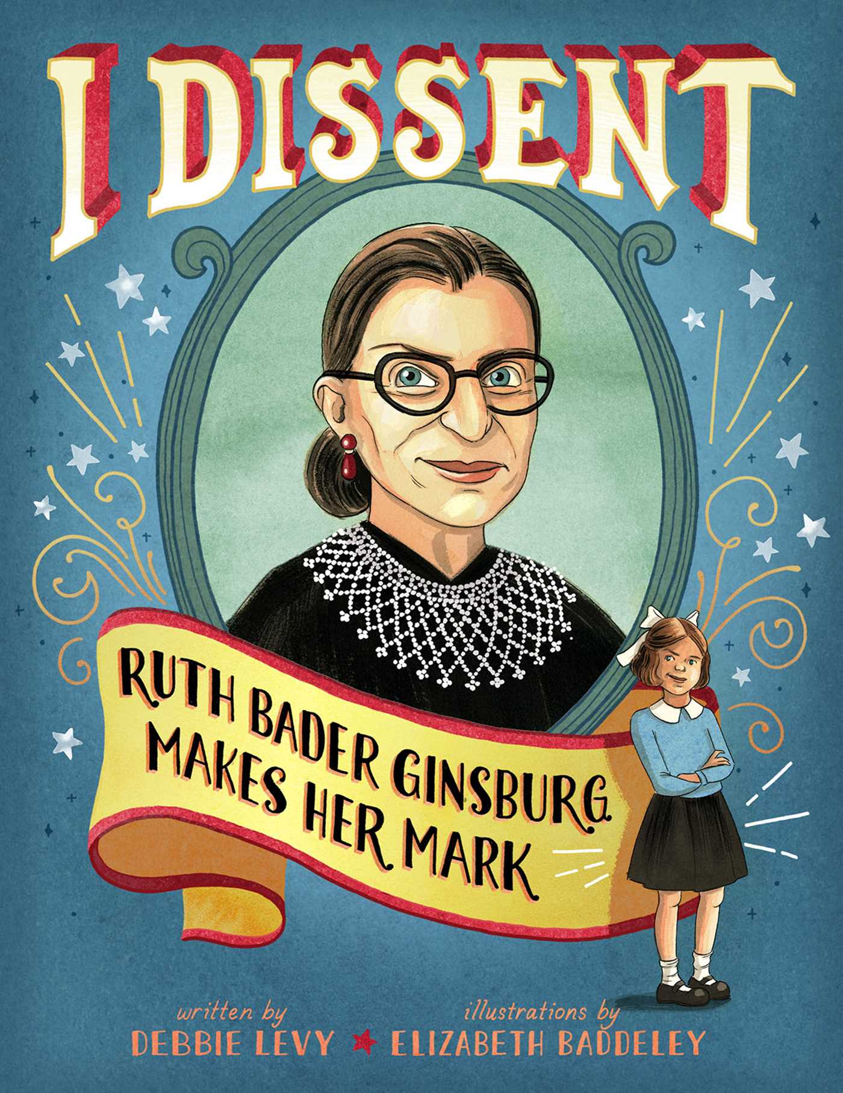
Dissent
In the picture book I Dissent: Ruth Bader Ginsburg Makes Her Mark, author Debbie Levy and illustrator Elizabeth Baddeley introduce young Ruth as a smart, vocal girl who grew up in the ’40s facing sexism, anti-Semitism and even a bias for right-handedness.
“You could say that Ruth Bader Ginsburg’s life has been . . . one disagreement after another,” Levy observes. “This is how Ruth Bader Ginsburg changed her life — and ours.”
On each page, readers see Ginsburg — with the support of her mother and, later, her husband — standing up for her beliefs, especially equality of the sexes.

Slide 6
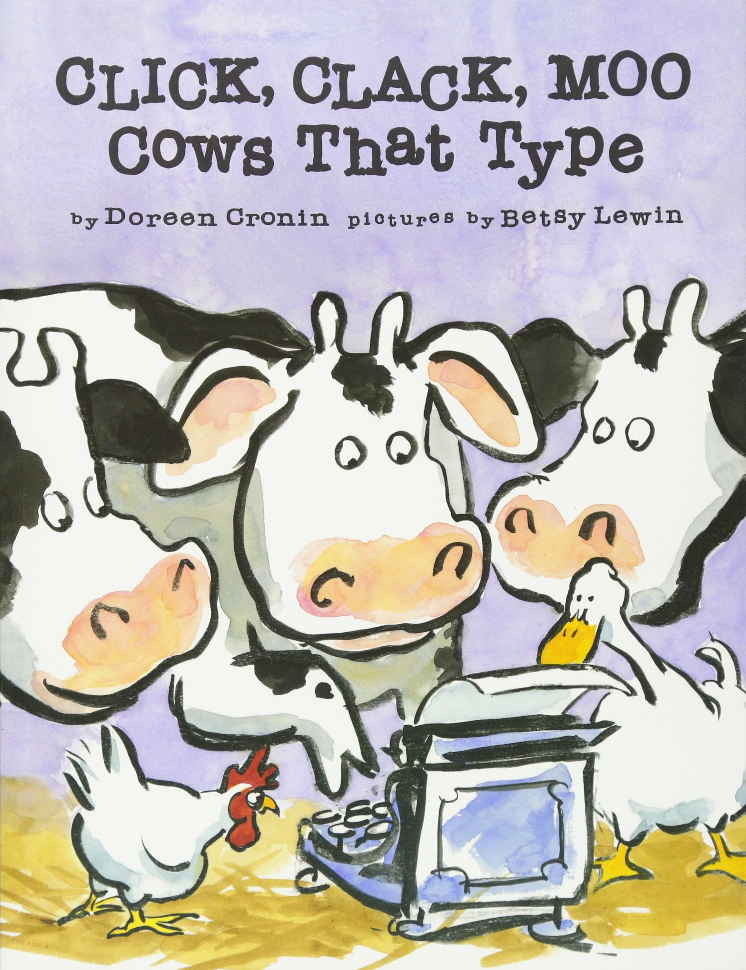
Unions
Reflecting the decades-long decline in union membership in the US, relatively few recent children's books have celebrated labor organizing.
Despite the ostensible pro-labor message of Doreen Cronin and Betsy Lewin's popular Click, Clack, Moo: Cows That Type (2000), as Kimberly Jack points out, that book can as easily be interpreted as trivializing unions as of supporting them.

Slide 7
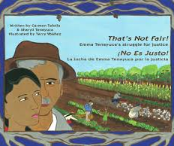
Small Press Challenges
A more explicitly pro-labor book, That's Not Fair / No Es Justo!: Emma Tenayuca's Struggle for Justice/La lucha de Emma Tenayuca por la justicia (2008), celebrates the leadership of Mexican-American labor activist Emma Tenayuca in the 1930s.
Co-written by her niece Sharyll Teneyuca and Carmen Tafolla, and illustrated by Terry Ybáñez, the book is significant as one of the few recent books about labor, as well as Mexican-American activism.
But because it is published by a small-press, it lacks wide distribution.

Slide 8
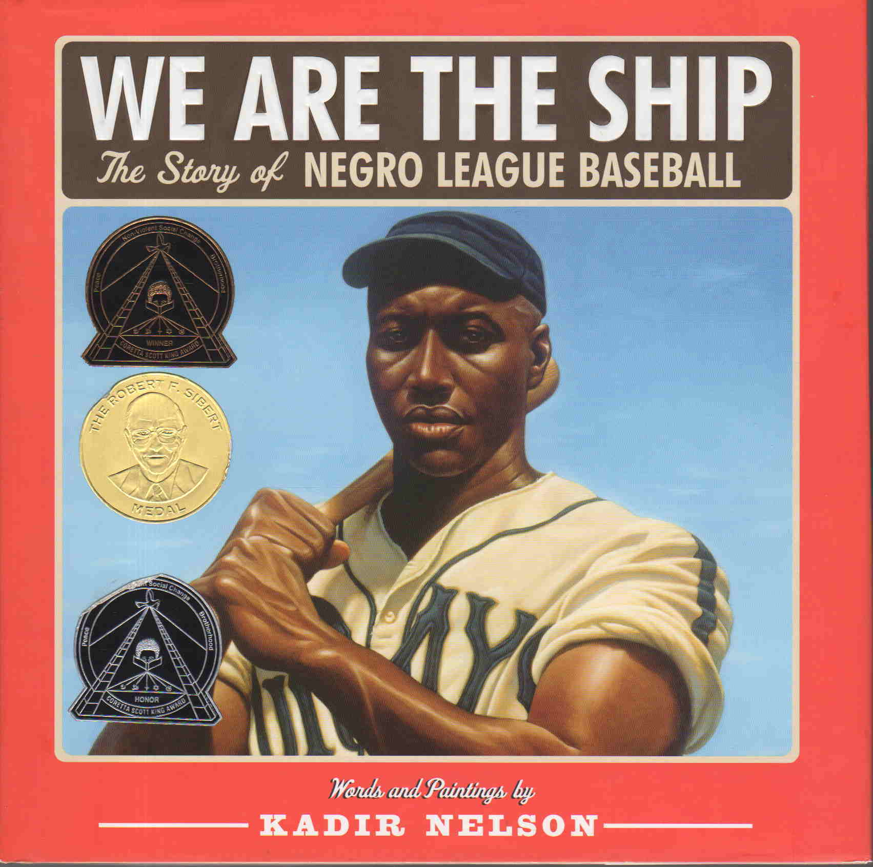
Fight Prejudice
Kadir Nelson's We Are the Ship (2008), conveys the histories of athletes who, denied participation in the all-white major leagues, displayed their talents in the low-paying but high-performing Negro Leagues.
When discussing the fact that many ballplayers came from Latin America, his narrator says of Cristóbal Torriente: "If he had been a couple shades lighter, he could have played in the majors. Major league owners would take a Cuban before they would a Negro. Guess they didn't know slave ships stopped down in those islands, too" (53).

Slide 9
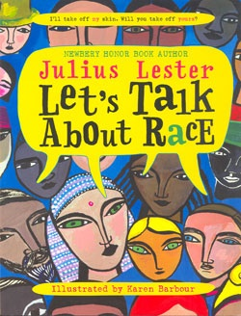
Frankness & Framing
Julius Lester’s Let’s Talk About Race introduces race as just one of many chapters in a person's story. Beginning with the line, "I am a story," Lester tells his own story with details like favorite food, hobbies, and time of day. Then he states, "Oh. There's something else that is part of my story…I'm black." Throughout the narrative, he asks questions that young readers can answer, creating a dialogue about who they are and encouraging them to tell their own tales.
Lester discusses "stories" that are not always true, pointing out that we create prejudice by perceiving ourselves as better than others.

Slide 10
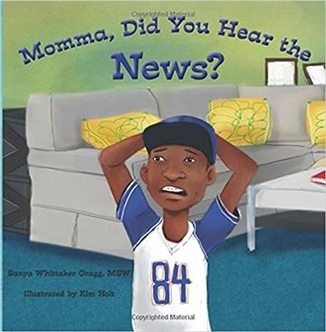
Seeing all experiences
Sanya Wittaker Gragg published her first book Momma, Did You Hear the News? in April. The book is centered around “Little Avery,” a young boy who witnesses the police shooting of an unarmed Black man.
This traumatic incident prompts Avery’s parents to have “the talk” with him and his brother, centered around what to do when you’re having an encounter with the police.
“I think [that] because of social media and our children’s access to it, this conversation is happening much sooner,” Gragg said. “What used to be a concern once our children started driving is now a concern if they are just walking down the street. I think this book can really help with the introduction of this topic.”

Slide 11
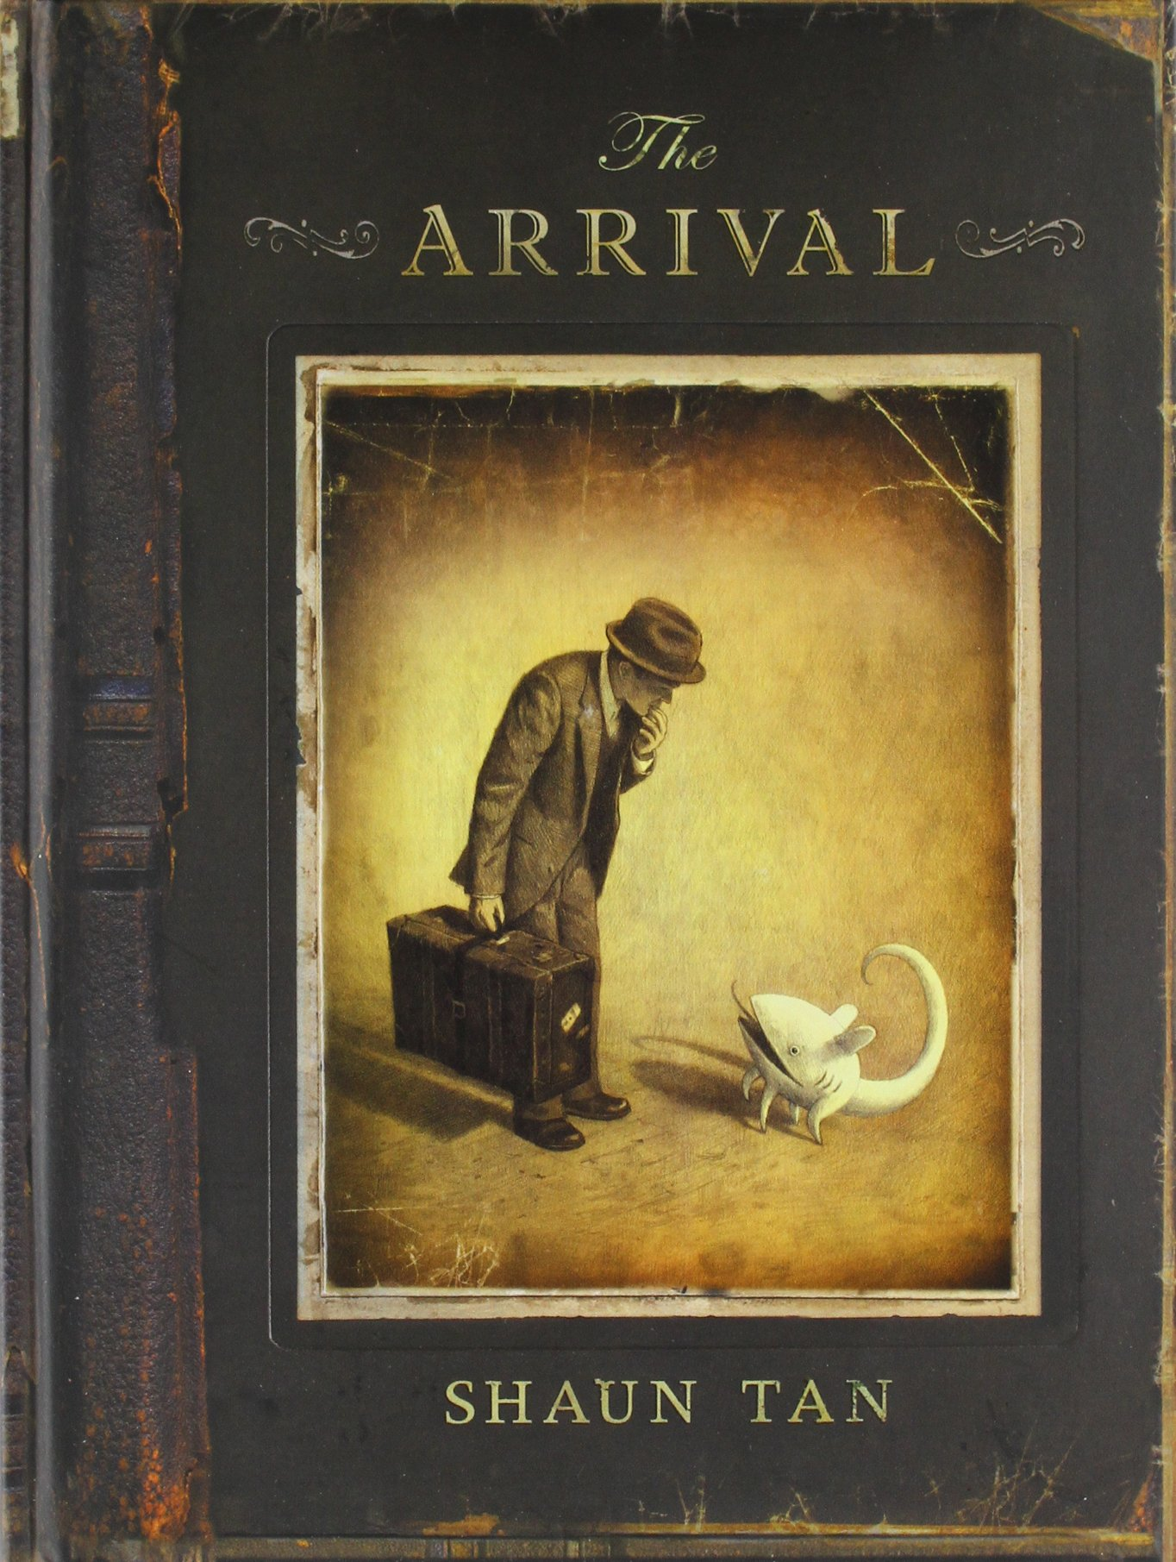
Experience “foreignness”
Australian artist Shaun Tan's The Arrival (2006) makes visible the experience of foreignness.
Tan invites readers to share the bewilderment, anxiety, and utter strangeness of being "foreign."
Just as Tan's new arrival does, we see signs and maps printed using a linguistic system we cannot comprehend.
Following the post-9/11 suspicion of people from other countries, The Arrival goes against the grain of both US and Australian immigration policies.

Slide 12
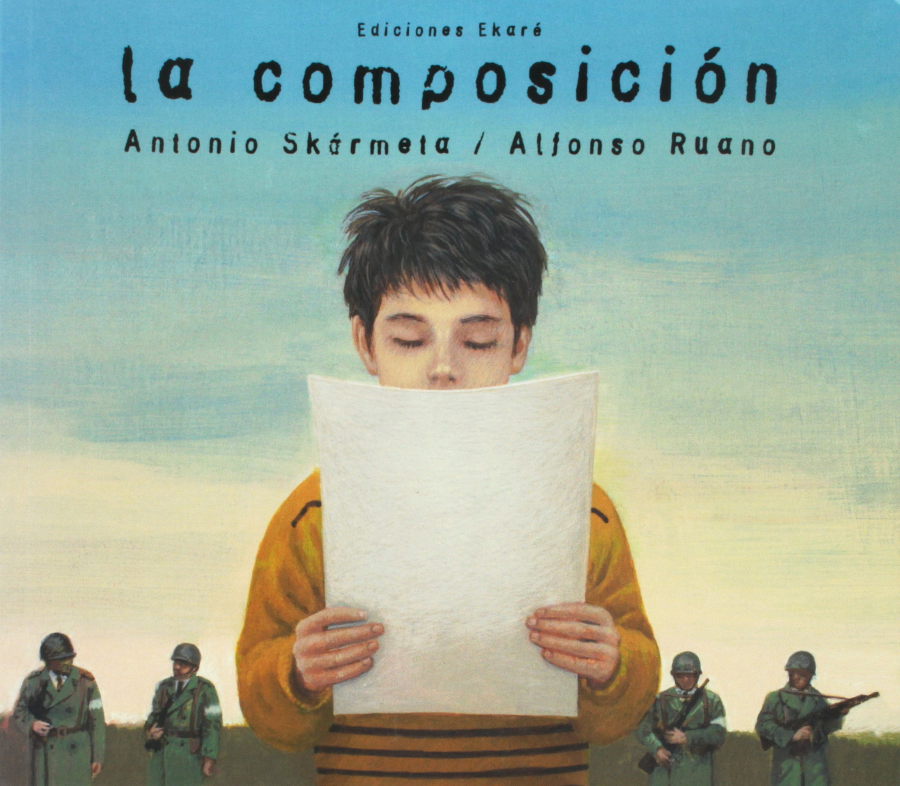
Internationalism
The Composition (2000), by Chilean writer Antonio Skarmeta, depicts young Pedro asking his friend Daniel why the police have taken his father away, Daniel replies, "My father is against the dictatorship." When Pedro asks his own father if he is against the dictatorship, an affirmative answer prompts Pedro to ask, "Will they take you to jail too?"
Back at school, "a man in a military uniform" announces that all the children are to write a composition on "what you and your parents do from the moment you get home from school and work. Which friends come over, what they talk about, what they say about the television programs you watch." When Pedro tells his parents …they are terrified.
But Pedro reads his essay aloud, and has said that he plays soccer every day after school, and after supper his parents sit and play chess until Pedro goes to bed. "Pedro looked up and saw that his parents were smiling. 'Well,' said his father, 'we'd better buy a chess set.'" Pedro has learned to lie to protect his family.

Slide 13
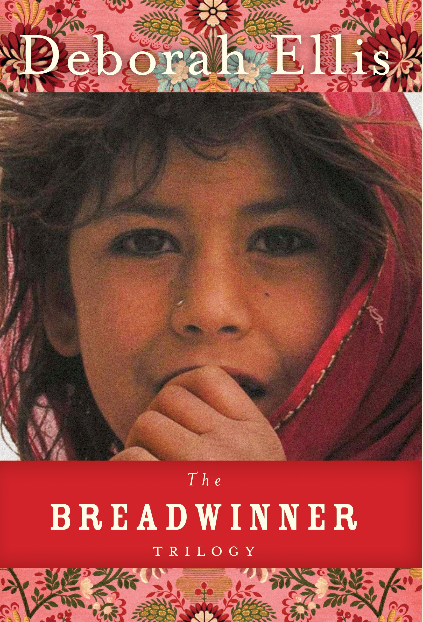
Power of Texts
Deborah Ellis's award-winning novel, The Breadwinner (2001), depicts an eleven-year-old Afghan girl living under Taliban rule who must cut her hair and dress as a boy in order to support the family after her father's imprisonment.
Published in the spring of 2001, the book became a bestseller after the events of September 11 raised interest in and concern about Afghanistan and the Taliban.
But the Breadwinner trilogy also was used to justify the US-led invasion of Afghanistan; as Ozlem Sensoy and Elizabeth Marshall point out, in exposing female suffering under the Taliban, the books feed the notion that all Moslem girls and women need to be saved by the West.

Slide 14
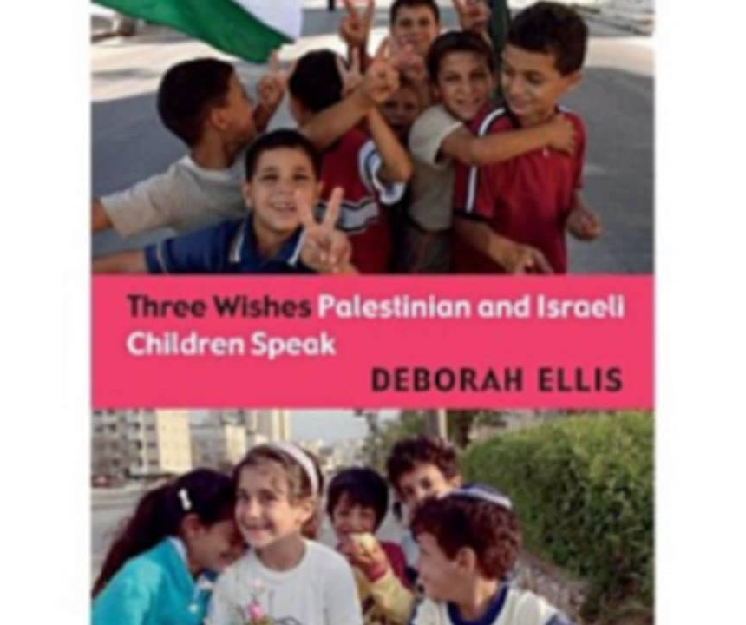
Controversy
Ellis's work has generated controversy for its positive portrayal of Muslims as well—and of Palestinians in particular.
Her Three Wishes: Palestinian and Israeli Children Speak (2006) offers a strikingly evenhanded depiction of the suffering that all children experience in a war-torn region. Including the voices of both Palestinian and Israeli children, it lists the names of the 429 children under the age of eighteen killed between 2000 and 2004 . . . and most of those names are clearly Palestinian.
The Canadian Jewish Congress successfully advocated for the removal of Three Wishes from the shelves of elementary school libraries in Toronto and York, citing the question of "age appropriateness" of a book that records the words and feelings of both Palestinian and Israeli children.

Slide 15

peace
The Enemy offers a incisive critique of war, showing how propaganda conditions both sides to fight each other.
Beginning on a battlefield with two foxholes, the book focuses on a soldier who has a manual telling him the enemy "is a wild beast," who "will also kill our families and our pets, burn down our forests, even poison our water." One night, he creeps over to the enemy's hole to kill him so that he can end the war and "go home to my family." He reaches the hole to find the enemy gone, but there are "pictures of his family," and a "manual just like mine. But there is a difference: in this one, the enemy has my face."
Realizing that the enemy must be in his hole, our soldier throws him a bottle with the message, "Let's end the war now." The final page shows two bottles arcing through the air, each about to land in the other soldier's hole.

Slide 16
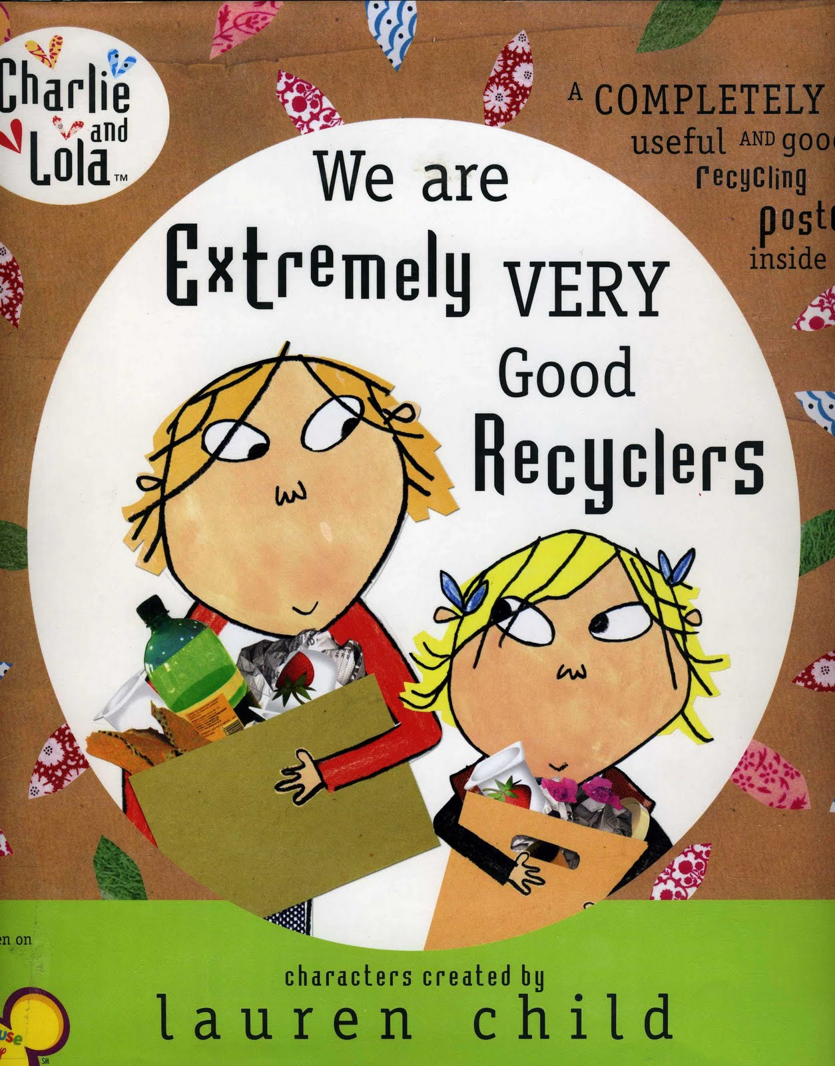
Environmentalism
At their most harmful, "green" books may breed self-righteous complacency about environmental issues: Just recycle, and that's all you need to do.
Even books that do, for instance, acknowledge the problem of overflowing landfills—such as Lauren Child's Charlie and Lola: We Are Extremely Very Good Recyclers (2009)—can make recycling an end in itself, and foster a self-congratulatory mindset.

Slide 17
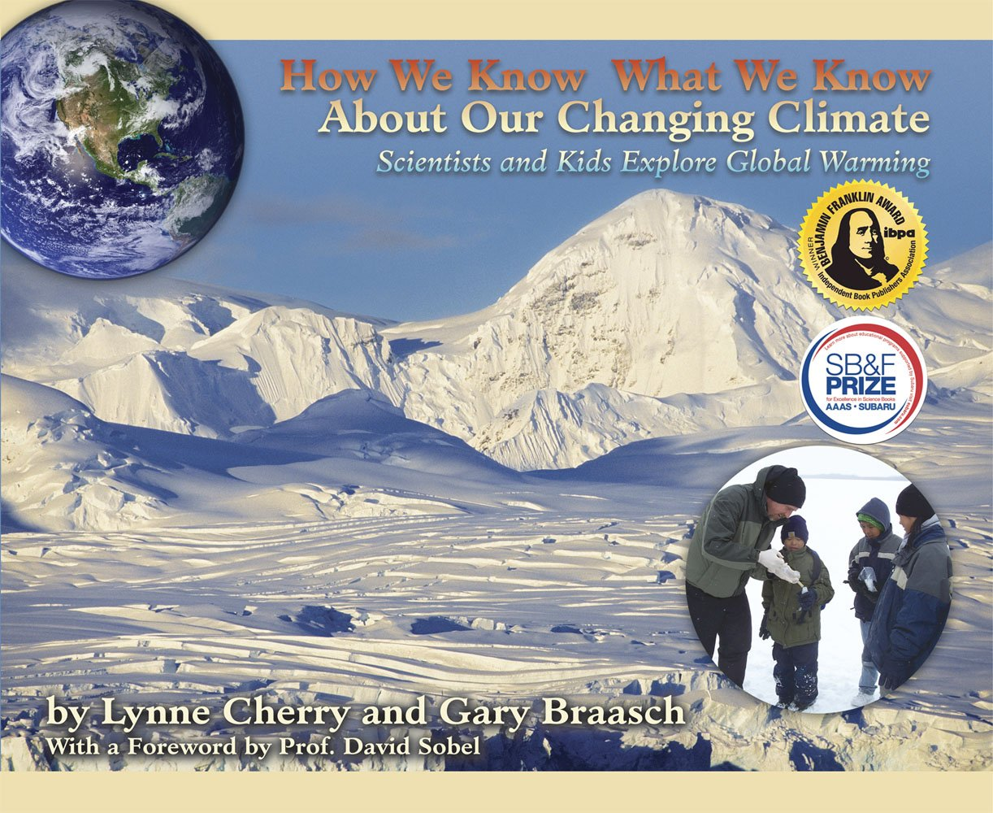
Radical environmentalism
In contrast, radical books about the environment don't just advocate recycling, but also consuming less.
One such book, Lynne Cherry and Gary Braasch's How We Know What We Know About Our Changing Climate: Scientists and Kids Explore Global Warming (2008), explains human causes of global climate change and encourages children to become involved, not just in making lifestyle changes, but in educating others and pressing for regulation.

Slide 18
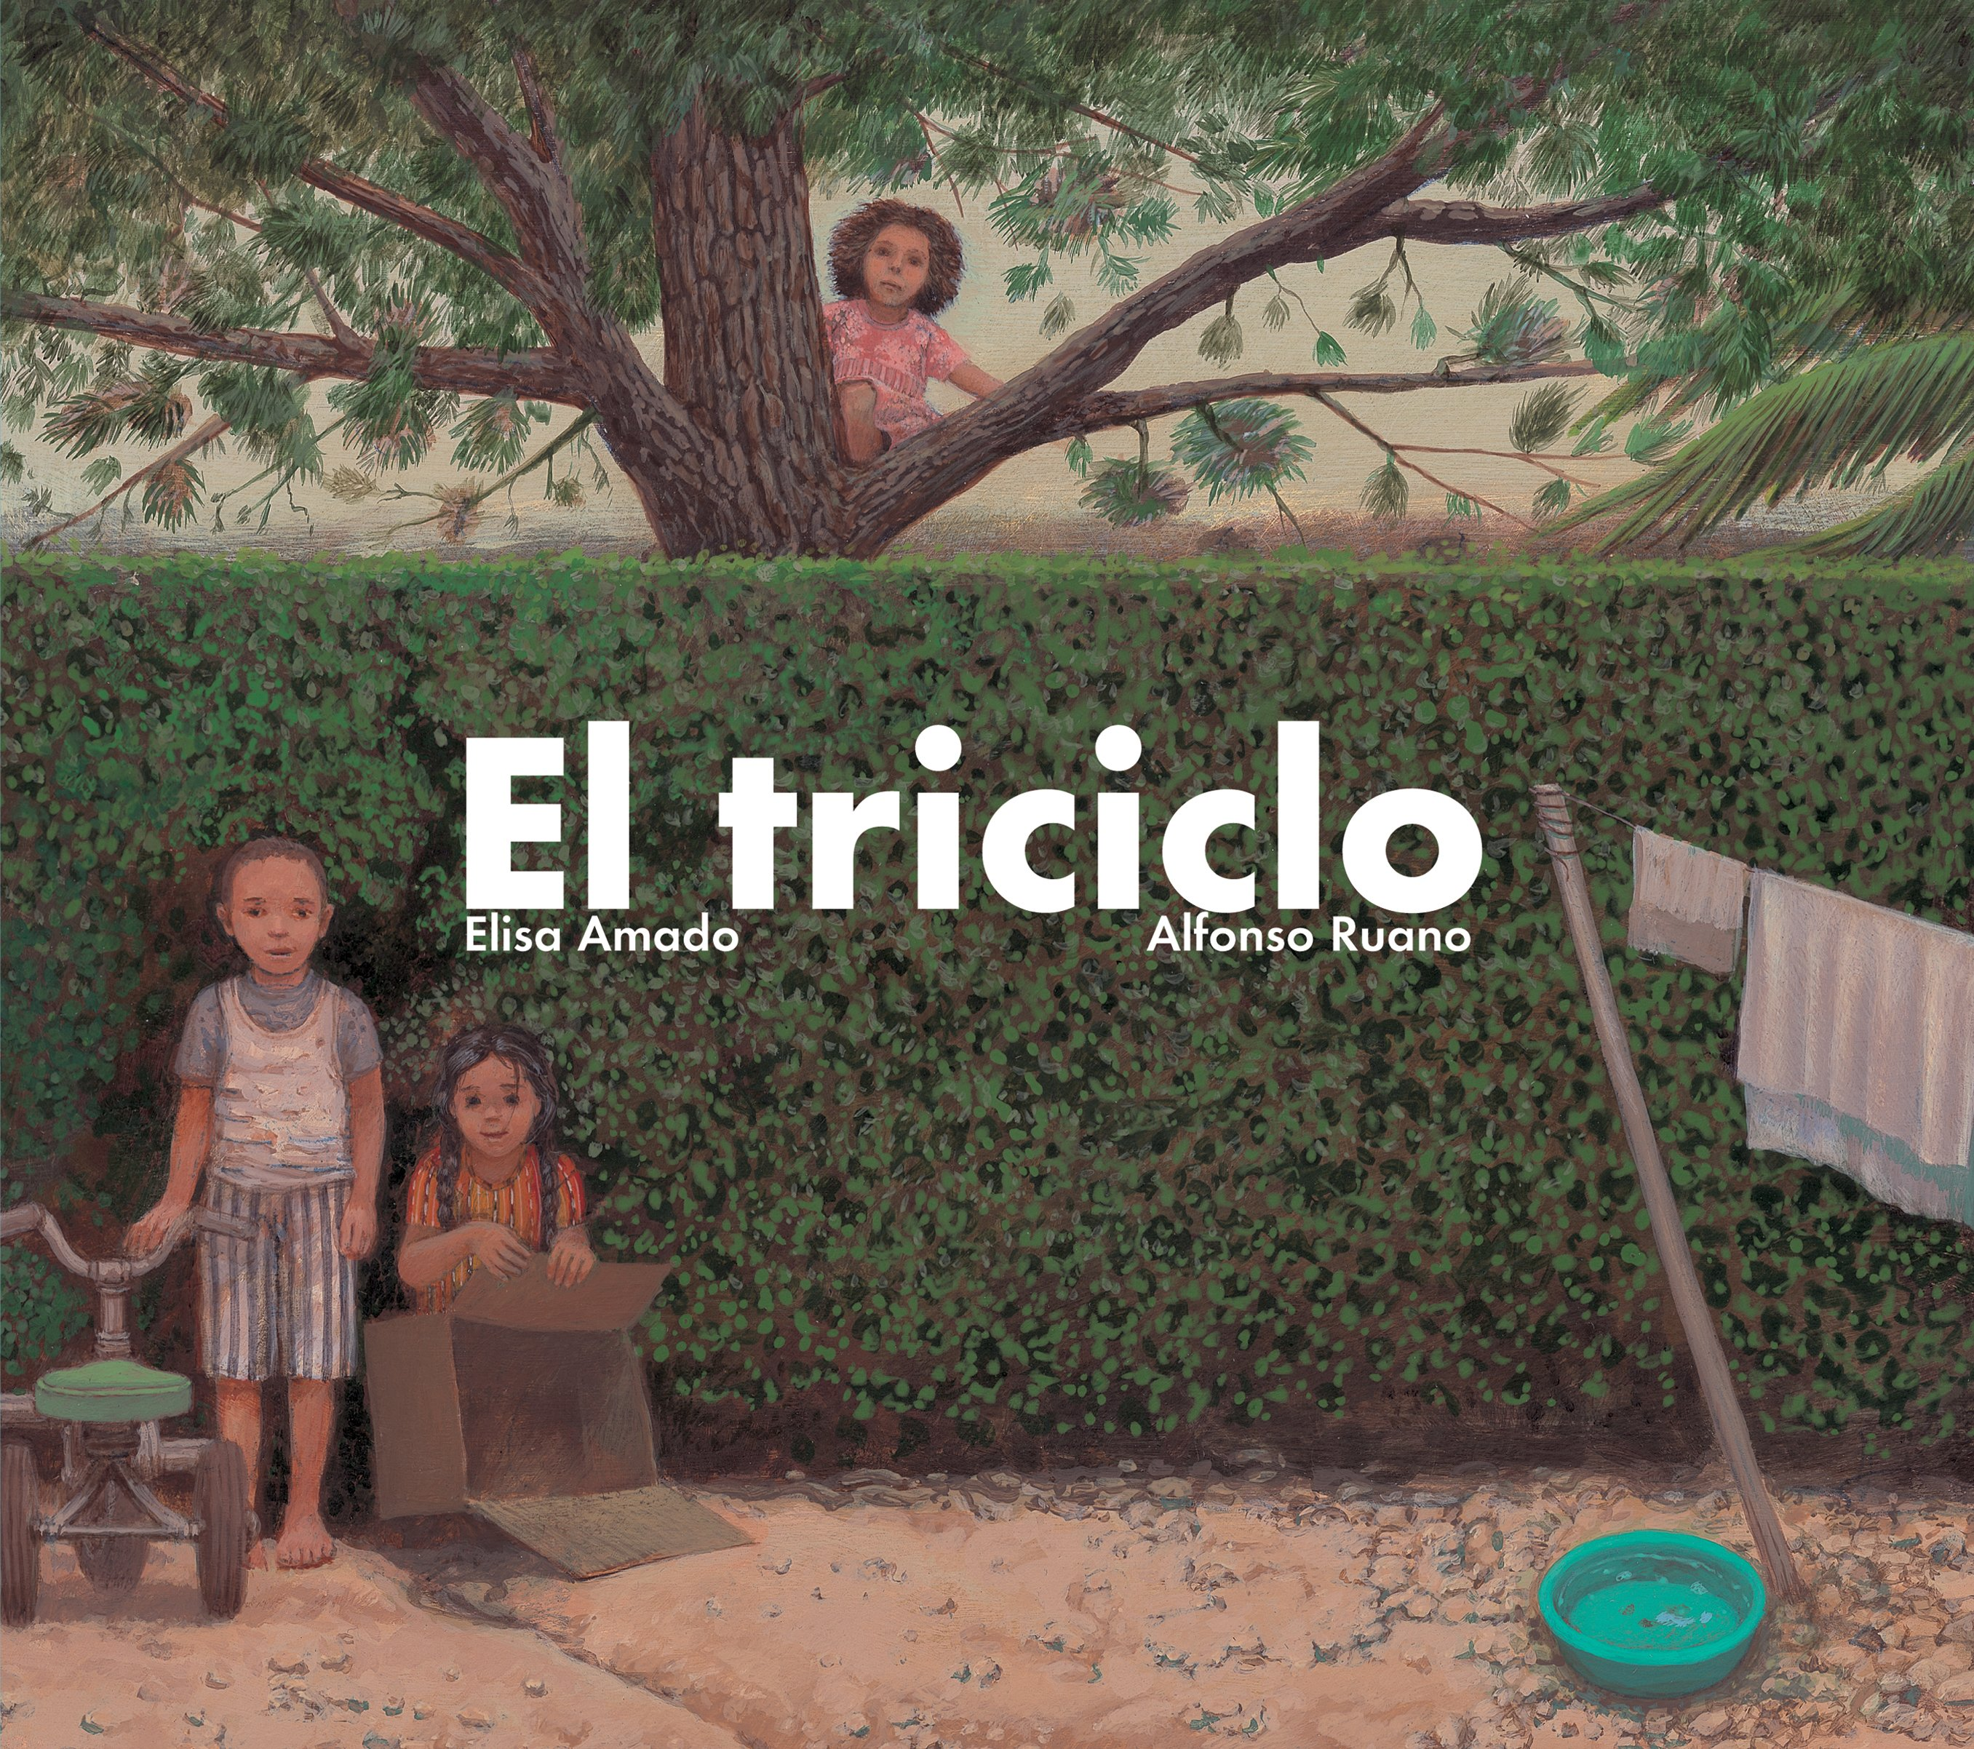
Child/adult: Justice
Tricycle (2007), written by Elisa Amado and illustrated by Alfonso Ruano, is narrated from the perspective of a wealthy girl in a Latin American country. From a tree, she watches two poor children—her occasional playmates—take and hide her tricycle. She says nothing, but thinks: "My mother always tells me not to leave my toys outside" (21).
At lunch she hears adults talking about the missing tricycle: "They're all thieves. They should be shot," one of them says (25). She tells her mother, "My tricycle got run over by a big black car. [. . .] Then some men with guns took it away with them” (29).
That the child's capacity for empathy surpasses that of the adults suggests that indifference is a learned response.

Slide 19
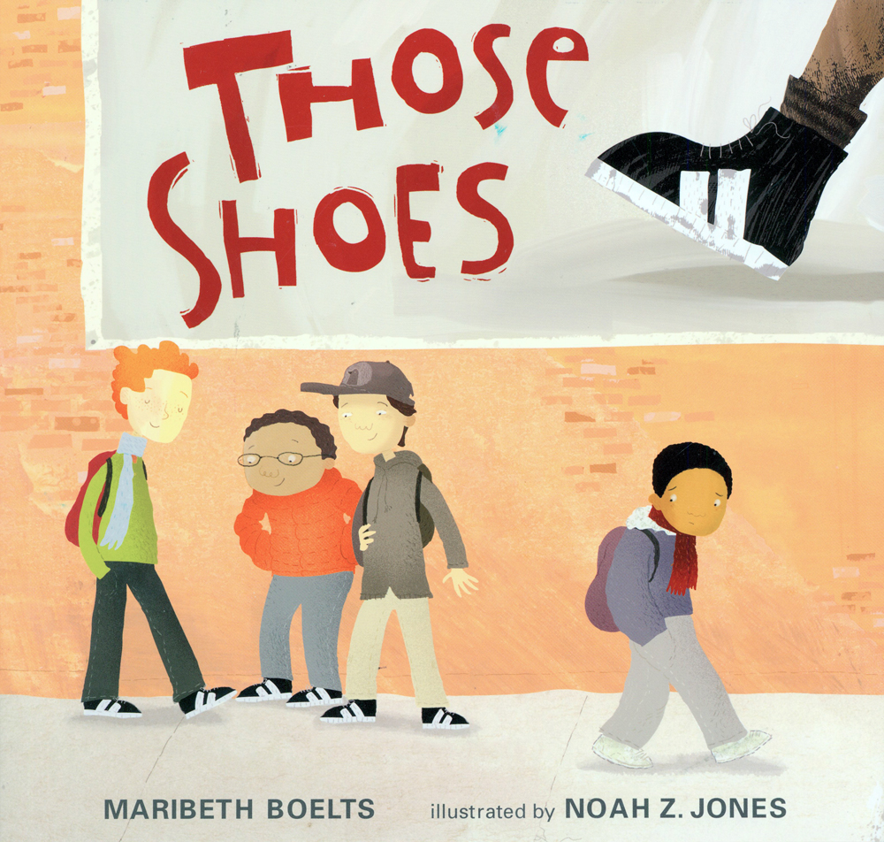
Poverty/homelessness
Fly Away Home and Yard Sale by Eve Bunting
The Hard-times Jar by Ethel Footman Smothers
Tìa Isa Wants a Car by Meg Medina
Those Shoes by Maribeth Boelts
A Chair for My Mother by Vera B. Williams

