Slide 1

So how do we interpret?
Let’s consider the elements of visual design that can help us interpret images in comics, graphic novels, and other visual mediums. To do so, we can use Molly Bang’s principles of design from Picture This…

Slide 2
Principles of Space/Visual Design
  Smooth, flat, horizontal shapes: sense of stability and calm (can’t fall down)
  Vertical shapes: exciting and active, rebelling against earth’s gravity, implying energy, reaching toward heights of the heavens (energy to create, energy released if fall)
  Diagonal shapes: dynamic, imply motion or tension (as if falling)
Notes:
This section uses Molly Bang’s renowned text “Picture This” which provides information on visual design.

Slide 3
Principles of Space/Visual Design
  Upper Half (of frame): Freedom, happiness, triumph, “spirituality”; a stronger tactical position, escaping gravity- greater “pictorial weight”- draws attention, more important
  Lower Half: threatened, heavier, sadder, more constrained, grounded, less important

Slide 4
Principles of Space/Visual Design
  Center: most effective “center of attention” point of greatest attraction
    Shifting away from the center implies movement
    Rarely used unless figure is intended to be an object of meditation
  Edges and Corners (of the picture) = the edges and corners of the picture world
    Closer an object is to the edge, the greater the tension

Slide 5
Principles of Space/Visual Design
  Light/Dark: White or light backgrounds feel safer than dark backgrounds (reminding of daytime) while dark background symbolize the unknown

Slide 6
Principles of Space/Visual Design
  Pointed/Rounded Shapes: frightened by pointed, secure with rounded shapes and curves
  Larger/Smaller: larger objects feel stronger

Slide 7
Principles of Space/Visual Design
  Same or Similar Colors: associated more strong than same or similar shapes
    Repetition and confusion (regularity and irregularity, order and disorder)
    Some repetition gives security, but too much “perfection”- continual, relentless repetition-can be terrifying (isn’t that a metaphor for life!)

Slide 8
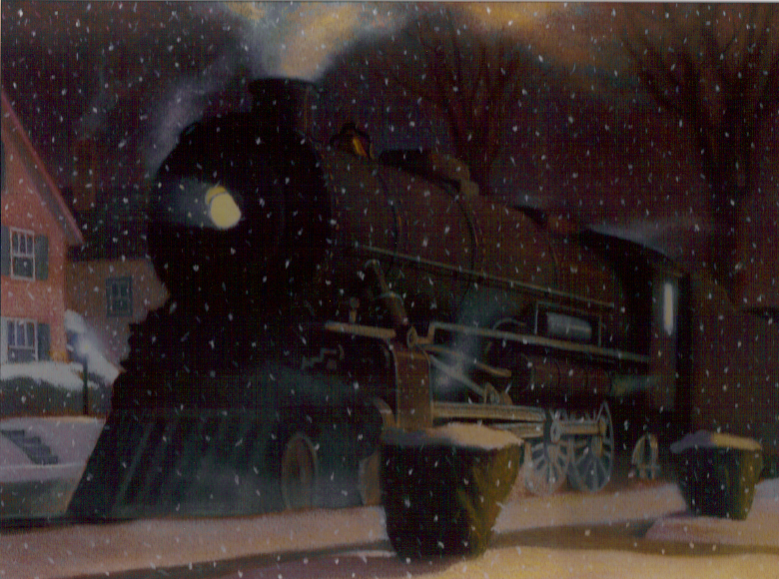

Slide 9
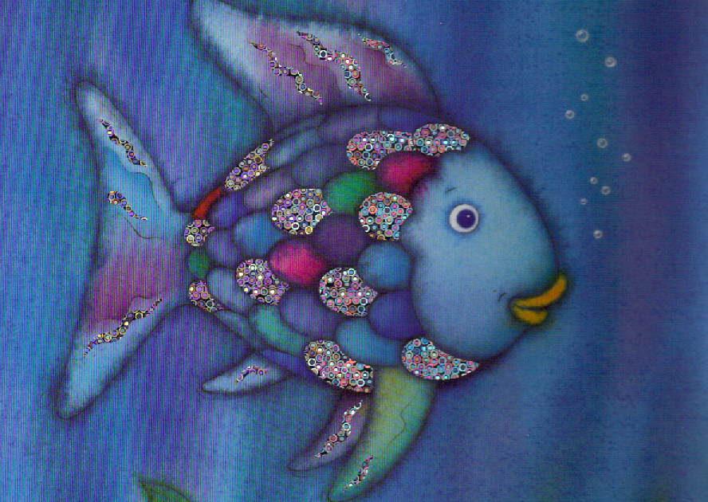

Slide 10
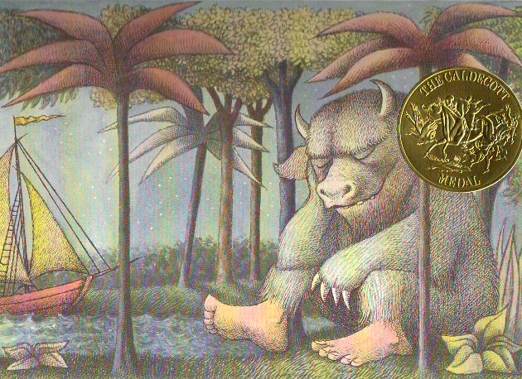

Slide 11


Slide 12
