Slide 1

Mirrors and Windows
Dr. Meghann Meeusen
Western Michigan University

Slide 2
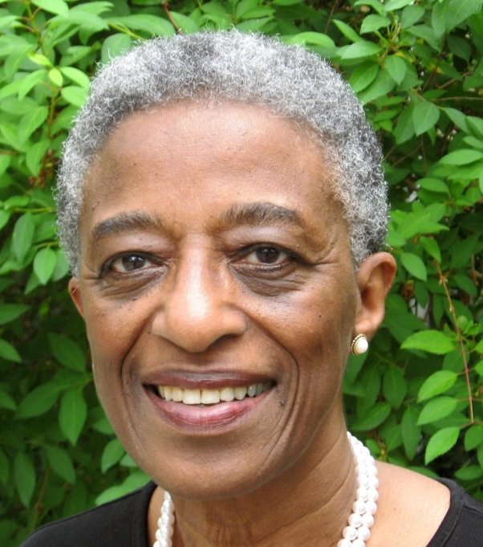
Rudine Sims Bishop (1990)
A major academic force behind the shift to more diverse books for young people is Dr. Rudine Sims Bishop, whose 1990 article "Windows, Mirrors, and Sliding Glass Doors," explained the need that each child has to be connected with a wide variety of texts.
"We need diverse books because we need books in which children can find themselves, see reflections of themselves.”

Slide 3
Rudine Sims Bishop (1990)
“Books are sometimes windows, offering views of worlds that may be real or imagined, familiar or strange. These windows are also sliding glass doors, and readers have only to walk through in imagination to become part of whatever world has been created or recreated by the author. When lighting conditions are just right, however, a window can also be a mirror. Literature transforms human experience and reflects it back to us, and in that reflection we can see our own lives and experiences as part of the larger human experience. Reading, then, becomes a means of self-affirmation, and readers often seek their mirrors in books. (p. ix)

Slide 4
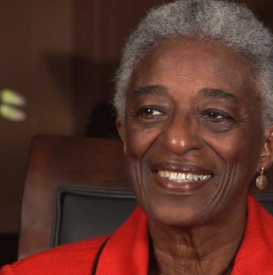
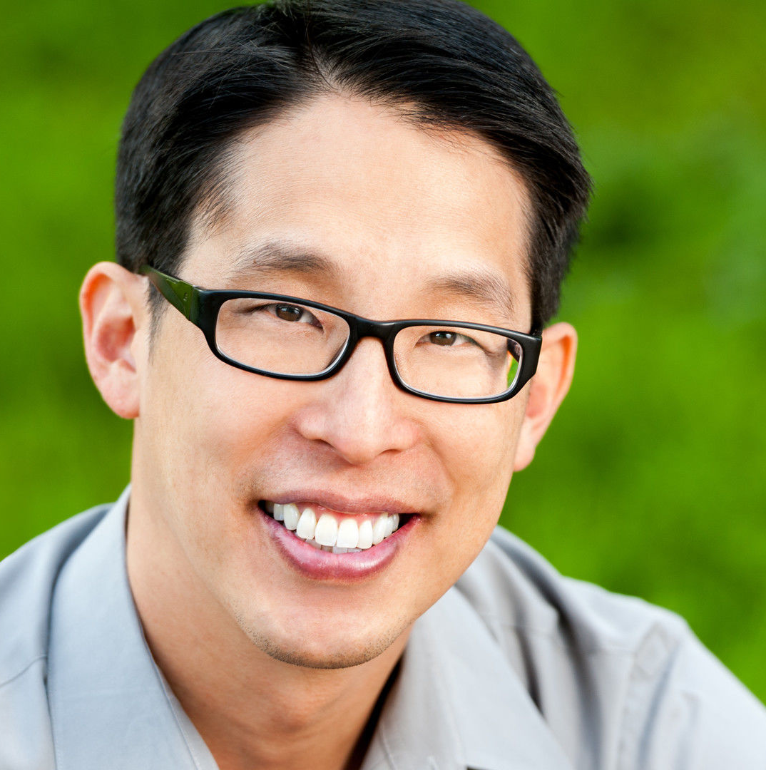
In Their Own Words…
We Need Diverse Books
Gene Luen Yang

Slide 5
Gene Luen Yang
"Stories have two different purposes," Yang told NBC News, citing a quote he'd heard before. "One, stories act as a window into somebody else's life; and the second one is they act as a mirror into your own. And I think that needs to be true for everybody — every aspect of American society, every corner of American society has to have stories that are mirrors and stories that are windows."

Slide 6
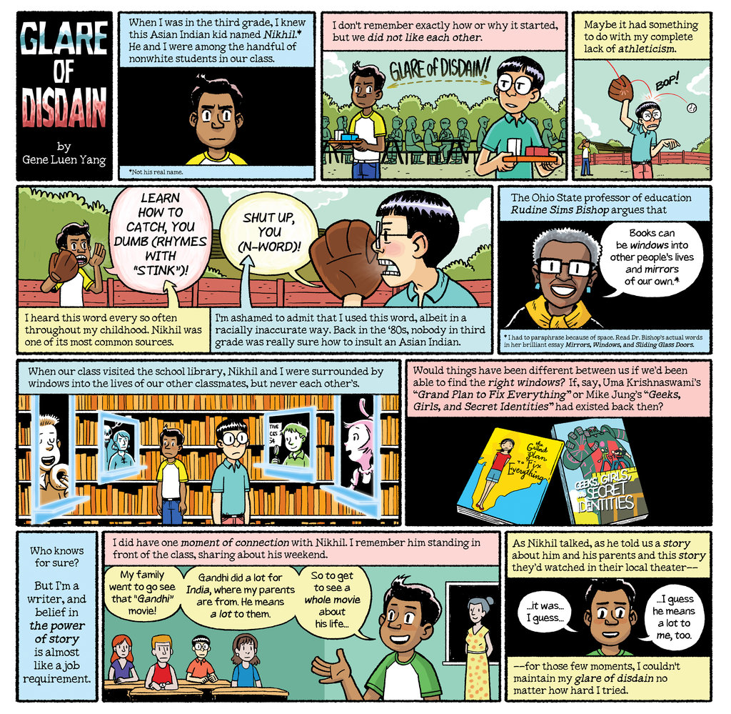

Slide 7
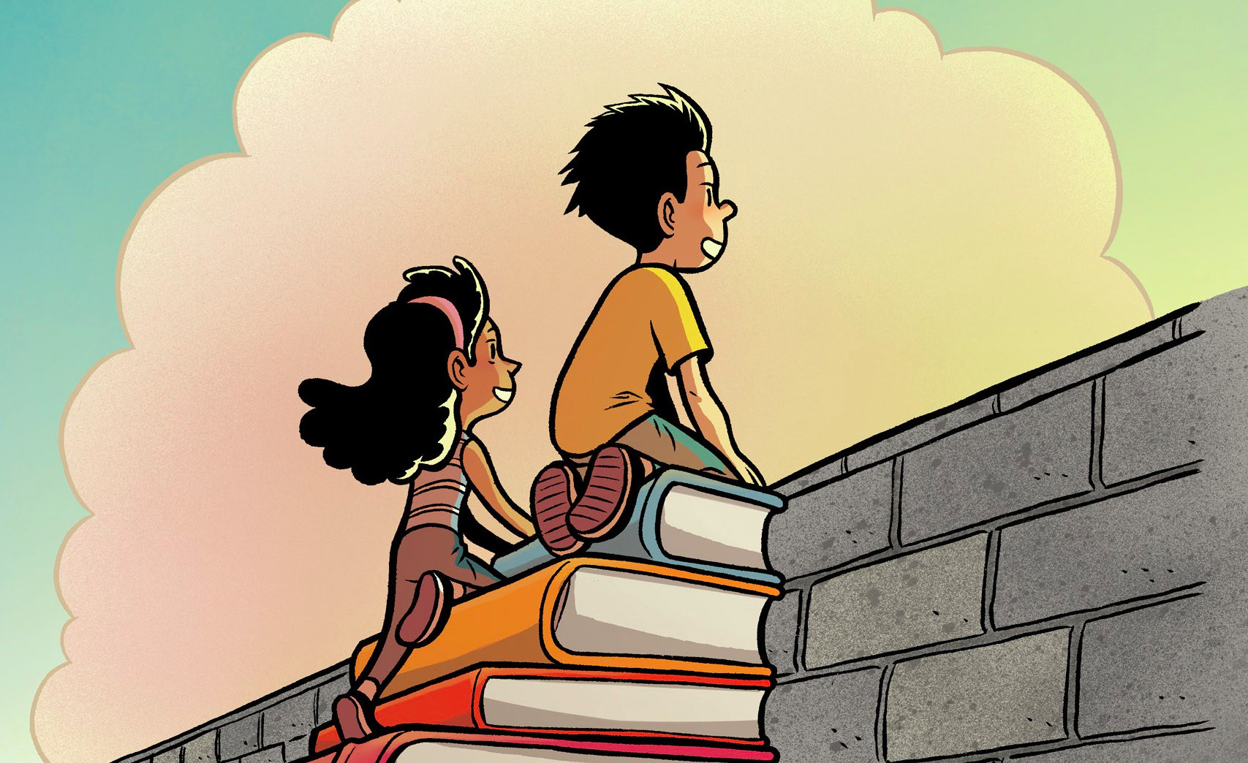
Notes:
http://boingboing.net/2016/01/08/gene-luen-yangs-inaugural-sp.html

Slide 8


Slide 9
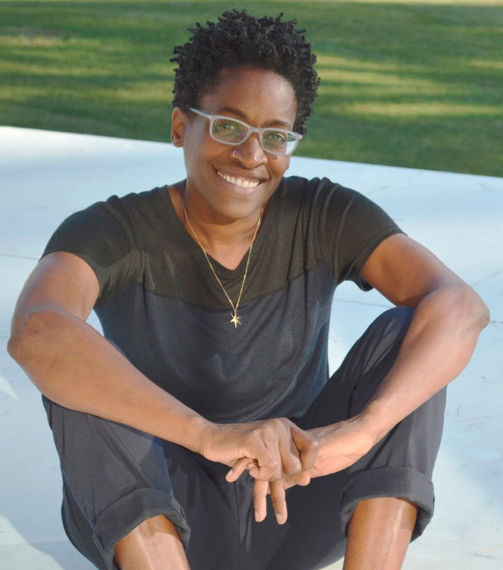
The New Ambassador:
Jacqueline Woodson
“For young people who are very stressed about the future, who have this sense of disempowerment, who don’t know what’s coming next, my big quest is for them to remain hopeful,” she said.
“When you come to literature, it does allow you an escape from the world if that’s what you need, but it also changes you. You’re different than when you started that book.”

Slide 10
Jacqueline Woodson’s
READING = HOPE x CHANGE (What’s Your Equation?)
Encourages young people to think about – and beyond – the moment we’re living in, the power they possess, and the impact reading can have on showing them ways in which they can create the hope and the change they want to see in the world.
“I don’t believe there are ‘struggling’ readers, ‘advanced’ readers or ‘non’ readers. I’d love to walk away from my two years as Ambassador with the qualifiers gone and young people able to see themselves beyond stigma or oft-times debilitating praise.”
“Martin Luther King Jr. said people should not be judged by the color of their skin but by the content of their character. In that regard, I think young people should not be judged by the level of their reading but by the way a book makes them think and feel. By the way it gives them hope. By the way it opens them up to new perspectives and changes them. I’m excited to have these conversations with some of the best conversationalists in our country – our young people.”

Slide 11
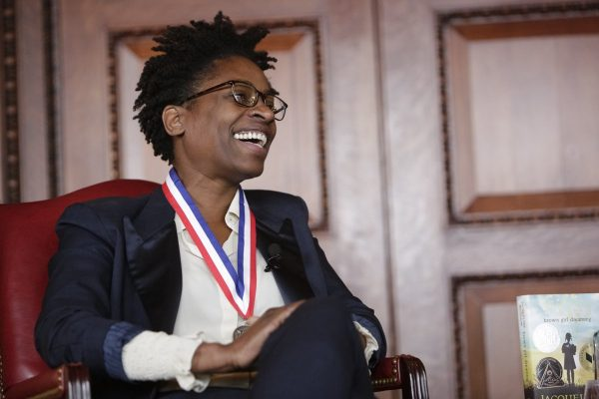


Click Here to Watch Woodson’s Speech

Slide 12
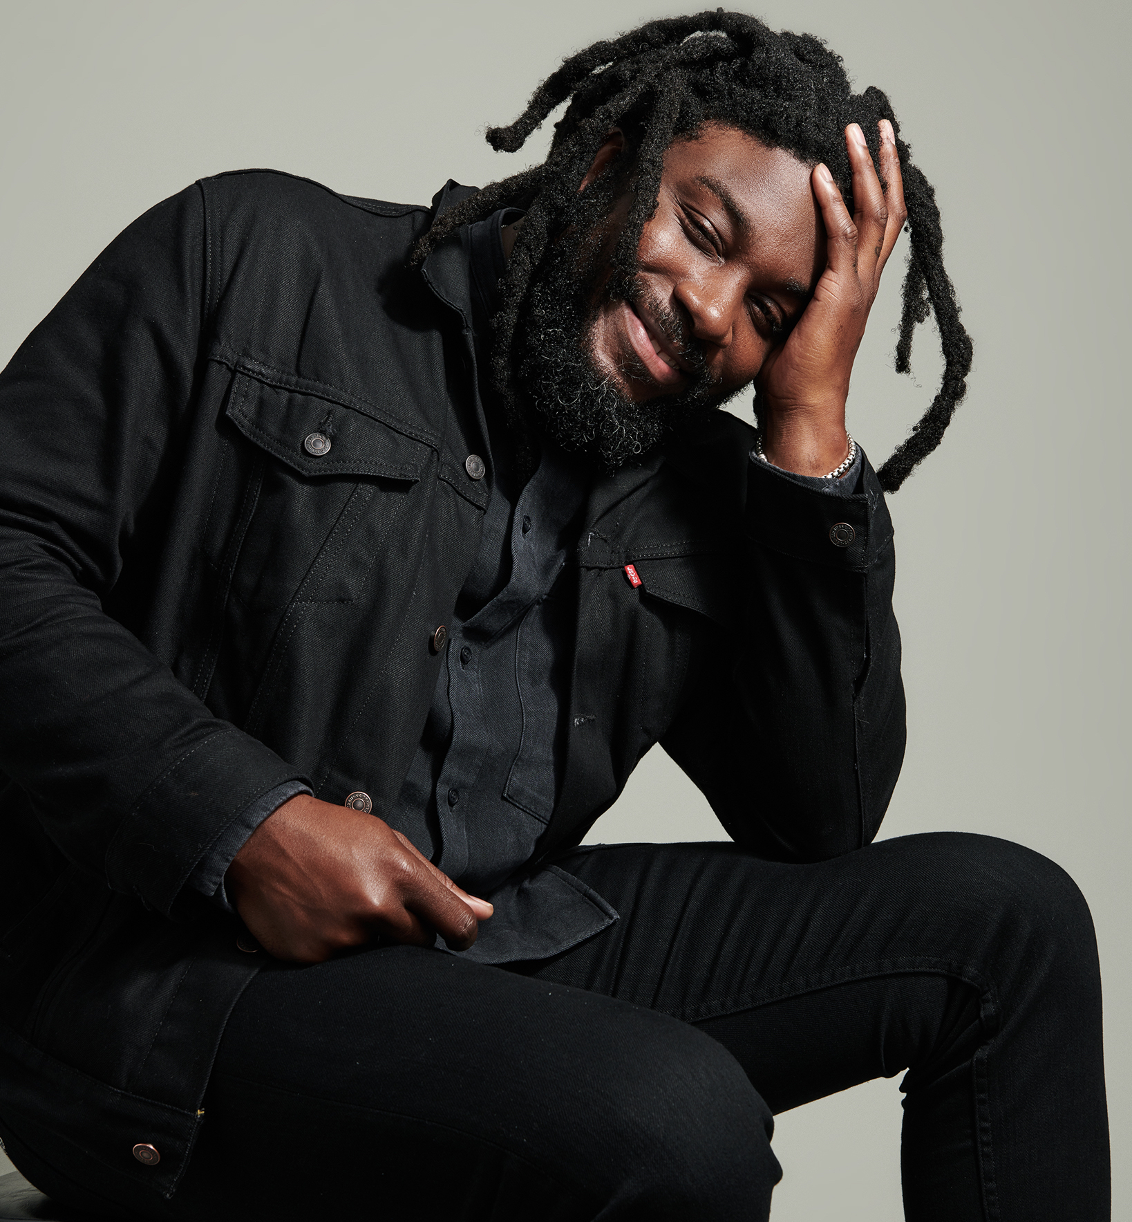
Ambassador for 2020-2021
“My mission is to take a different approach: Instead of explicitly encouraging young people to read, my goal is to get them to see the value in their own narratives — that they, too, have a story, and that there's power not just in telling it, but in the opportunity to do so. I’m excited to create spaces around the country for this to happen — spaces where young people can step into their voices and become their own ambassadors.”

Slide 13


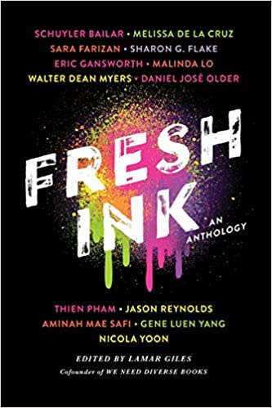

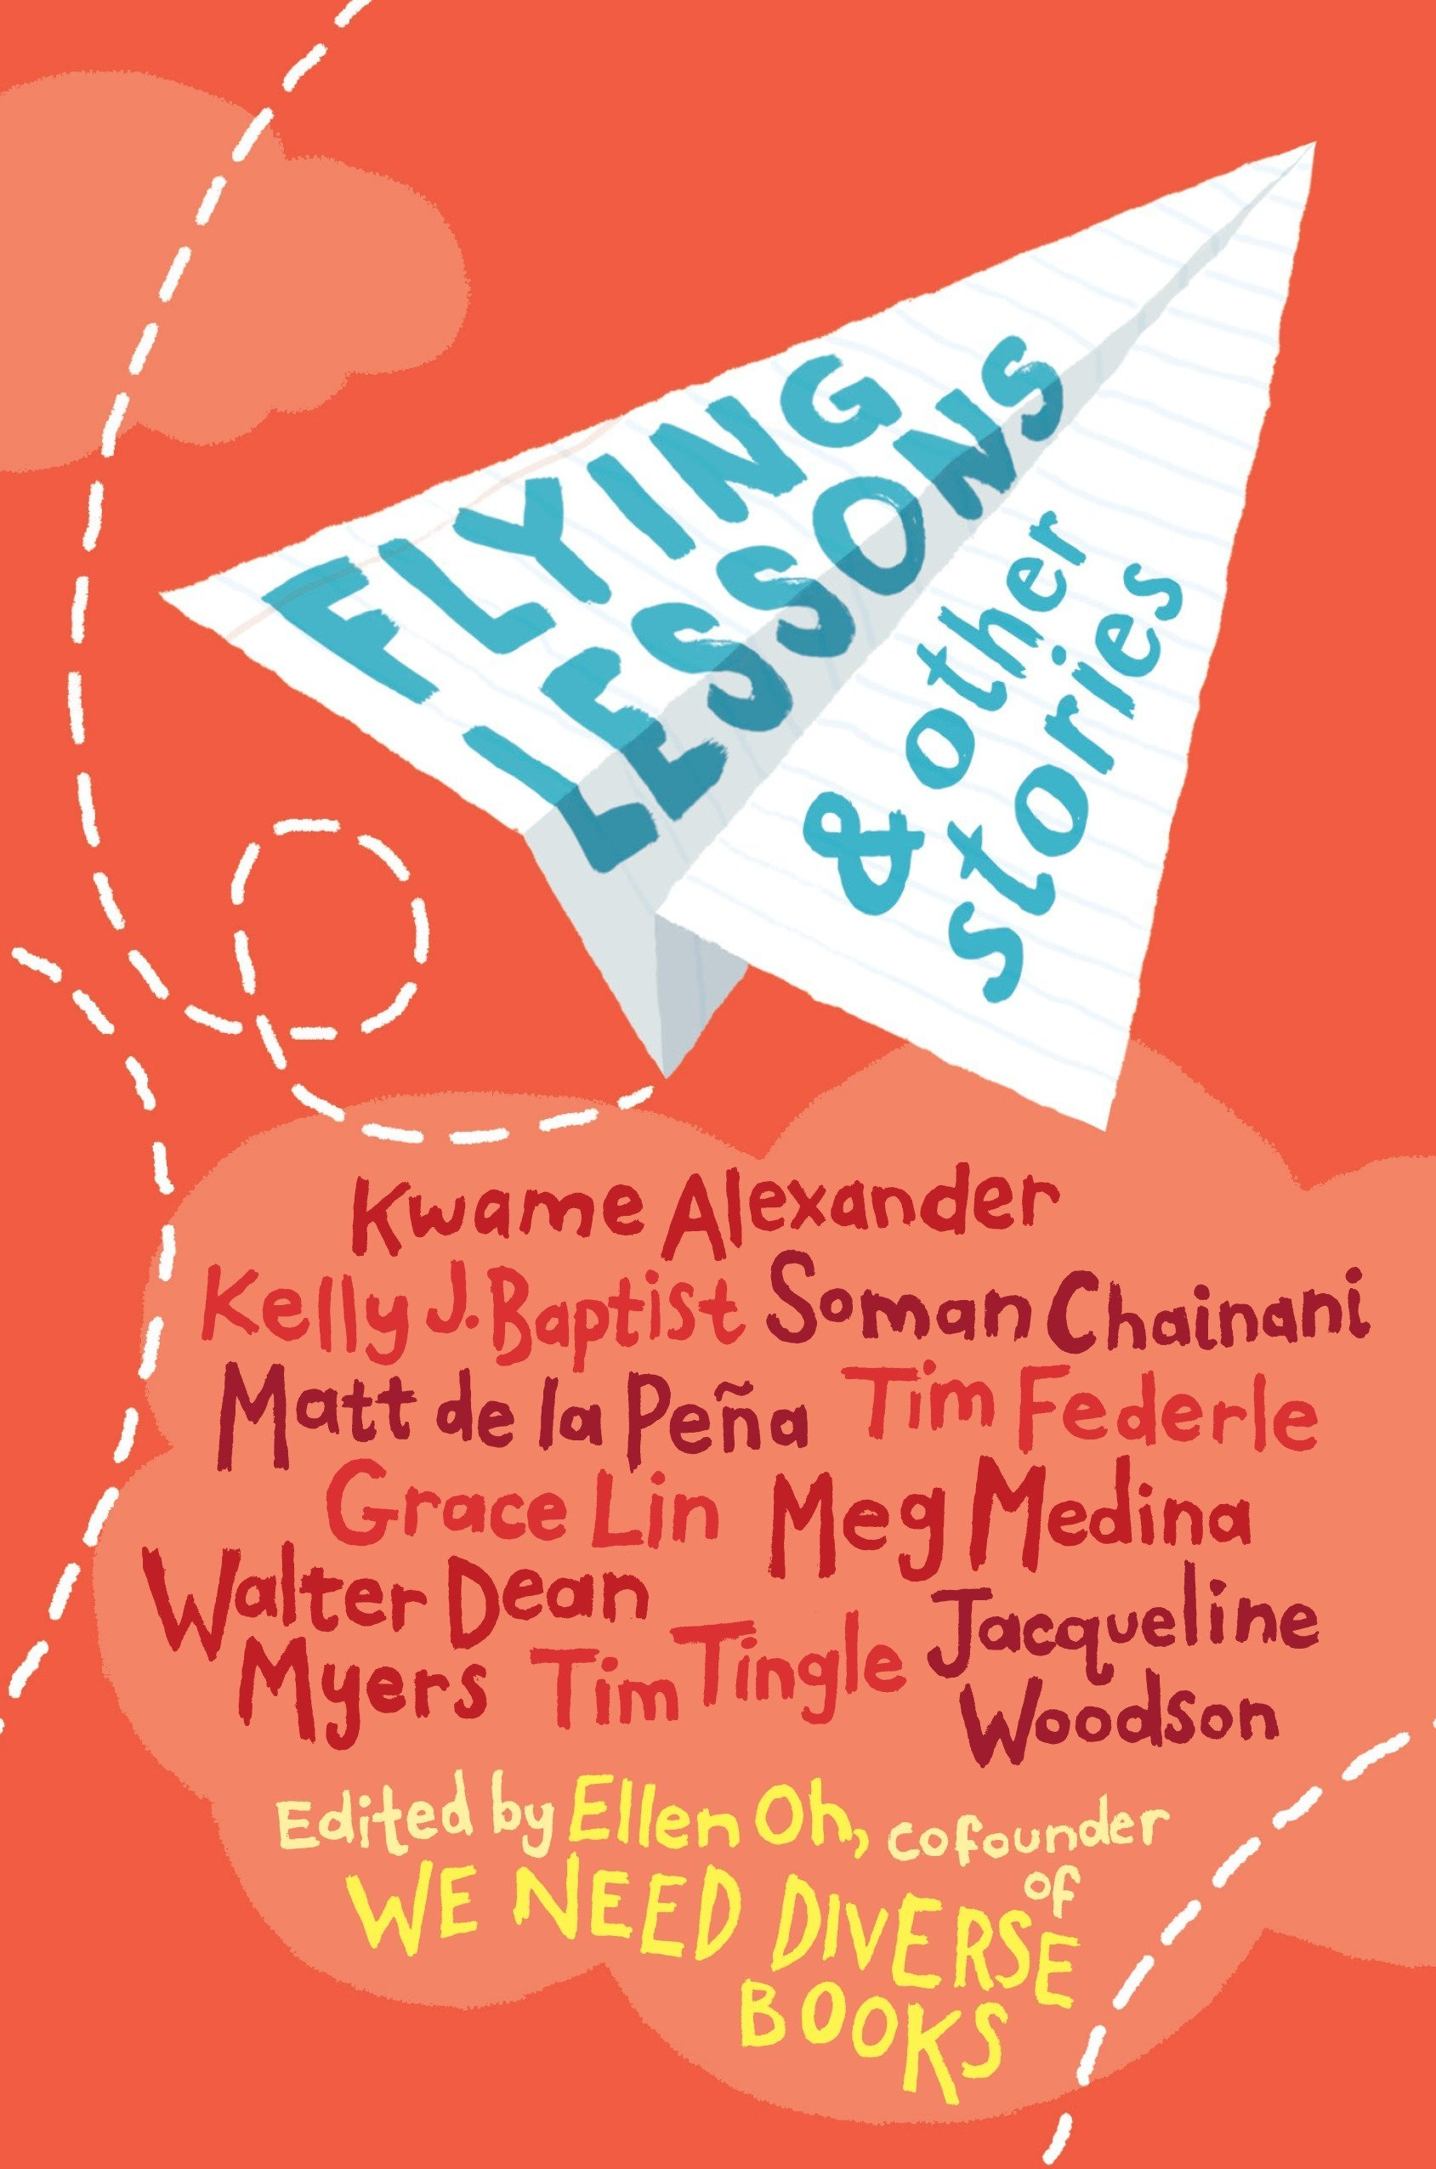
Grab the Mic
Through his platform, “GRAB THE MIC: Tell Your Story,” Reynolds, who regularly talks about his journey from reluctant reader to award-winning author, will redirect his focus as ambassador by listening and empowering students to embrace and share their own personal stories.

