Slide 1
Critical Race Theory & Disney
Dr. Meghann Meeusen
Western Michigan University

Slide 2
What is critical race theory?

Slide 3
Defining Critical race theory
CRT is a framework used to examine and challenge the ways race and racism and explicitly shape social structures, practices, and discourses.
CRT scholars begin with the premise that race is a social con­struct and that racism is permanent in U.S. society.
Notes:
What are normalized forms of racism? Where do we see them in society? (large group discussion, share out)

Slide 4
Defining Critical Race Theory
Rather than focus on explicit acts or incidents of racism, CRT scholars instead focus on the subtle, hidden, and insidious forms that operate at a deeper, more systemic level.
By focusing on the hidden and everyday forms of racism, CRT posits that racism has never waned; it has merely assumed a normality, and thus an invisibility, in our daily lives.” (p. 9, López & López, 2010)
Notes:
What are normalized forms of racism? Where do we see them in society? (large group discussion, share out)

Slide 5
What are the purposes of CRT?
To advance social justice ideas to the general public, and scholars, while also aiming to even out social inequalities
Study the intersections between different groups of minorities. Recognizing that race and racism work with and through gender, ethnicity, class, sexuality and/or nation as systems of power
Study the significance of mass media and popular culture in the distribution of power and the perception of minorities

Slide 6
What does CRT ask us to focus on?
Is this good for people of minority and underrepresented groups?
How does this portray people of minority and underrepresented groups?
What conclusions seem to be made about people of people of minority and underrepresented groups?
What intersectionalities (race + gender, class, ethnicity, sexuality) can you find and what do they mean?

Slide 7
Applying critical race theory to disney

Slide 8
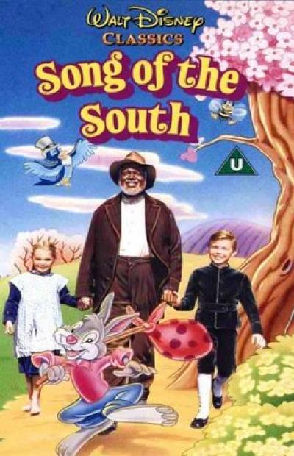
Song of the South (1946)
The problem isn’t necessarily what Song of the South depicts, but what it chooses not to depict… If you’re not a scholar or an Uncle Remus expert, it’s very easy to assume that the film is set before the Civil War, and that Remus and Aunt Tempy (Hattie McDaniel) are slaves — and that they are completely fine with that.
Song of the South’s version of the South is sanitized in the extreme. Here “utterly uncomplicated” applies to the way they strip any sense of politics, history, or ideology out of this setting to make it palatable to a mainstream audience.

Slide 9
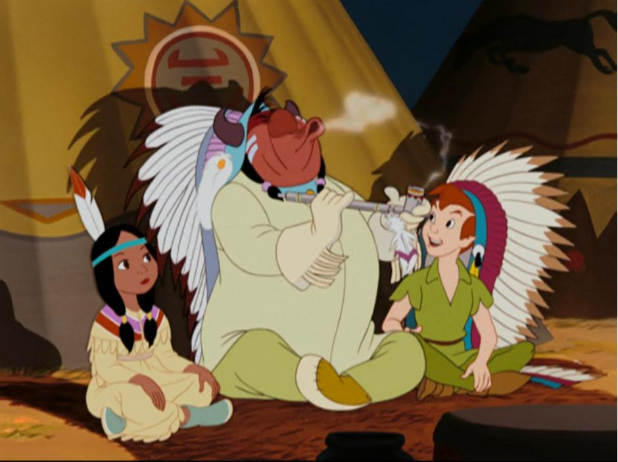
Peter pan (1953)
David Martinez, author of American Indians and Film, writes, "My jaw hit the ground when I heard this song and saw these 'redskins' hopping around and making fools of themselves. Granted it was only a cartoon, but it was one in which the animators took the liberty of demeaning an entire race in the name of entertainment.”
Sasha Houston Brown, Santee Sioux tribe member, says about the scene: "I remember seeing it and not having the skills to understand why it made me feel embarrassed. What does that do to a child's formation of identity, even if it's subliminal and subconscious? The message is, 'You're not human. You're a trend. You're something that can be commodified and bought and sold.'

Slide 10
Animals and race

Slide 11
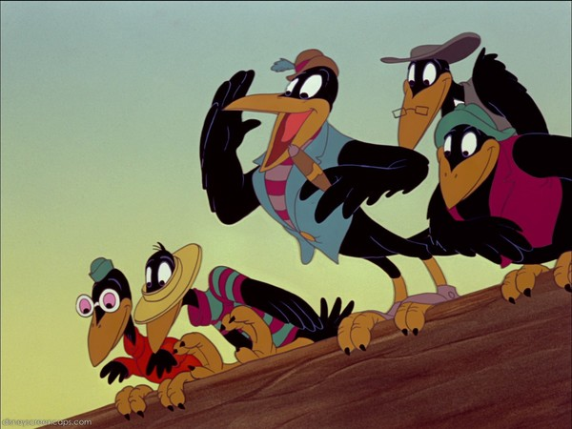
Dumbo (1941)
Critics consider the crowsin Dumbo to be stereotypically black characters. In addition to main crow being named JIM Crow, the song "When I See an Elephant Fly," contains heavy-use of southern black vernacular, including: "I'd be done see'n about everything / When I see an elephant fly!"
The fact that the crows are the color black and speak in a stereotypical manner not only reinforces, but with the "Song of the Roustabouts," Disney features faceless black circus workers working while singing, "We slave until we’re almost dead / We’re happy-hearted roustabout" and "Keep on working / Stop that shirking / Pull that rope, you hairy ape."

Slide 12
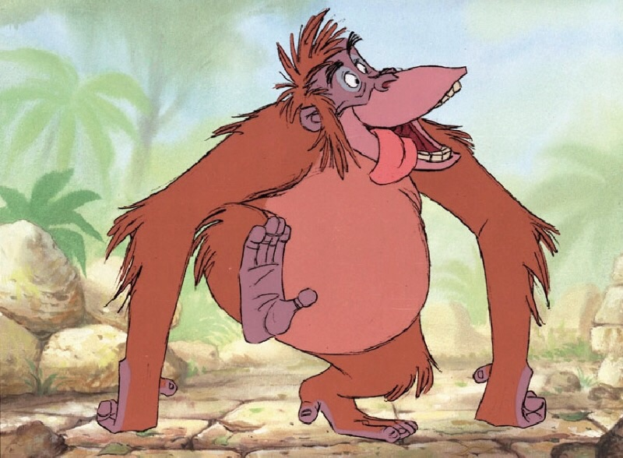
Jungle Book (1967)
Scholars such as Susan Miller and Greg Rode,
Greg Metcalf, and Heather Neff especially
critique the depiction of King Louis, suggesting
him as highly racist caricature of African Americanism.
If this jazz-singing, jive-talking ape, who does not appear in Kipling’s work, is taken as such—a point that most critics agree upon—the musical number “I Wanna Be Like You” sets up a concerning interpretation of his desire to be more like man because he has “reached the top and had to stop.”
More even than an insulting caricature, this song offers a troubling depiction of power dynamics between African Americans and their white oppressors.

Slide 13
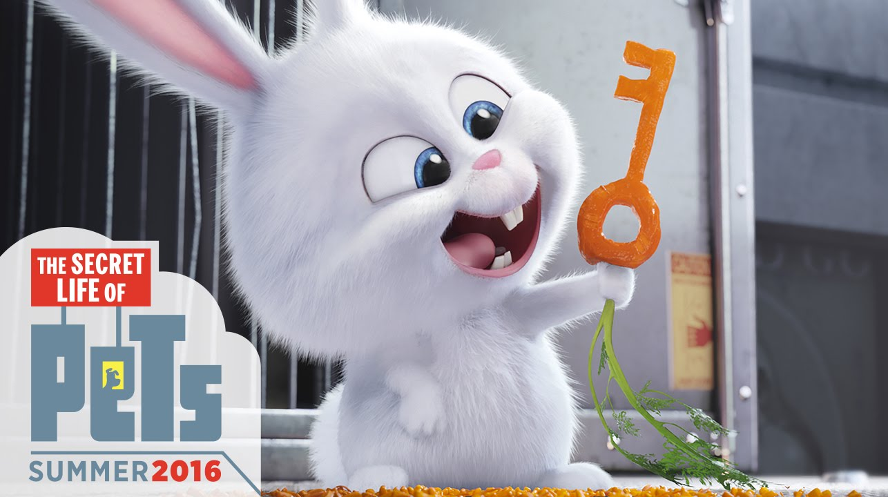
Secret Life of Pets (2016)
The far more noticeable voice talent of the film is Kevin Hart, who plays Snowball, the bright white rabbit leader of an underground gang of abandoned pets, who are “like a club, but with fighting and scratching and stuff.” Snowball is first introduced to viewers when he frees the detainees of an animal control truck, exclaiming “The revolution has begun! Liberated forever! Domesticated never!”
The divide between the upper-class pets and gang of forgotten street animals sets up a clear class binary, but more concerning, a divide that is consistently coded with racial markers.

Slide 14
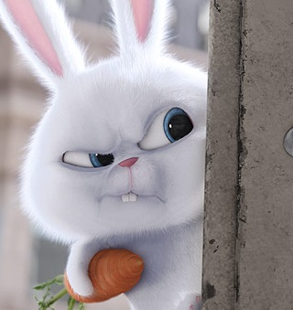
Secret Life of Pets (2016)
In Secret Life of Pets, power structures are represented not to critique or dismantle them; instead, these structures are reinforced and even celebrated, used primarily for humor rather than any critical purpose.
And in fact, the film never actually explores the plight of these abandoned animals, linking them to black power movements, gangs, or militant minority groups but never offering any actual interrogation of these structures, and making it seem as if all can be resolved if such individuals are simply loved by the white, upper-class individuals in power above them.

Slide 15
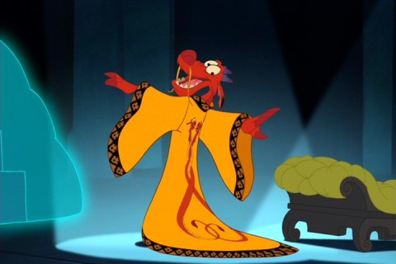
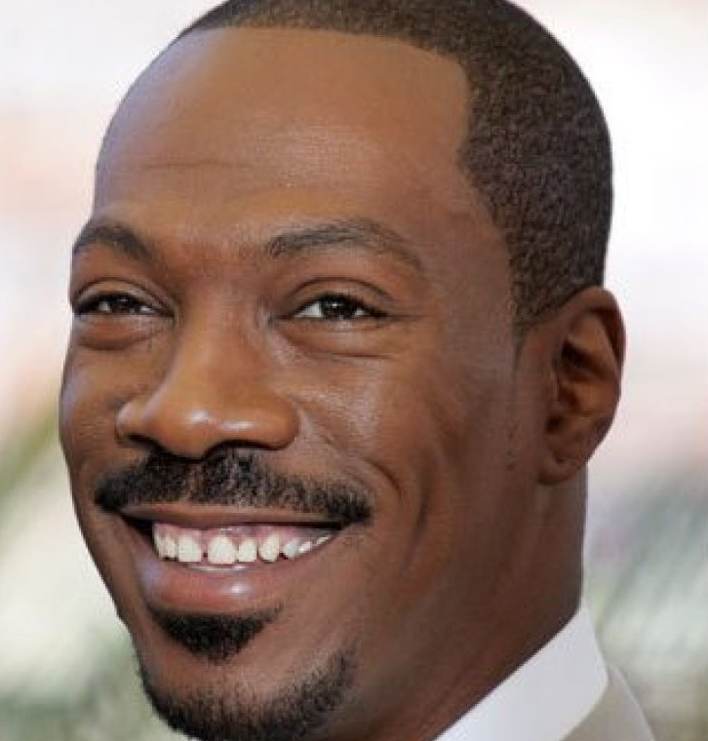
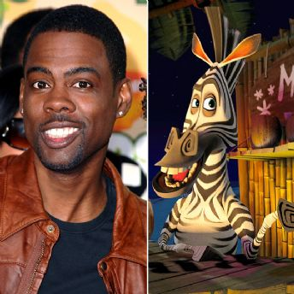
Other Examples
Unfortunately, Secret Life of Pets does not represent an isolated instance and in fact, when especially male African American comedians are cast in animated roles, the result is often humor created through stereotyping, and even cultural appropriation.
  Mulan, when Eddie Murphy portrayal of the dragon spirit, Mushu, not only poses problematic representation of Chinese spirituality, but also wades into some of the same stereotypes as Kevin Hart
  these characters suggest potentially questionable power-dynamics, which can also be seen in Chris Rock’s portrayal of Marty in Madagascar, which also engages some potentially questionable commentary on colonization.

Slide 16
Voice Acting and Retellings

Slide 17
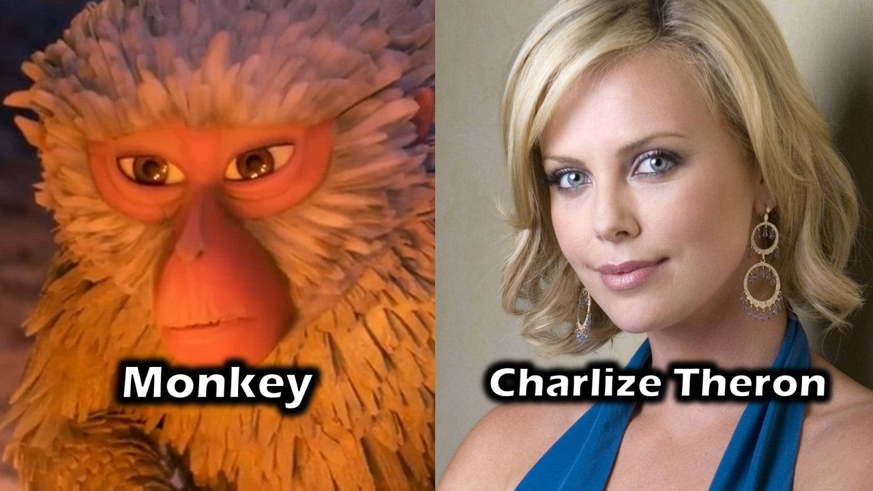
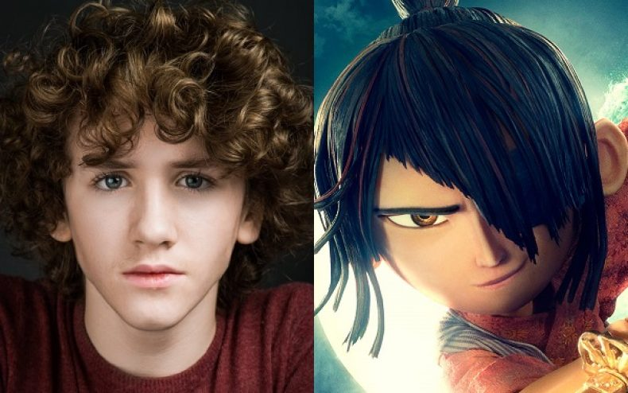
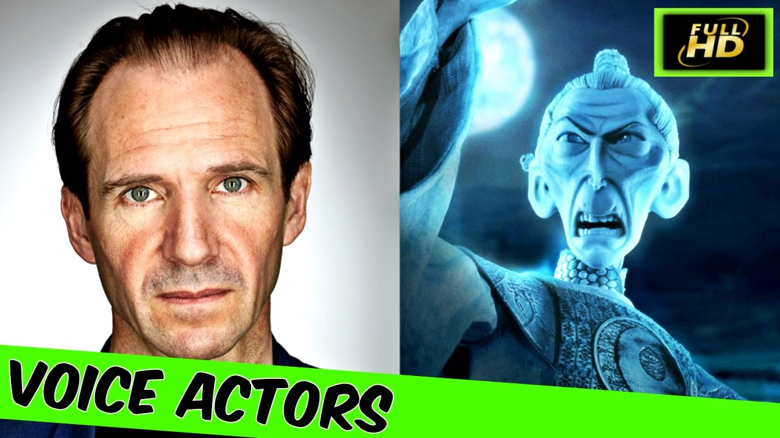
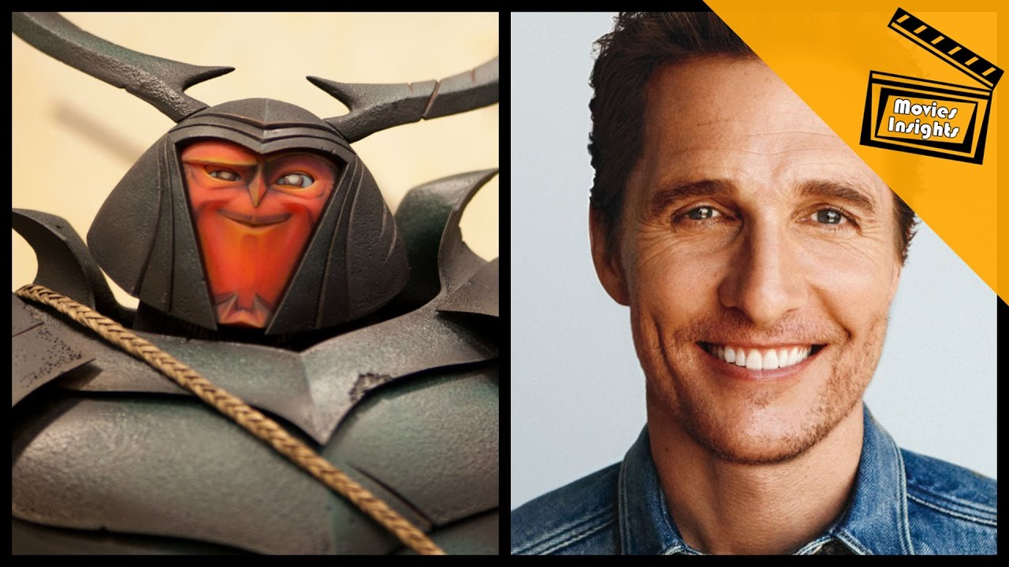
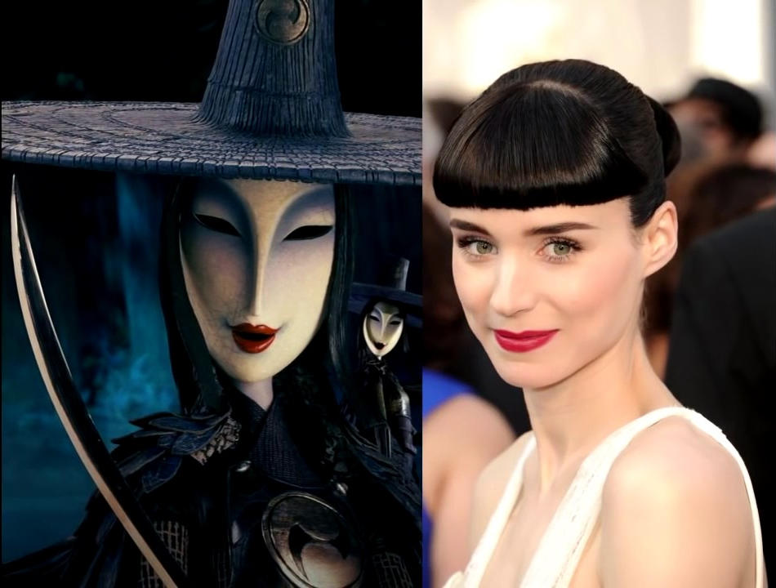
Kubo and the Two Strings

Slide 18
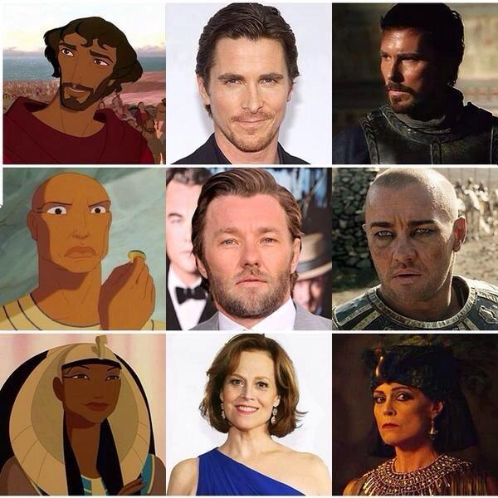
“Whitewashing” in Film
One use of the term whitewashing relates to the casting of white actors to represent characters of color in film.
This can happen in both animated film and live action, as seen in this example.
In Exodus: Gods And Kings, white actors were chosen to play key roles in a film set in Egypt– and coincidentally, these were the same actors to play some of the key roles in an earlier children’s film similarly set in Egypt…

Slide 19
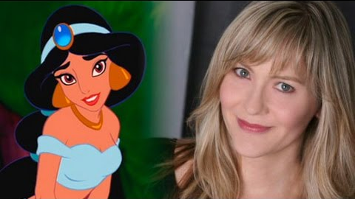
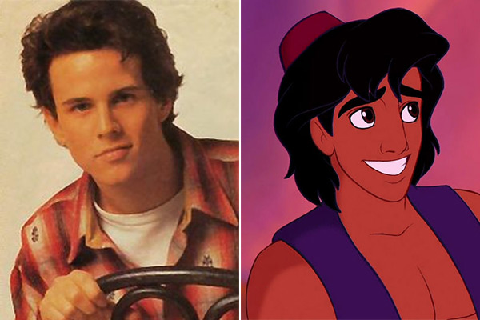
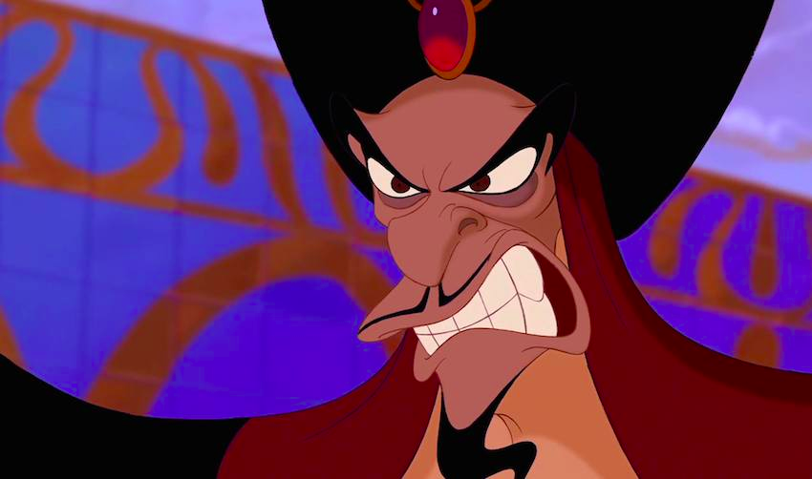
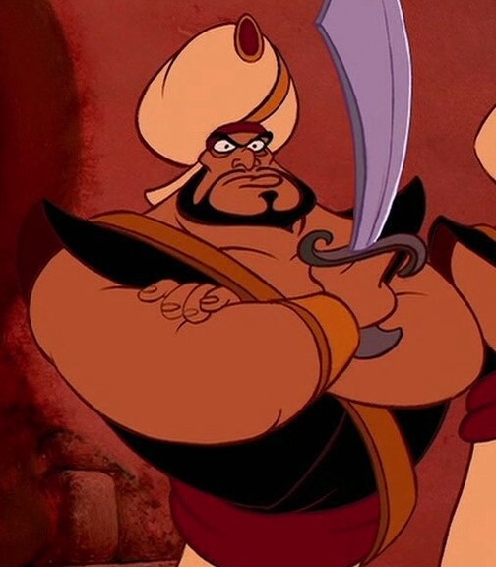
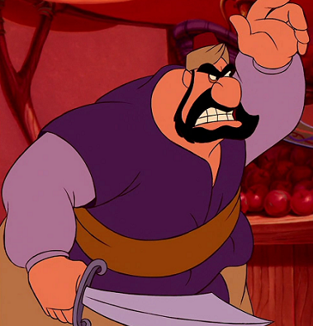
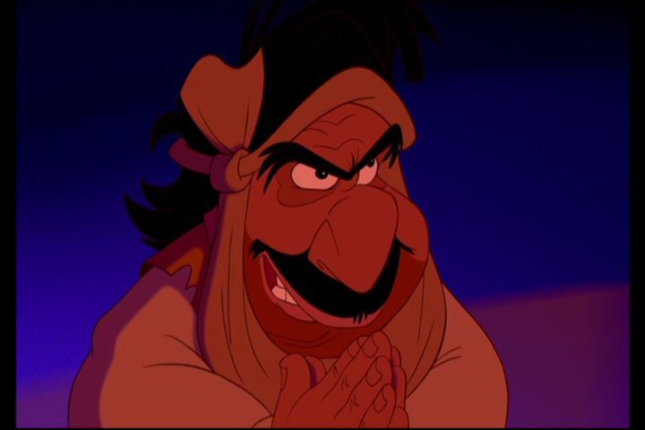
Children’s Film: Problematic Past

Slide 20
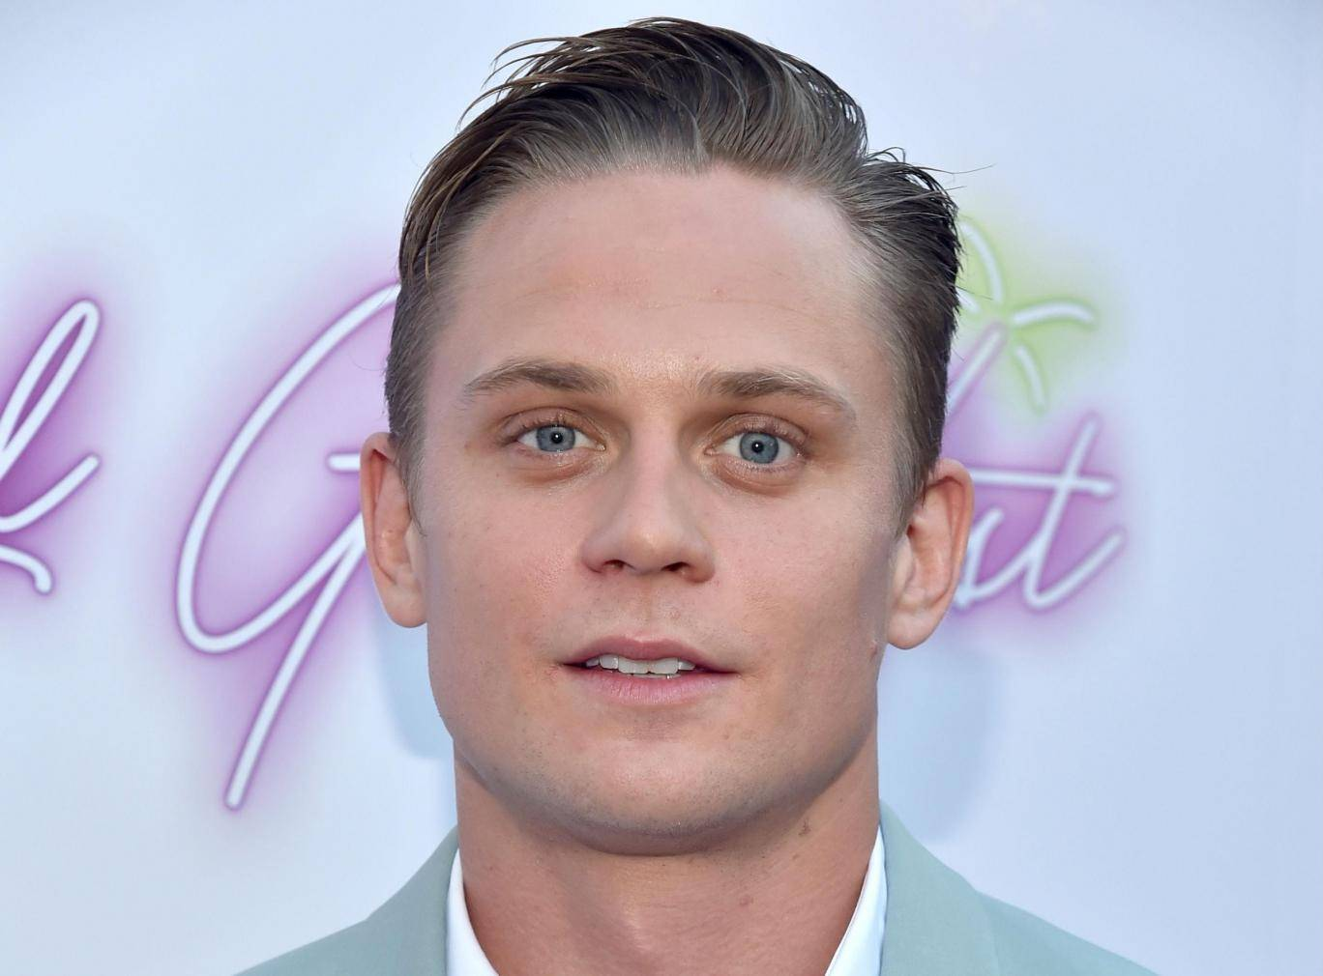
Resurfacing? AladdinControversy
In the Aladdin Broadway musical, casting was criticized because none of the actors are Middle Eastern. Why is there seemingly limited indignation around issues of invisibility and exclusion for Middle Eastern performers?
There has been, however, outcry erupting over the casting of Billy Magnussen, who plays a brand-new character named Prince Anders in the upcoming live action version of Aladdin. Why did the studio need to invent a brand-new white character for this live-action remake, especially since its story largely centers on a fictional Middle Eastern country?

Slide 21
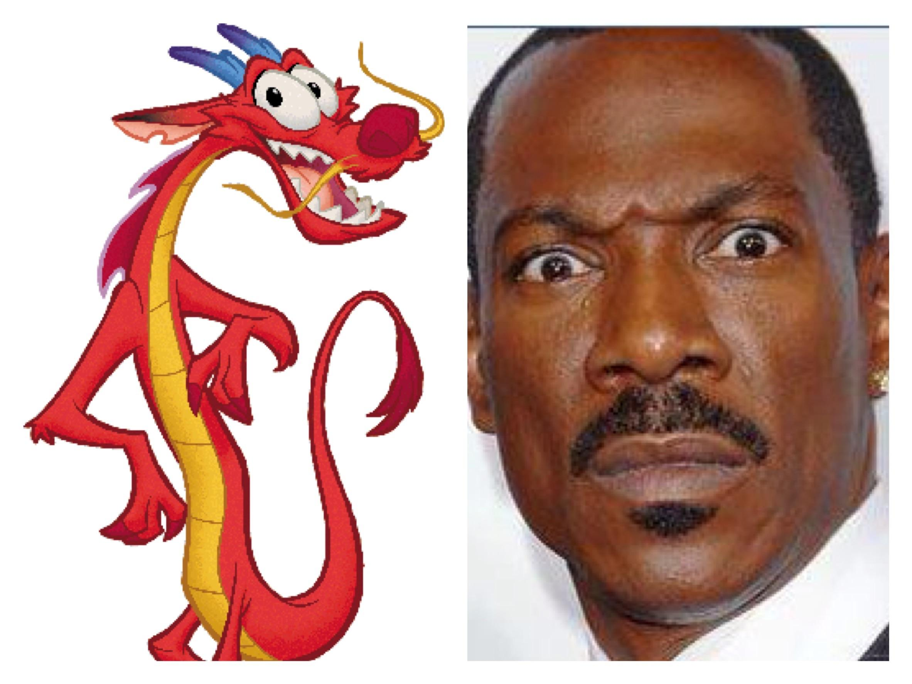
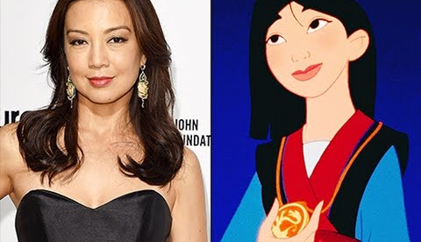
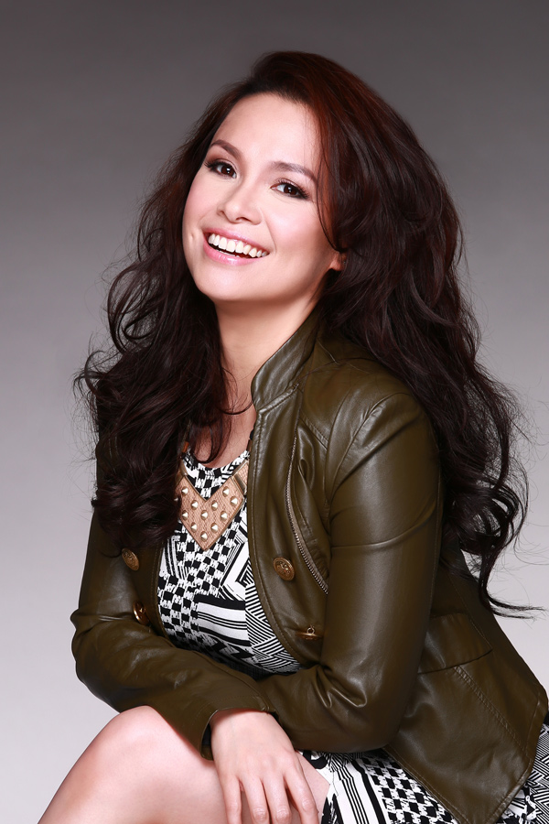
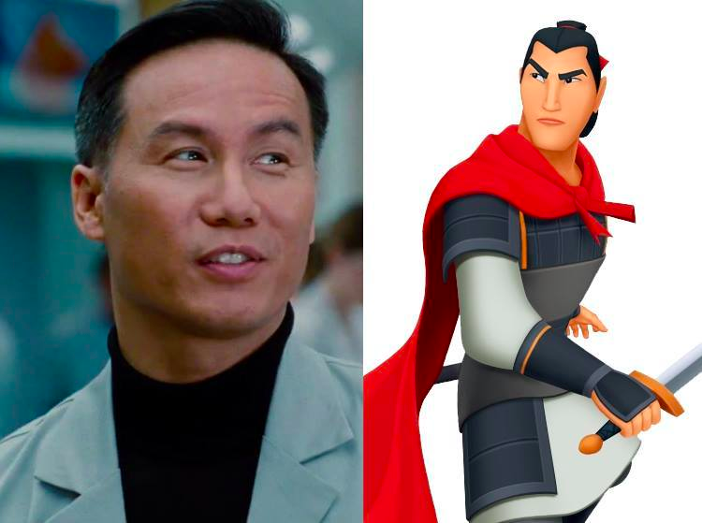
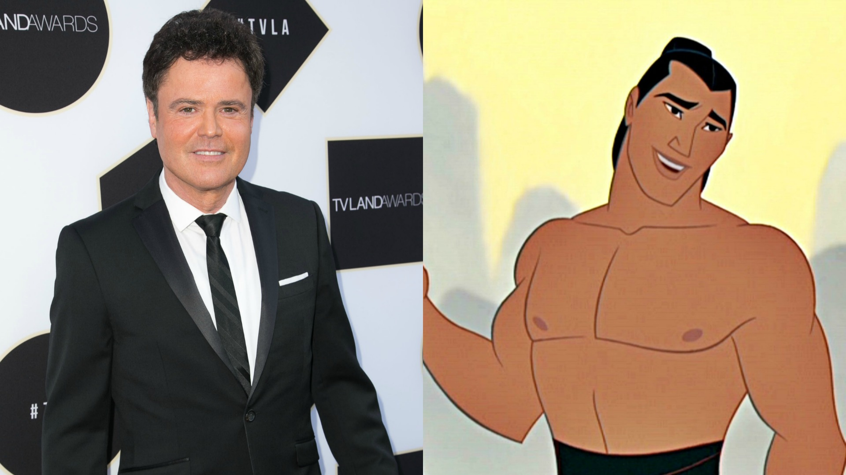
Children’s Film: Doing Better?
Notes:
Ming-Na Wen does the voice, but Lea Salonga does the singing
BD Wong does the voice, Donny Osmond does the singing

Slide 22
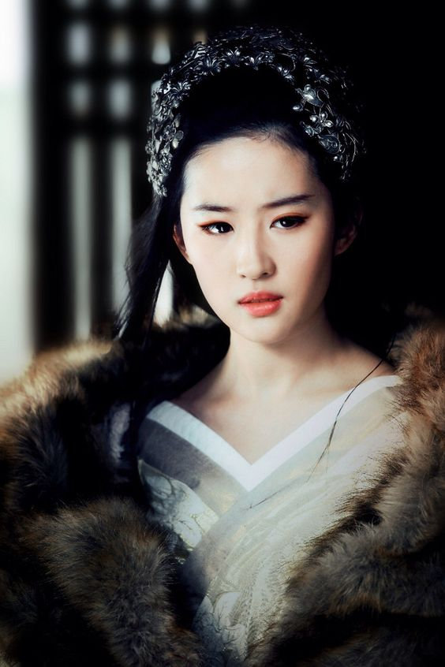
Mulan and Social Media Backlash Adjustment
Disney earned praise from “Mulan” fans for casting Chinese star Liu Yifei as Mulan in Niki Caro’s upcoming remake, bringing an actress known throughout China into the spotlight in America.
Last year, an anonymous letter posted to the claimed that a spec script for the remake rewrote the story to feature a white European trader who falls in love with Mulan. The letter prompted an internet outcry urging Disney to not force white characters into the film.
An insider, however, said the spec script was only a “jumping-off point” and that “Mulan is and will always be the lead character in the story, and all primary roles, including the love interest, are Chinese.”
Disney has made good on that promise with Yifei, as well as characters in Jon Favreau’s remake of “The Lion King”.

Slide 23
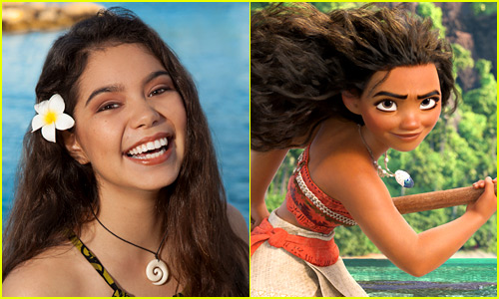
Cultural Authenticity Sells

Slide 24
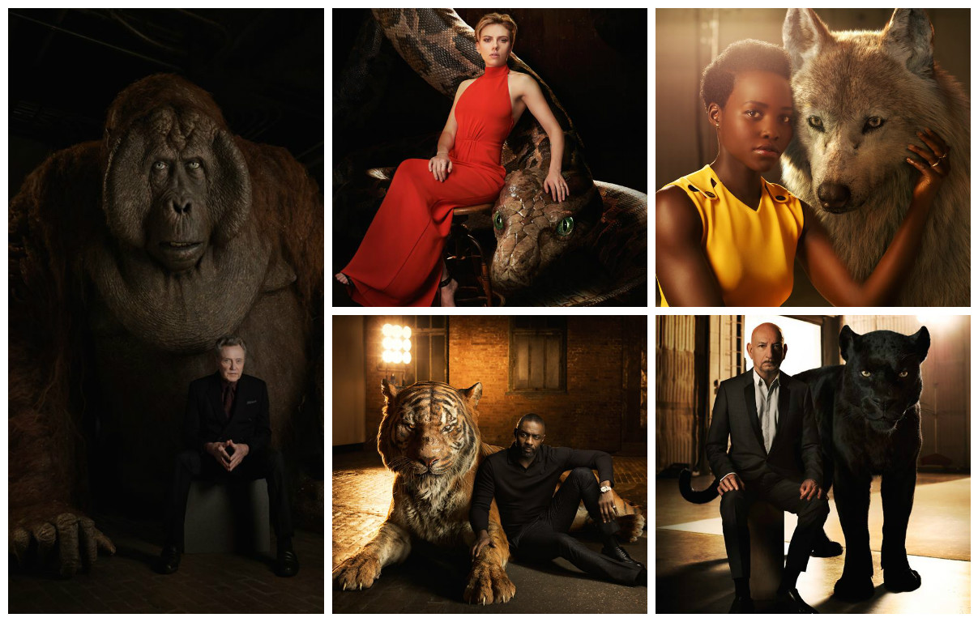
Complications: Jungle Book Voice Actors
Notes:
Christoper Walken is playing King Louie.
Scarlett Johansson is playing Kaa.
Idris Elba is playing Shere Khan.
Lupita Nyong’o is playing Raksha.
Ben Kingsley is playing Bagheera.

