Slide 1
Censorship, Selection, & #WeNeedDiverseBooks
Dr. Meghann Meeusen
Western Michigan University

Slide 2
Censorship and Childhood Experiences
Complexities and Questions

Slide 3
Censoring
Children’s Literature
Children’s literature has long been censored, often based on what parents believe to be “appropriate” for their children.
This concept of appropriateness, however, is not only subjective, but builds from adults’ beliefs (personal or societal) about childhood.
Questions of appropriateness place value judgments on a text, often less based on the text itself, but rather on whether the information it presents aligns with personal/social values and beliefs.

Slide 4
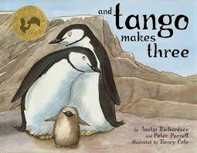
The Most Famously Censored Children’s Book

Slide 5
Questions to Consider
How does Tango Makes Three speak to a unique experience of childhood in a way that normalizes it?
Why might some adults be uncomfortable with this book or wish it not to be shared with children?
We’ll think this semester not only about diversity related to culture, but also a wider range of experiences of childhood. What do we need to think about to be sensitive, thoughtful, and positive in discussions about a wide range of experiences and perspectives of young people?

Slide 6
Appropriateness, Political Correctness, & Representation
Is censorship positive or problematic?

Slide 7
Social Media’s Influence: Censorship?
More recently, social media has opened opportunities to voice opinions about children’s books in ways that have never before been so immediate or accessible.
One effect of this is that publishers can (and do) respond to claims and discussions that certain texts are problematic, even inappropriate, in how they represent a particular culture.
Activists use social media to work towards change in this way– pointing out concerning depictions in ways that often result in action.

Slide 8
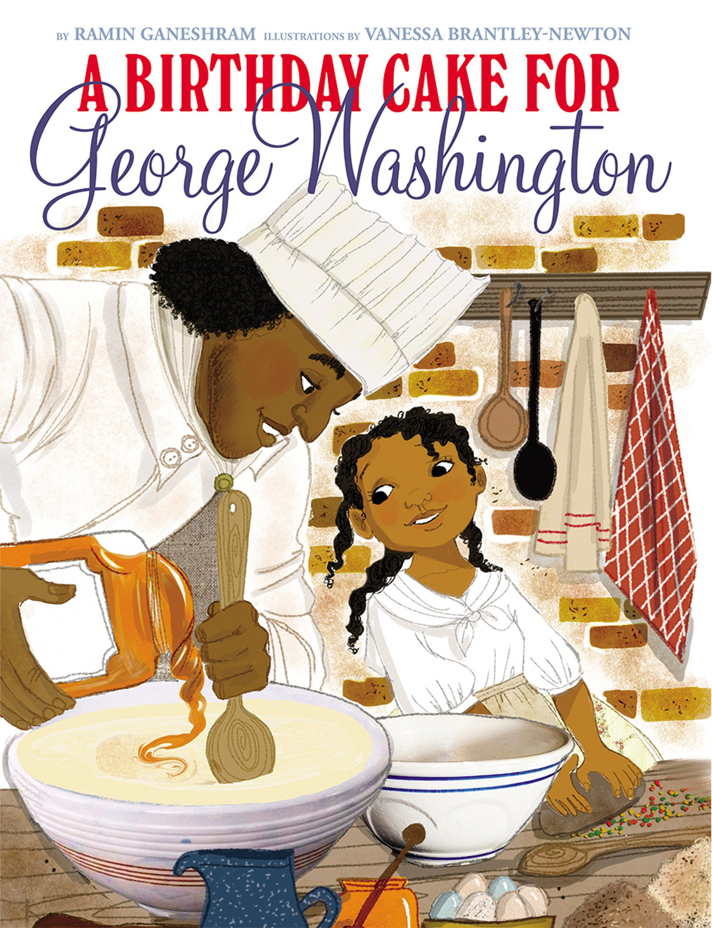
Scholastic Pulls from Shelves

Slide 9
A Birthday Cake for George Washington
“George Washington loves his cake! And, oh, how he depends on Hercules, his head chef, to make it for him,” reads Scholastic’s book description. “Hercules, a slave, takes great pride in baking the president’s cake.”
The book, which was released Jan. 5, was written by Ramin Ganeshram and illustrated by Vanessa Brantley-Newton. After receiving over 100 one-star ratings on Amazon, it was pulled from shelves and no longer sold—this occurred less than two weeks after its release date.

Slide 10
Scholastic’s Response
"We believe that, without more historical background on the evils of slavery than this book for younger children can provide, the book may give a false impression of the reality of the lives of slaves and therefore should be withdrawn," Scholastic said in a statement. "We do not believe this title meets the standards of appropriate presentation of information to younger children, despite the positive intentions and beliefs of the author, editor, and illustrator."

Slide 11
A Complicated Question?
A Birthday Cake for George Washington was written, illustrated and edited by a diverse group of people of color, including editor Andrea Davis Pinkney, who is black and a winner of the Coretta Scott King Award.
Pinkney, in fact, wrote a long essay in defense of the book. American history, she wrote, is a messy and nuanced affair and, yes, some slaves found happiness in some of their tasks.

Slide 12
Andrea Davis Pinkney
"Hercules was well known throughout Philadelphia. He was a highly regarded chef and a dapper dresser, who insisted on perfection in his kitchen. George Washington depended on Hercules to make him the perfect birthday cake. Hercules is often thought of by culinary historians as the first celebrity chef in America. On each day of the year ― and especially on the president's birthday ― Hercules ruled the kitchen. He was quite proud of his status in the Washington home, and he lived a life of near-freedom. But as the founding fathers knew (and as the author notes) being 'almost-free' is not the same as being free. Hercules dreamed of his own liberty.
"Delia, Hercules' daughter, often worked alongside her father, and was also keenly aware of her life as an enslaved person. In A Birthday Cake for George Washington, young Delia tells us the story of how her remarkable father does the impossible and makes a birthday cake for the most famous man in America—without any sugar. The story illuminates Hercules' purposeful work as a chef and the pride young Delia feels at the tremendous achievements of her father. The book concludes with Hercules' whole story and what it means when you and your loved ones will never savor the sweet taste of freedom."

Slide 13
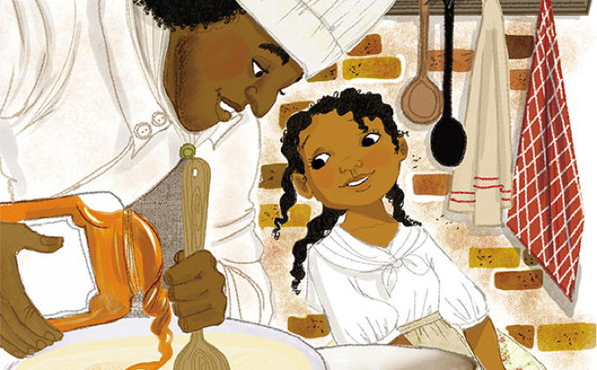

Slide 14
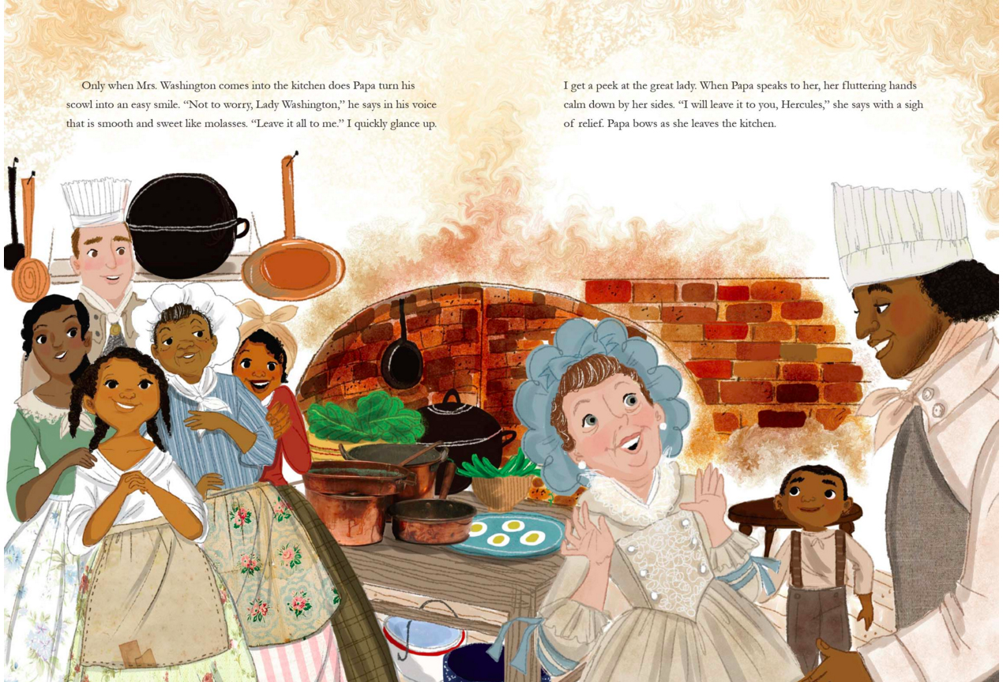

Slide 15
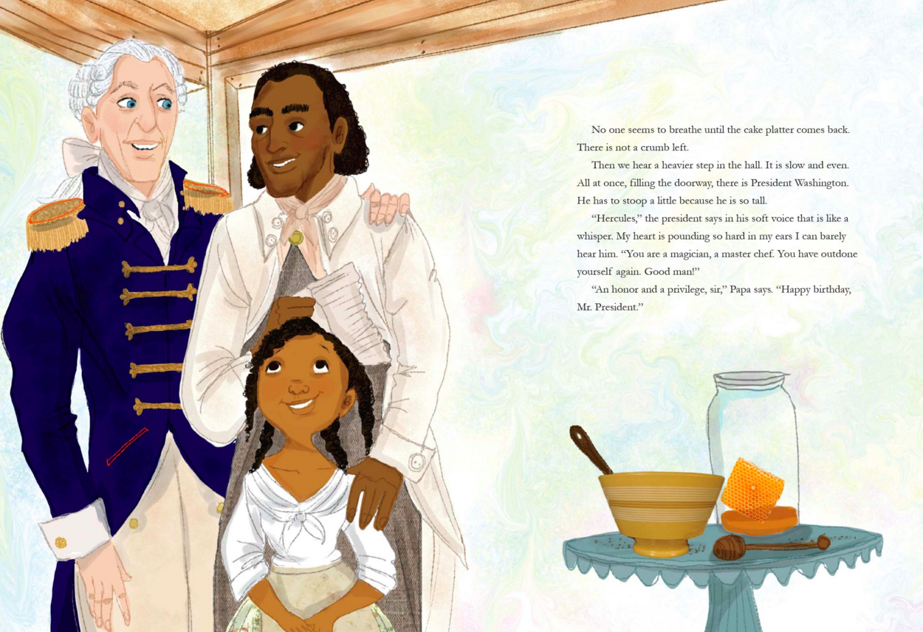

Slide 16
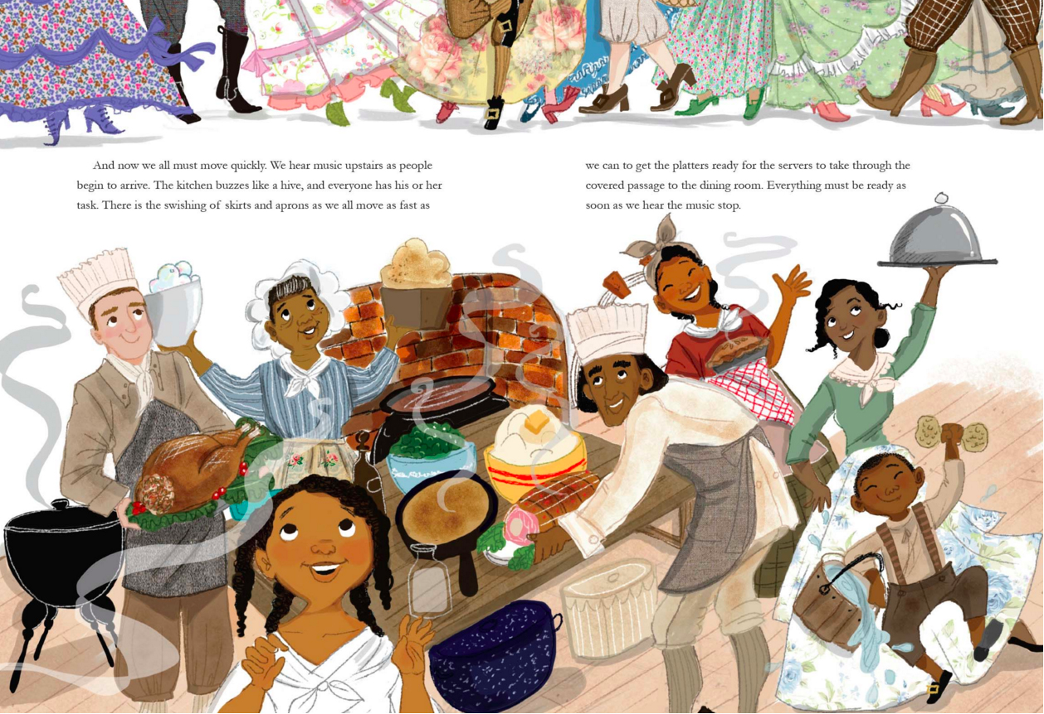

Slide 17
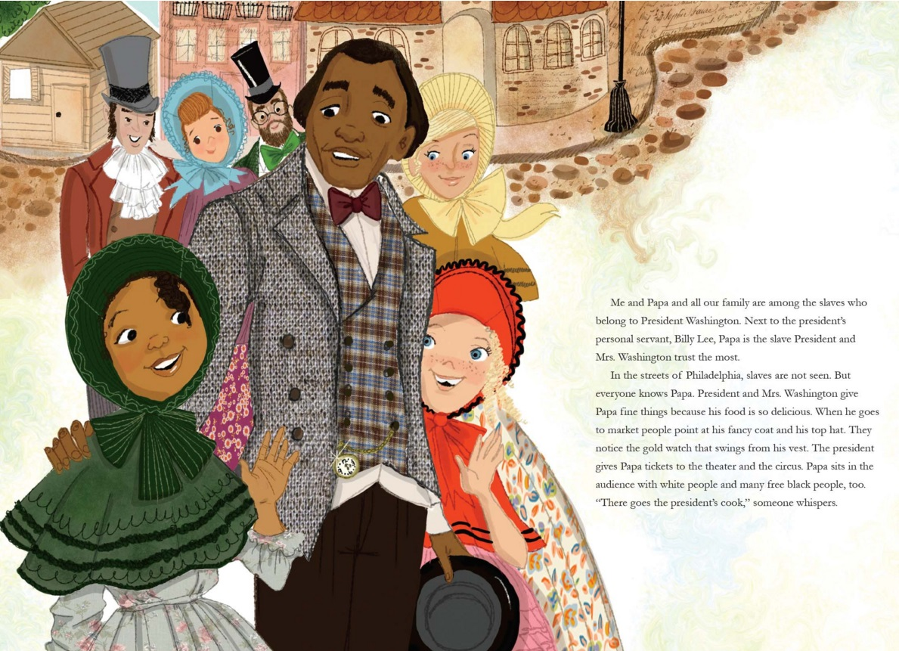

Slide 18
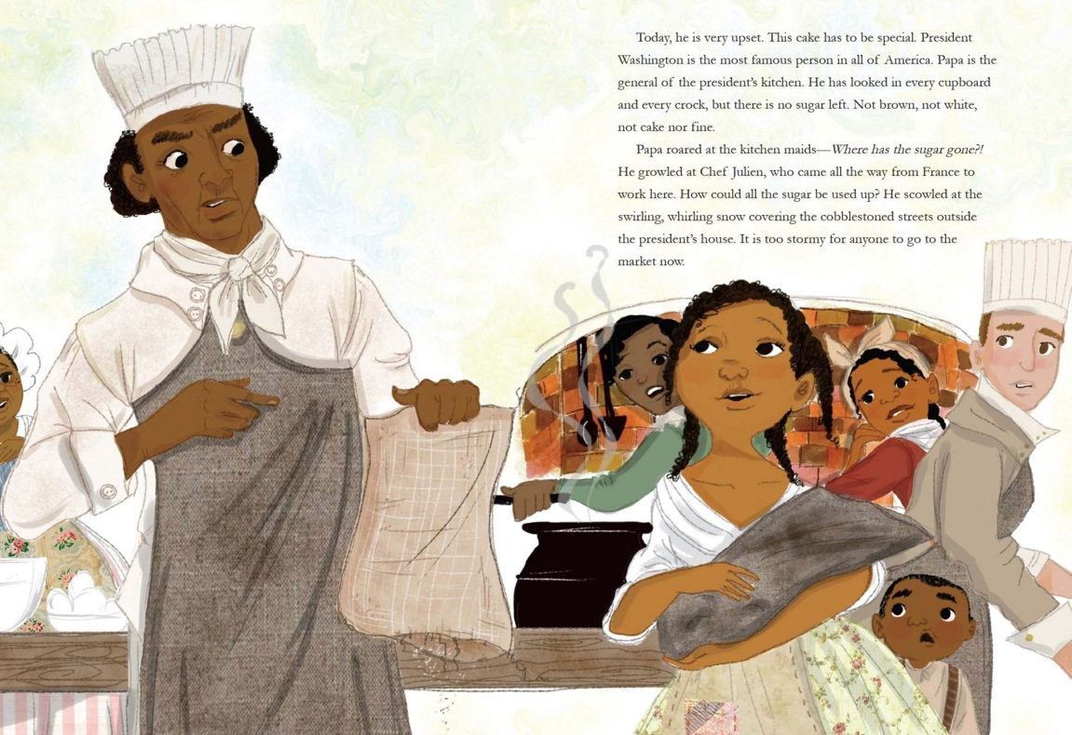

Slide 19
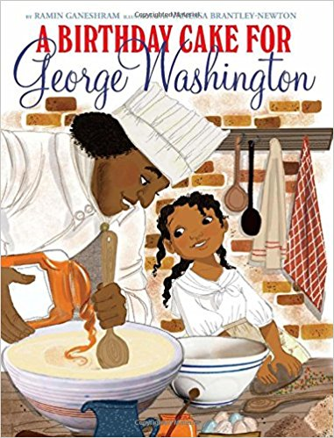
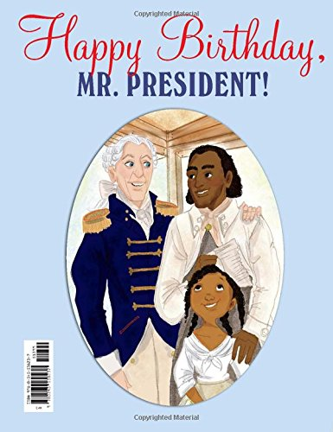

Slide 20
Questions to Consider
Is the removal of A Birthday Cake for George Washington censorship?
Do you think that it was right or necessary for scholastic to pull the text? Why or why not?
Why is it important to represent minority individuals and historical experiences with accuracy and respect? How is this task sometimes more difficult than it seems?

Slide 21
A Unique Social Movement:
#WeNeedDiverseBooks
Looking to the Future of Children’s Literature

Slide 22
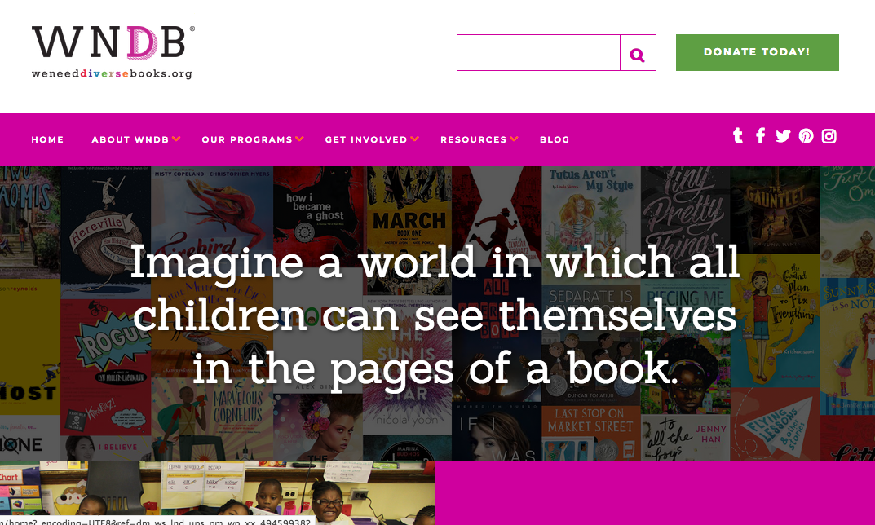
A Mission and a Message

Slide 23
From Hashtag to Movement to Book
What started as a hashtag response to an all-white, all-male panel of children's book authors at a 2014 BookCon reader event has resulted in a newly-published book aiming to promote diversity in children's literature.
Since 2014, the hashtag #WeNeedDiverseBooks has grown into the We Need Diverse Books (WNDB) nonprofit organization supporting diversity in children’s literature with special events, panel discussions, writing contests, grant awards, mentorships, resources for teachers and librarians,
Now, its first book — “Flying Lessons & Other Stories,” a middle-grade anthology for children ages 8 to 12 released this week by Crown Books for Young Readers.

Slide 24
Questions to Consider
Why is the #WeNeedDiverseBooks movement necessary? Why might this have been difficult to achieve in the past?
What works about the #WeNeedDiverseBooks movement? What is unique about this moment in history that makes it possible?
How must readers and critics be aware of both “more,” but sometimes also “better.” How does the intersection of these concepts complicate the movement?

Slide 25
Award Winners: Taking Notice
Have there been increases in diverse books, and what books are gaining acclaim?

Slide 26
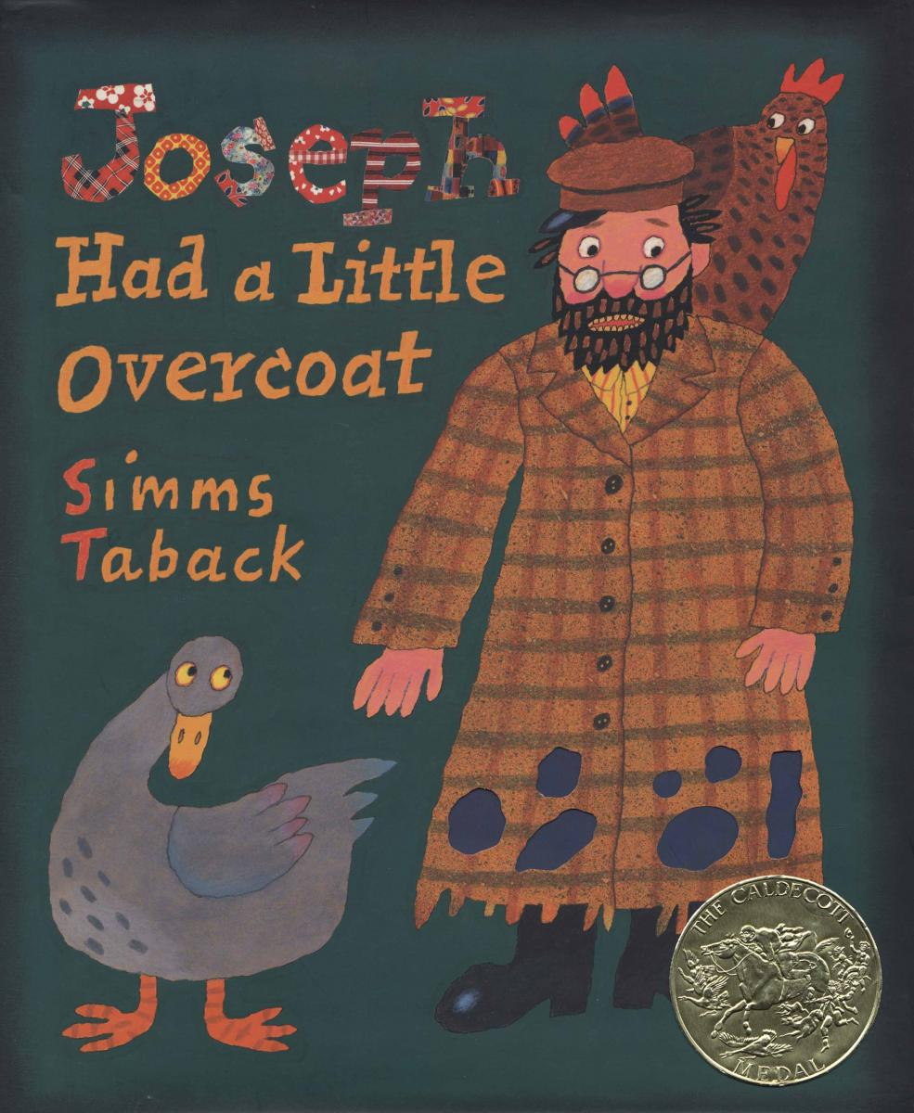
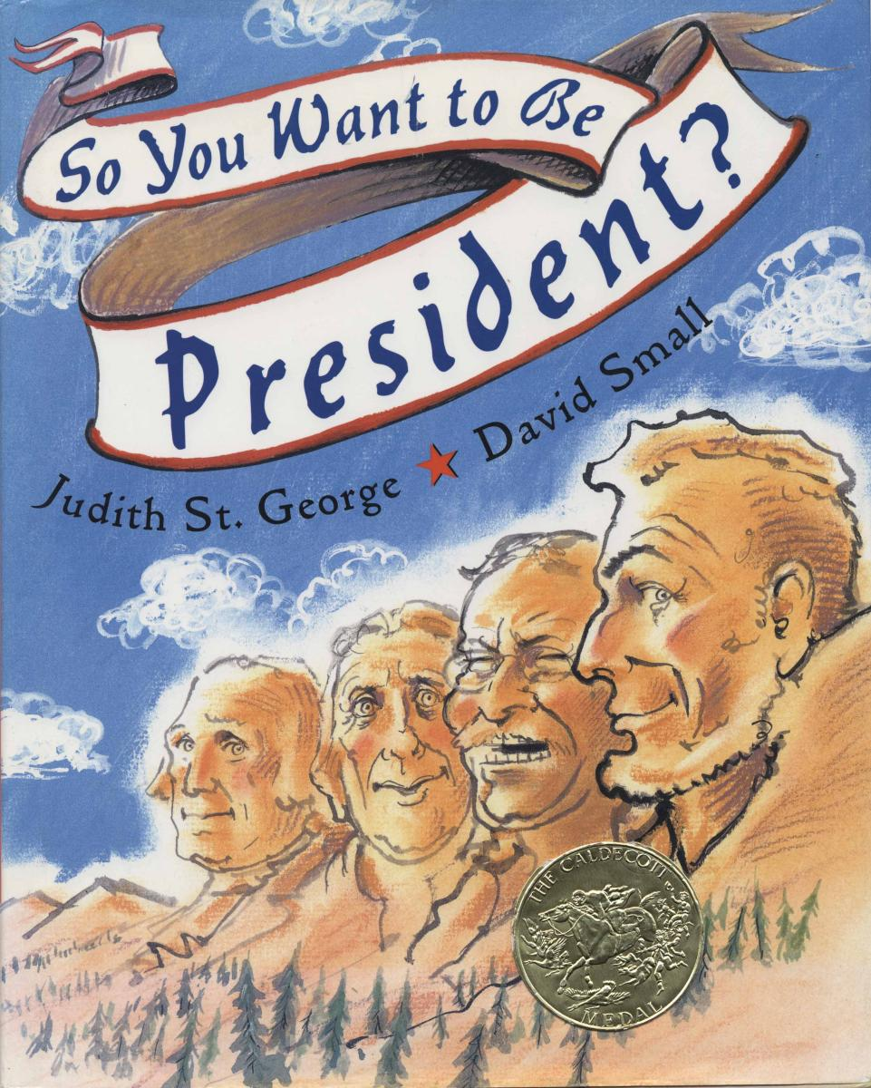
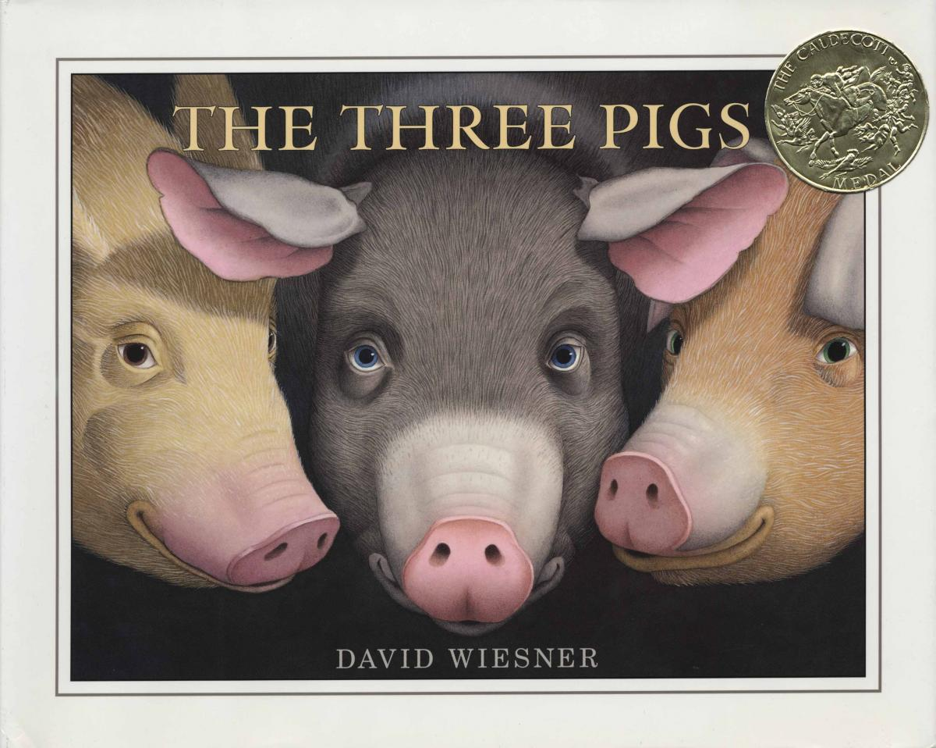
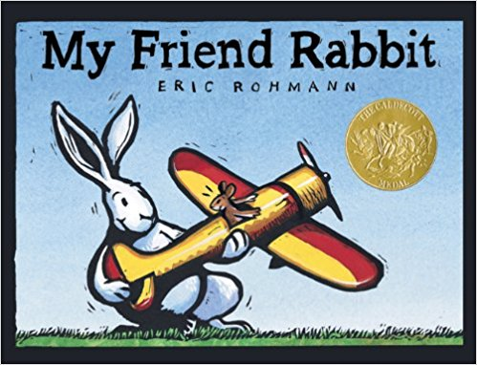
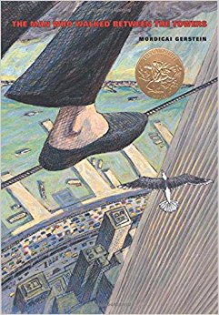
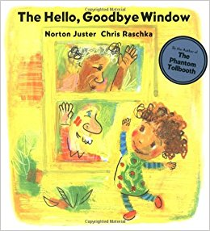
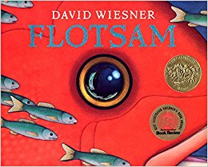
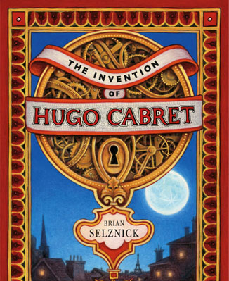
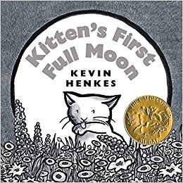
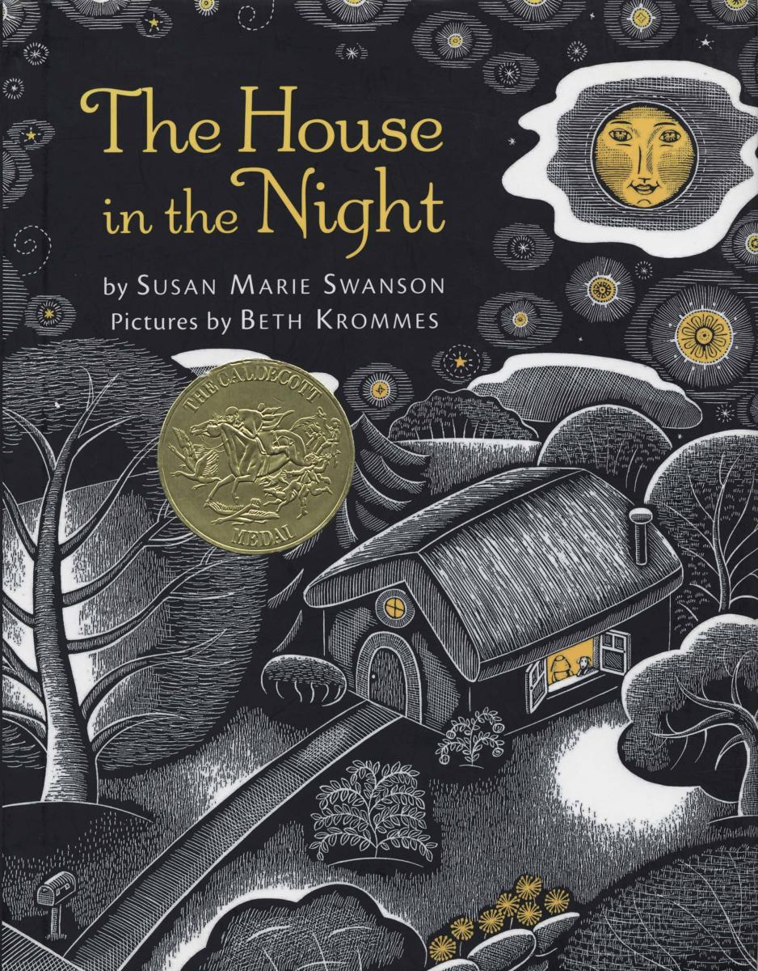
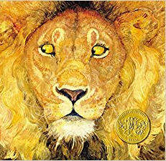
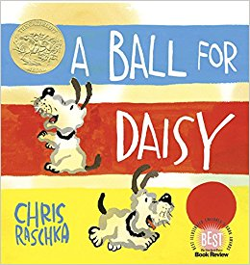
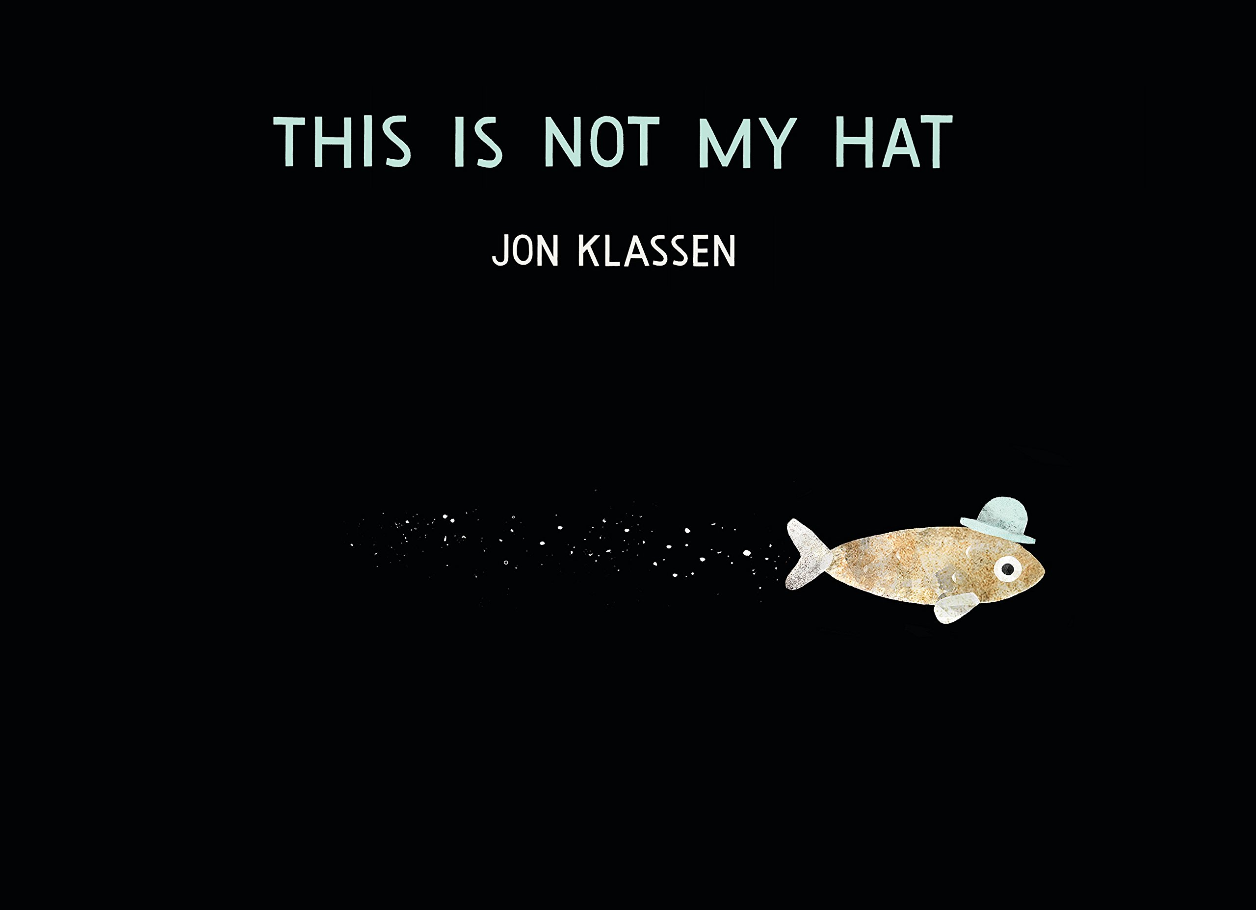
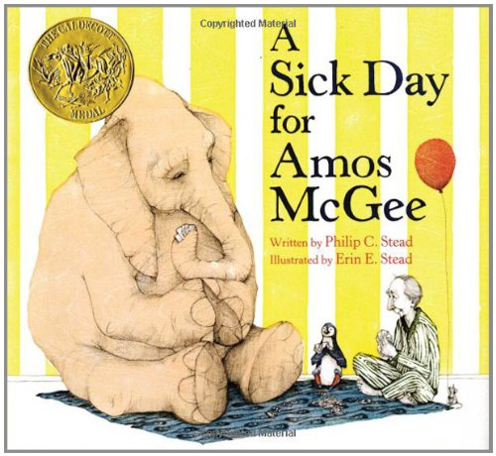
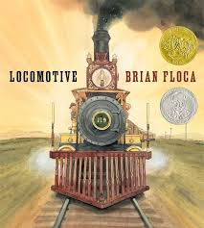
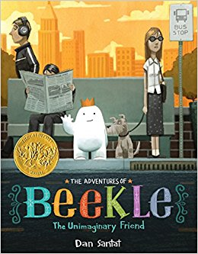
Past Winners

Slide 27
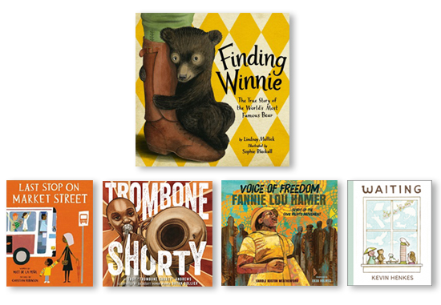
What about more recently?

Slide 28
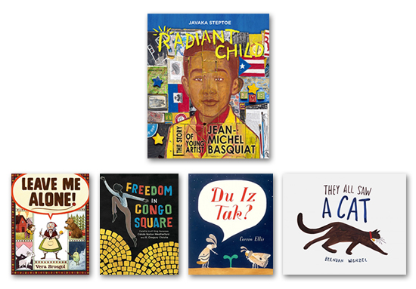
What about more recently?

Slide 29
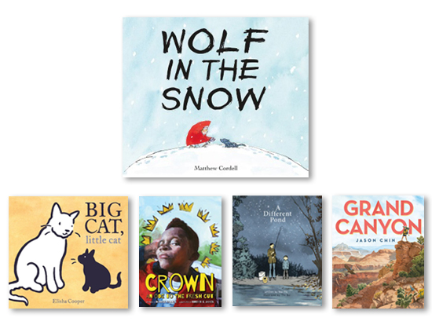
What about more recently?

Slide 30
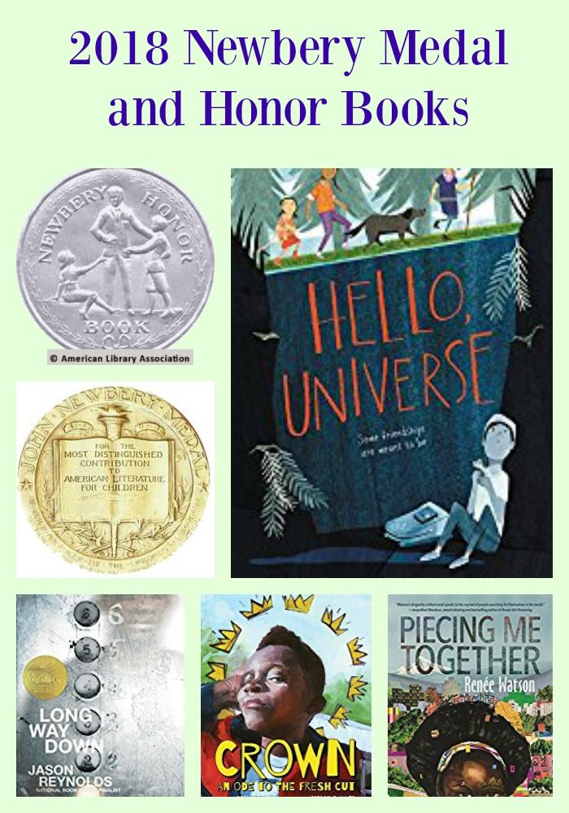
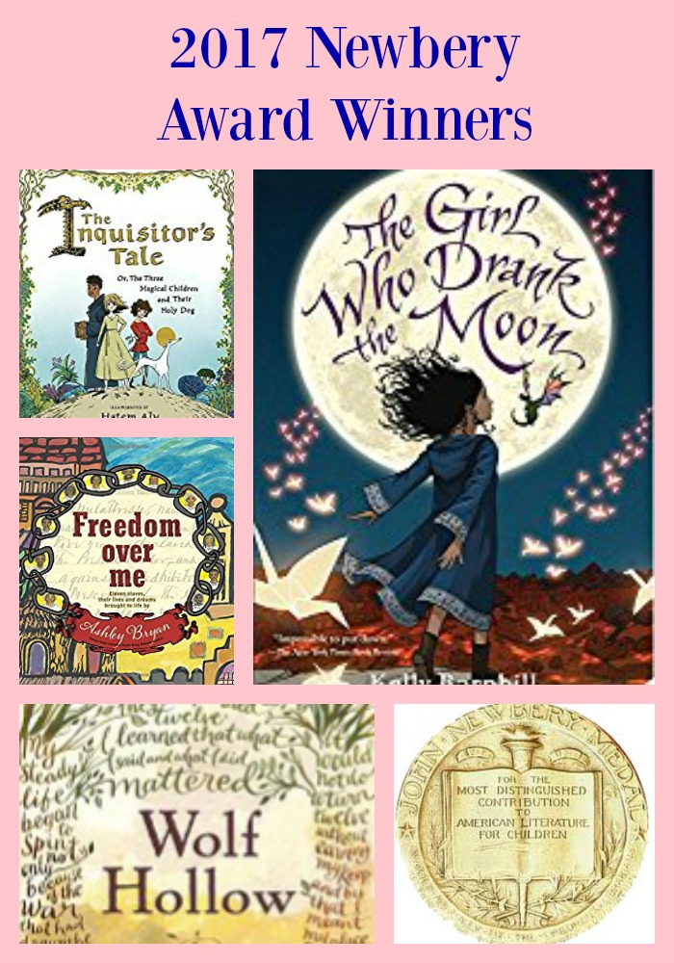
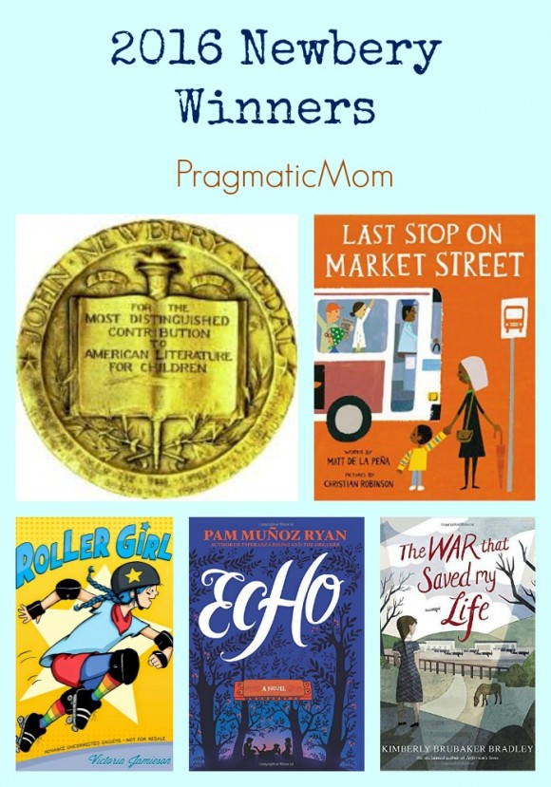
What about more recently?

Slide 31
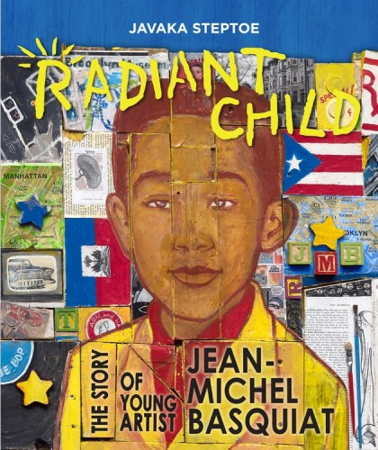
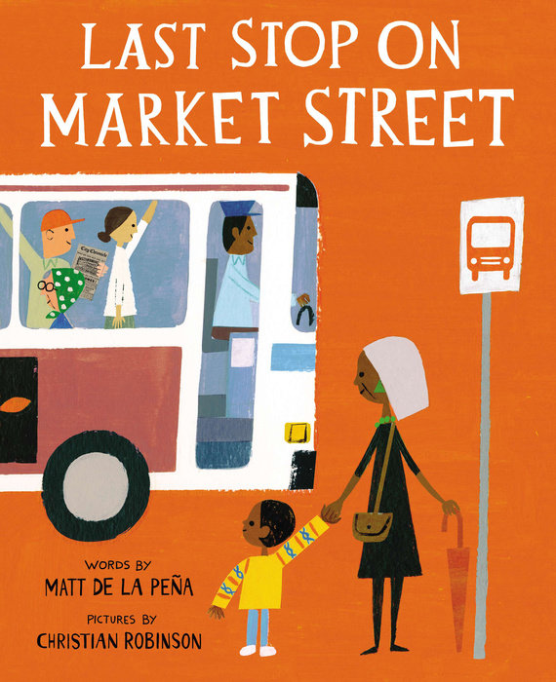
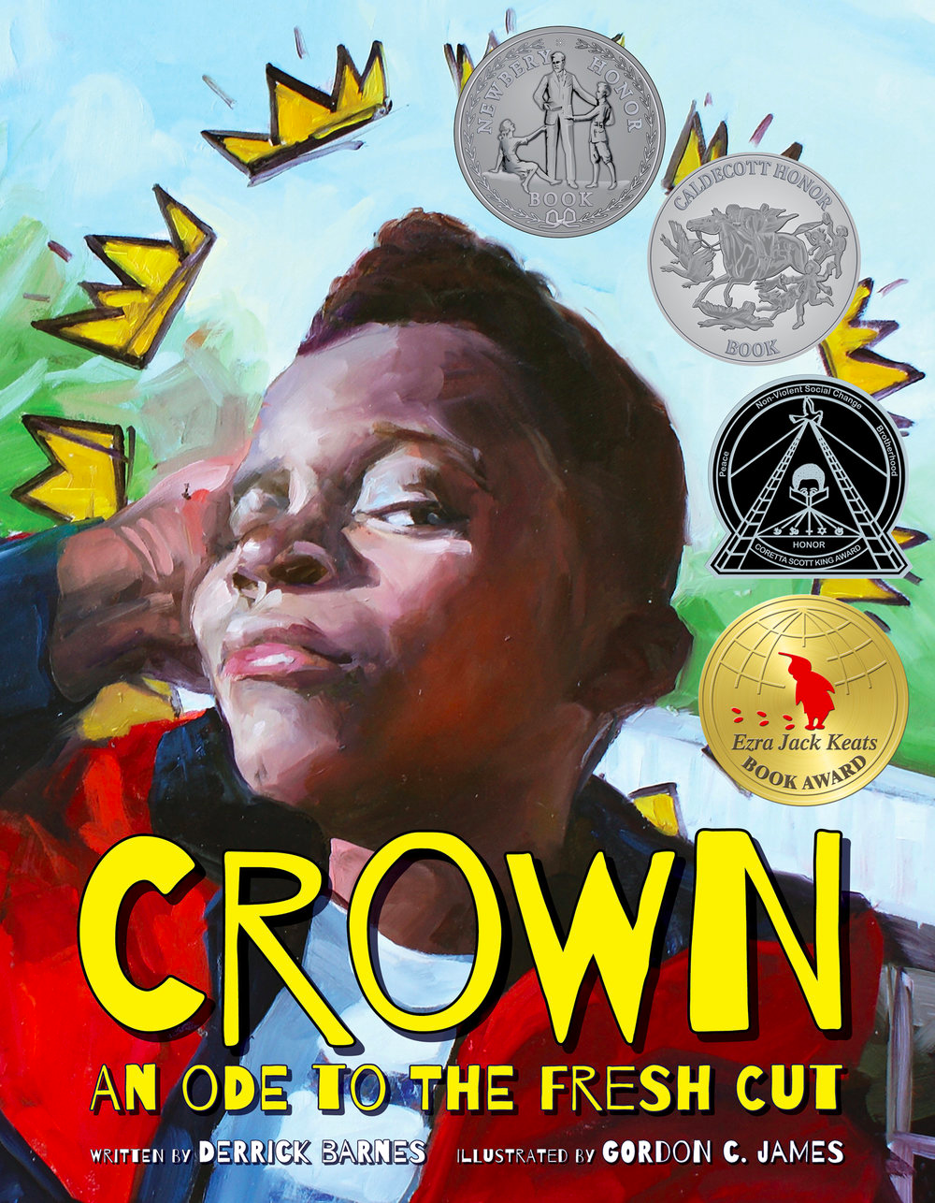
Books that Standout

Slide 32
Questions to Consider
How has emphasis on representation changed, and how do major children's literature awards reflect this?
How are awards interesting indicators of trends but also limited in how they can describe the evolving focus and values of readers and the field more broadly?
What do books like Last Stop on Market Street and Radiant Child demonstrate about the specific approaches and values that are most acclaimed in books featuring minority characters and diverse approaches?

