Slide 1
We Want to Do More Than Survive: Abolitionist Teaching for Education Freedom by Bettina Love
Quotes and Key Points

Slide 2
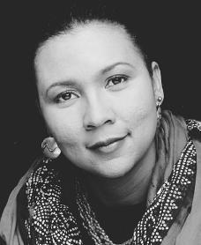
Home Place
In her book We Want to do More Than Survive, Bettina Love references the idea of a “homeplace” from social activist and author, bell hooks, and describes it as a “space where black folx truly matter ...where souls are nurtured, comforted and fed” (63).

Slide 3
“We Who Are Dark”
“Antidarkness is the social disregard for dark bodies and the denial of dark people’s existence and humanity. When White student attend nearly all-White schools, intentionally removed from America’s darkness to reinforce White dominance, this is antidarkness. When dark people are presented in school curriculums as unfortunate circumstances of history, that is antidarkness. When schools are filled with White faces in positions of authority and dark faces in the school’s help staff, that is antidarkness. The idea that dark people have had no impact on History or the progress of mankind is one of the foundational ideas of White supremacy” (14).

Slide 4
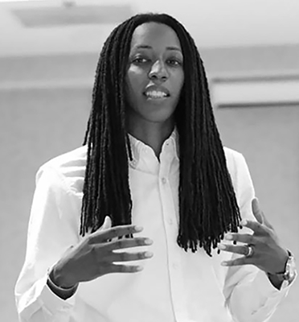
Education’s Power
“Education is one of the primary tools used to maintain White supremacy and anti-immigrant hate. Teachers entering the field of education must know this history, acknowledge this history, and understand why it matters in the present-day context of education, White rage, and dark suffering” (23).

Slide 5
Closing the Door
“Schools are mirrors of our society; educational justice cannot and will not happen in a vacuum or with pedagogies that undergird the educational survival complex. We need pedagogies that support social movements. I hear teachers say all the time, “I close my classroom door and teach.” This strategy helps teachers survive the disempowering and stressful environment, irrelevant curriculums, and bureaucratic mess of education, but it does not change the field or the context in which youth are being disposed of; it may just prolong the inevitable” (40).

Slide 6
The Real Work
“The writer bell hooks argues that loving Blackness is an act of political resistance because we all have internalized racism, regardless of the color of our skin, which operates to devalue Blackness, but she argues that Black people need to love themselves not in spite of their Blackness but because of their Blackness” (49-50).
“Too often we think the work of fighting oppression is just intellectual. The real work is personal, emotional, spiritual, and communal. It is explicit, with a deep and intense understanding that loving Blackness is an act of political resistance, and therefore it is the fundamental aspect to teaching dark kids” (51).

Slide 7
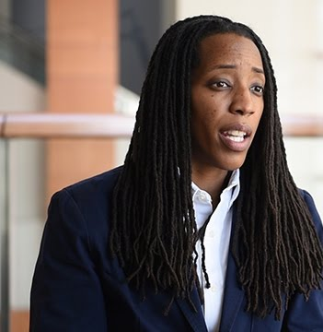
Consciously Committing
“Antiracist teaching is not just about acknowledging that racism exists but about consciously committing to the struggle of fighting for racial justice, and it is fundamental to abolitionist teaching. Antiracist educators seek to understand the everyday experiences of dark people living, enduring, and resisting White supremacy and White rage” (53).

Slide 8
Unpacking and Interrogating
“Teachers need to be taught how to question Whiteness and White supremacy, how to check and deal with their White emotions of guilt and anger, and how these all impact their classrooms. Only after unpacking and interrogating Whiteness, White teachers—and, really, all teachers—must unpack how Whiteness functions in their lives; then they can stand in solidarity with their students’ communities for social change” (75).

Slide 9
Black Joy
“Abolitionist teaching is not sustainable without joy. Dark students have to enter the classroom knowing that their full selves are celebrated. Not just their culture, language, sexuality, or current circumstances but their entire selves, past, present, and future. Their ancestors, their family members, their friends, their religion, their music, their dress, their language, the ways they express their gender and sexuality, and their communities must all be embraced and loved” (120-121).

Slide 10
Dismantling White Privilege
“White folx can also embrace Black joy by helping, advocating for, and wanting Black folx to win. Recognizing and acknowledging White privilege is cute, but what does it mean without action? Dismantling White privilege is giving something up so Black folx can win….By winning, I mean White folx ensuring that people of color are being paid equally or more than their White peers. White teachers demanding that schools hire more teachers of color. Silencing your White voice so dark folx’ voices can be heard. White folx bringing dark folx in on all decision-making and dark folx having equal or more weight, and not just on issues about injustice or education but on issues that impact all of us, regardless of the color of our skin” (121).

Slide 11
Coconspirators, Not Allies
“Ally-ship is working toward something that is mutually beneficial and supportive to all parties involved” while a “coconspirator” understand “how Whiteness works in our society…willing to use his intersections of privledge, leverage his power, and … stand in solidarity and confront anti-Blackness. A cocospirator functions as a verb, not a noun” (117).

Slide 12
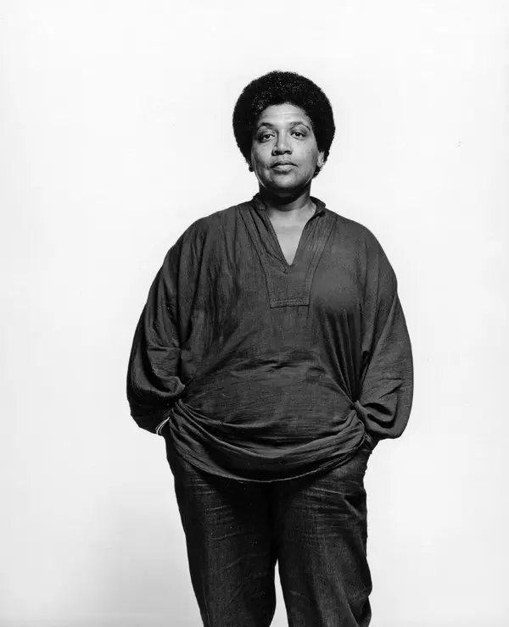
Audre Lorde
“The great Audre Lorde said, ‘The true focus of revolutionary change is never merely the oppressive situations which we seek to escape, but that piece of the oppressor which is planted deep within each of us.” Abolitionist teaching asks us to question the piece of the oppressor that lives in all of us’” (122).

Slide 13
How Can You Love
“Another facet of the teacher education gap is White students’ limited interactions with people of color, which perpetuates the myths about people of color. Many White students believe that their hard work is one of the major reasons they landed at a top university; or that their parents’ decision to live in an all-White neighborhood had nothing to do with race, racism, or enclaves established by White rage; and that their privilege—if they recognize it—will not have any impact on their students, because they “love kids,” “want to make a difference,” and/or “have wanted to be a teacher since they were little girls playing school with their dolls.” How can you love something you know so little about?” (130).

Slide 14
Taking Risks
“Being an abolitionist means you are ready to lose something, you are ready to let go of your privilege, you are ready to be in solidarity with dark people by recognizing your Whiteness in dark spaces, recognizing how it can take up space if unchecked, using your Whiteness in White spaces to advocate for and with dark people. And you understand that your White privilege allows you to take risks that dark people cannot take in the fight for educational justice” (159).

Slide 15
Questions
Relate an aspect of this week’s reading to one of the quotes from Love’s text presented here.
  What part of the story or element of the writing helps you to understand a concept that Love consider?
  How could the reading we’ve done so far be used in the pursuit of abolitionist teach?
Include a quote from the reading to support and help explain the connection you are drawing.

