Slide 1
Purpose and Development of Children’s Literature
Key Terms and Tensions Lecture
Dr. Meghann Meeusen
Western Michigan University

Slide 2
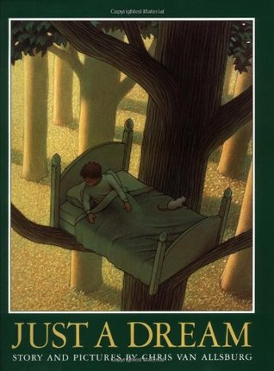
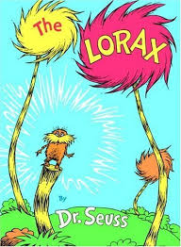
Didacticism
books specifically designed to teach a lesson, whether moral, political, religious, social, or practical
While much of the history of children’s literature has been defined by didacticism or by efforts to avoid it, even didactic works can be complex, important, and pleasurable.
In what ways are all children’s books didactic? Why might this be?

Slide 3
Dual Address
ways that texts move between addressing child and adult readers, in part because adults act as a mediator between children and books
adult mediator: adults writing and publishing children’s literature, choosing or recommending books for children, reading books to children,
what goals to various adult mediators have?

Slide 4
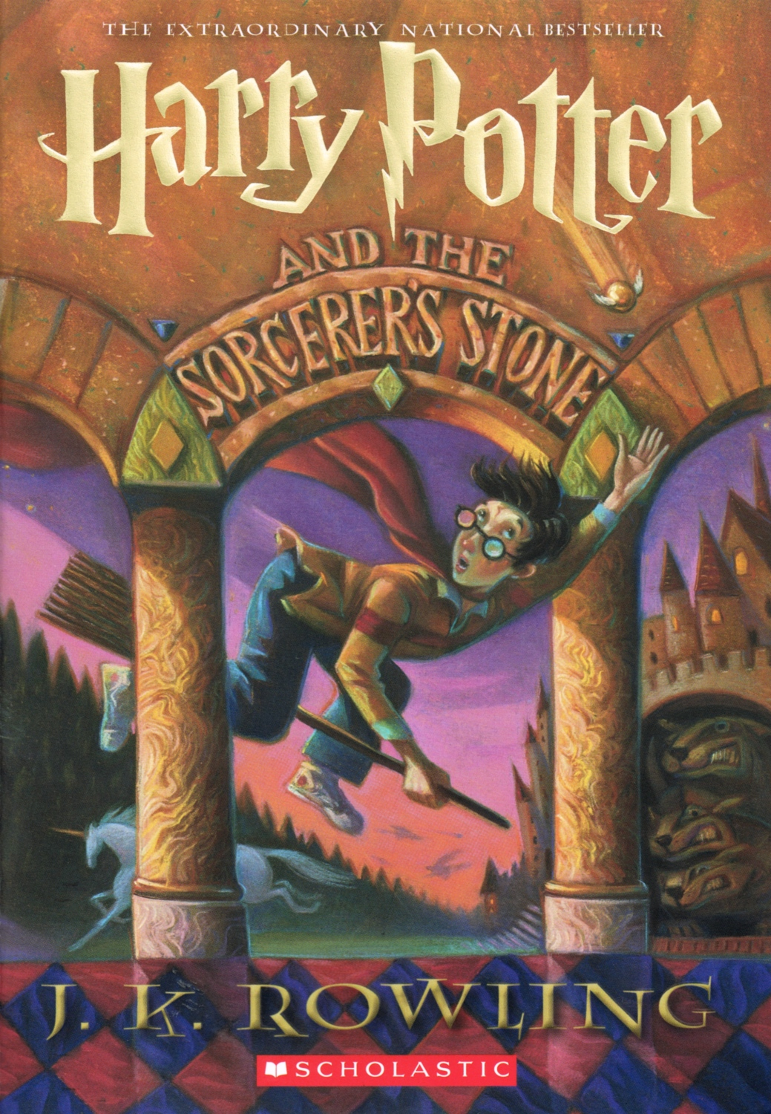
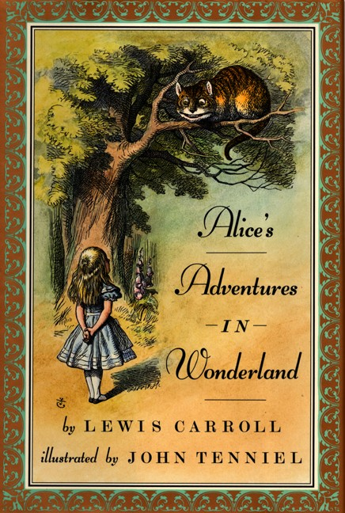
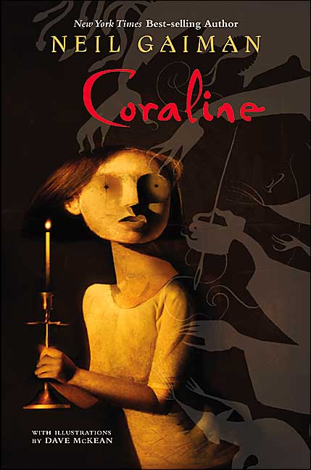
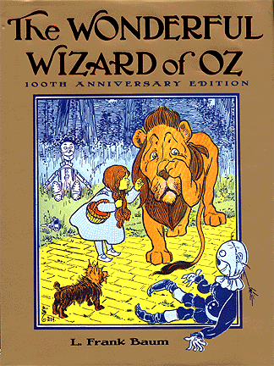
Cannon and Classic
Those texts that by social and cultural consensus have been acknowledged as the most important or central works of a period, country or genre are considered part of the canon.
A classic is one that has endured overall several generations and which is esteemed on both aesthetic and cultural grounds.

Slide 5
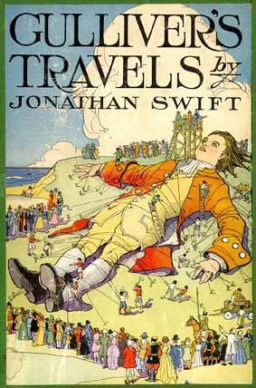
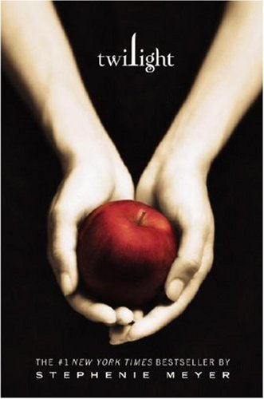
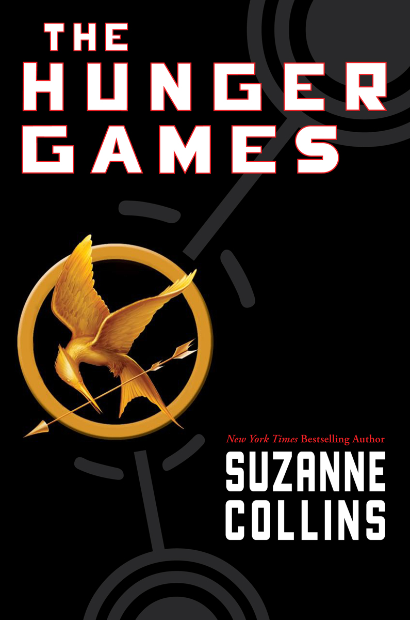
Crossover Texts
Definition One: though written for adults, were read and enjoyed by children as well (Gulliver’s Travels, Robinson Crusoe)
Definition Two: novels that appeal to adults as much as they do to children – are the publishing phenomenon of the past decade.

Slide 6
John Newbery
Often credited with the “invention” of children’s literature; London bookseller and publisher who published A Little Pretty Pocket-Book in 1744
Ignited the children’s book industry
  Advertised and designed not only for instruction but pleasure (enjoy as well as learn from it)
  Newbery began to think about children and their parents as a distinct consumer group
Namesake of the Newbery Award- given to the “most distinguished contribution to American literature for children”

Slide 7
Instruction or Pleasure?
The Golden Age (mid 18th century)
  Children and adults were increasingly imagined as segregated and distinct audiences
  More middle-class families could afford books for children than ever before
  Emphasize pleasure & creative expression in addition to instruction, new genres, more complex characters
  Lewis Carroll’s Alice’s Adventures in Wonderland
Development of many examples of “classic” children’s literature like Jungle Book, Wonderful Wizard of Oz, Peter Rabbit, Peter Pan, A Little Princess, Anne of Green Gables, Secret Garden, etc

Slide 8
Defining Tensions
Didacticism, Education, and Practicality: socializing children to behave or to think properly by providing models of good behavior
Pleasure, Popularity, Profitability: commercial, money-making enterprise, works that are pleasurable and popular
Aesthetics, Innovation, and Literariness: creative and artistic expression, works of literary merit, depth and significance

