Slide 1
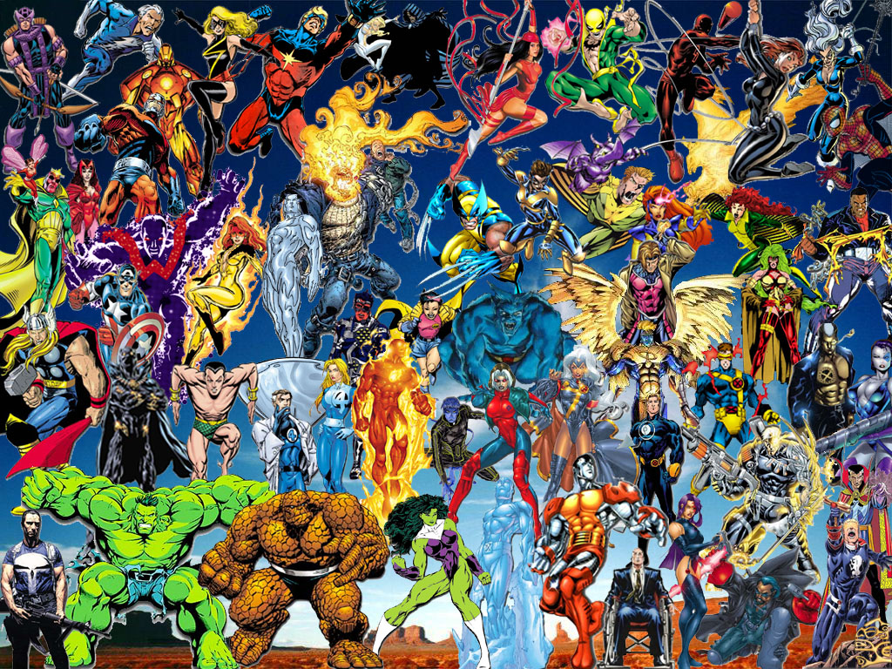
Graphic Novels
Changing Children’s Literature
via Visual Means
Notes:
Notes-
1. These slides are meant to be accompanied by a lecture, whose notes are attached in the independent study.
2. This presentation was originally begun and developed to teach as part of a practicum for Gwen Tarbox’s children’s literature. I taught it in conjunction with American Born Chinese, but updated it for this independent study. It serves as an introduction to the graphic novel world, and is meant to take a single two hour class, but could be expanded for a more in depth study.

Slide 2
What Do You Think of When You Hear the Word “Comics”?
Scott McCloud: “Colorful magazines filled with bad art, stupid stories and guys in tights- I read real books naturally. I was much too old for comics”

Slide 3
Once upon a time, comic books and graphic novels belonged to a small, loyal group of followers, but in recent times, this world has grown…

Slide 4
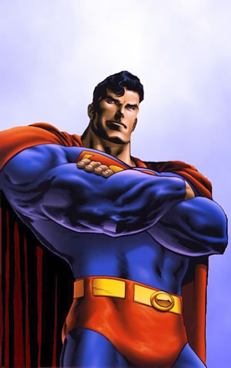
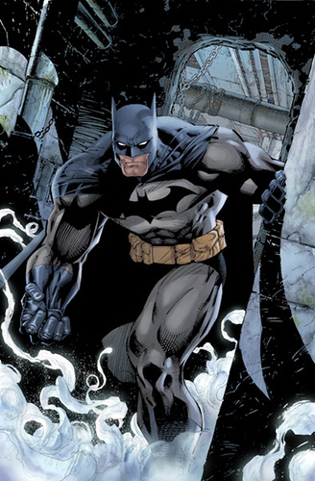
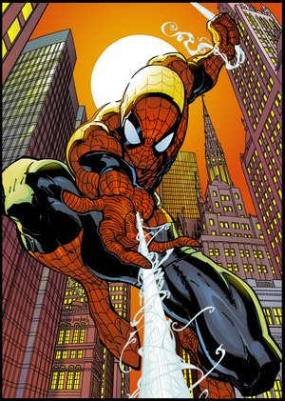
Blockbuster movies with memorable soundtracks, heartthrob lead actors, and breathtaking special effects turned a few favorite heroes into household
names…

Slide 5
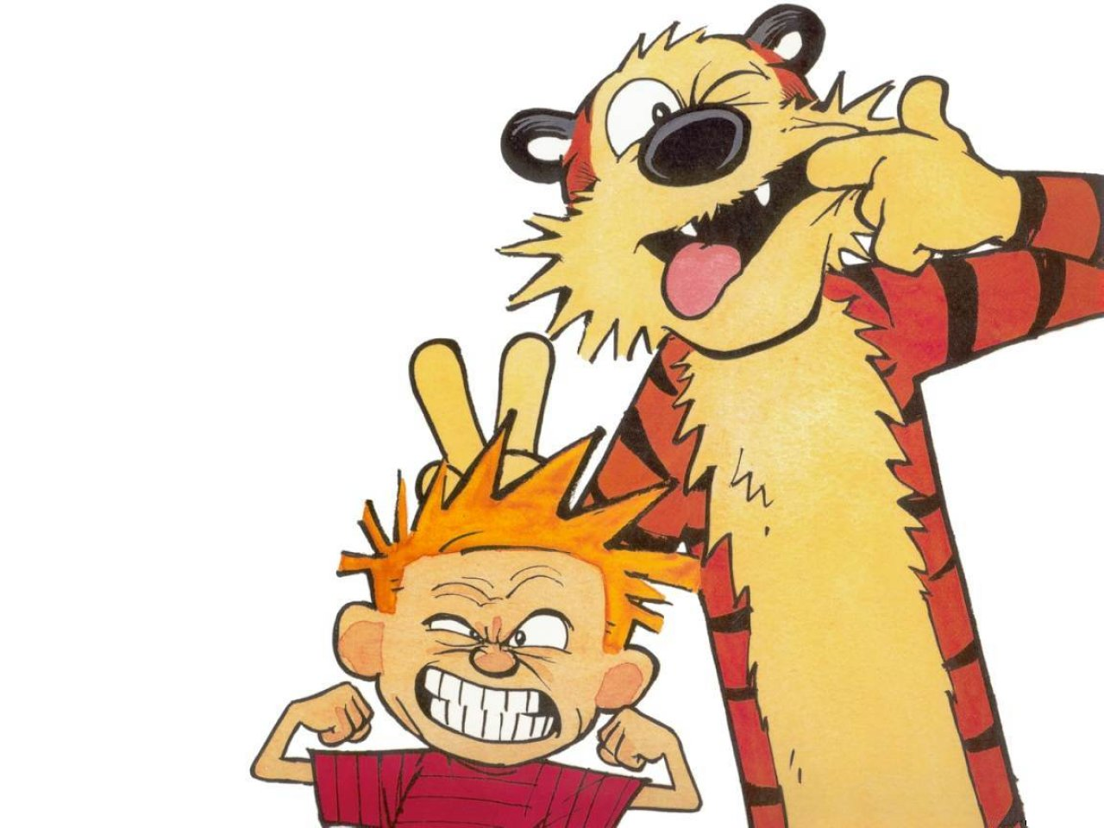
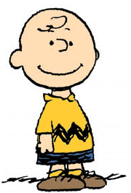
And Sunday funnies
took a place in the
hearts of America
until a few silly
characters
became known
to all…

Slide 6
What is it about comic characters, smiling friends and heroes sketched on the backs of napkins or drawn for millions on the big screen? What makes these characters so popular, so beloved, and so growing in popularity? What makes a few circles and connecting lines iconic? The answer can be found in one small character…

Slide 7
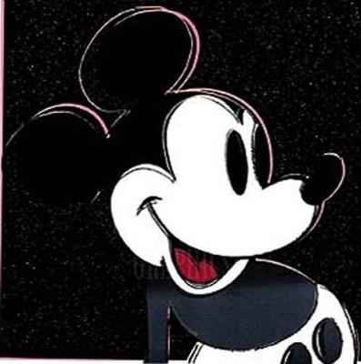
Characters like Mickey Mouse become iconic because they symbolize more than they are- they symbolize a memory, a hope, a dream or a way of life we can only imagine. Mickey Mouse is a symbol, not only of a corporation, but an idea, one that is nostalgic and more importantly, sells.

Slide 8
The Definition of Comic
juxtaposed pictorial and other images in deliberate sequence intended to convey information and/or to produce an aesthetic response in the viewer
Notes:
Keep in mind- these slides are not entirely self explanatory and are meant to be explained as a presentation, not viewed independently.

Slide 9
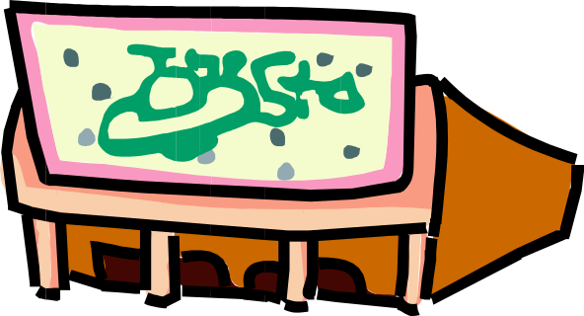

Animation vs. Comics-
  Animation is sequential in time, but not juxtaposed like comics- comics occupy multiples spaces, while animation exits in the same space (the screen), so space does for comics what time does for film

Slide 10
Pictures and Writing-
A Delicate Balance
Explained by the Experts
in the Way they Know Best

Slide 11
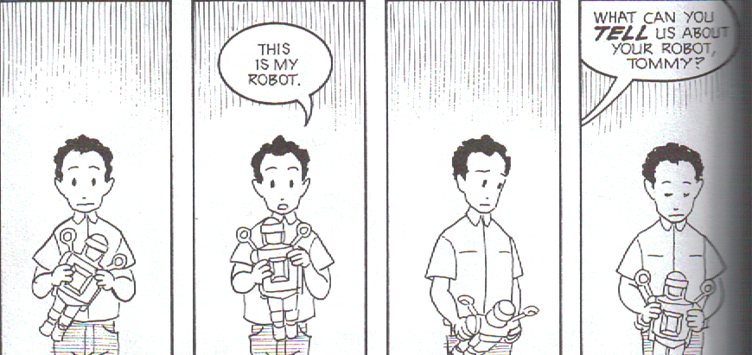
Popularity of Comics-
Think Show and Tell

Slide 12
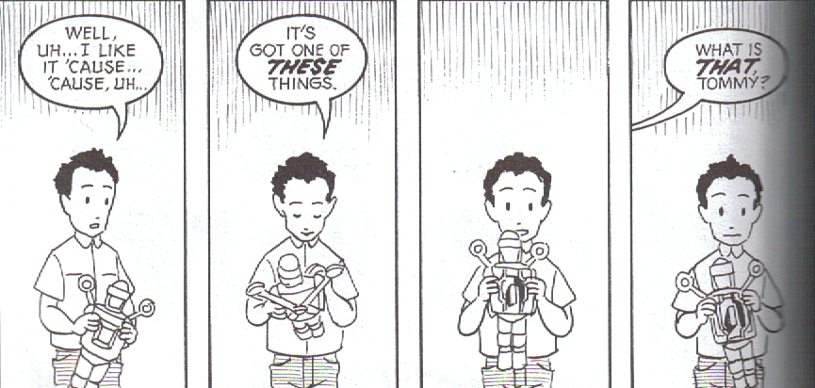

Slide 13
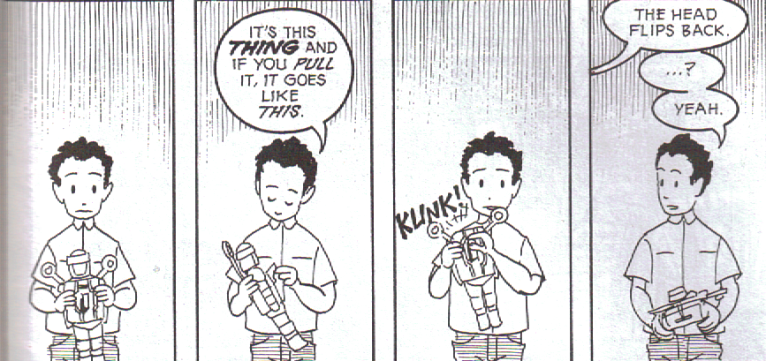

Slide 14
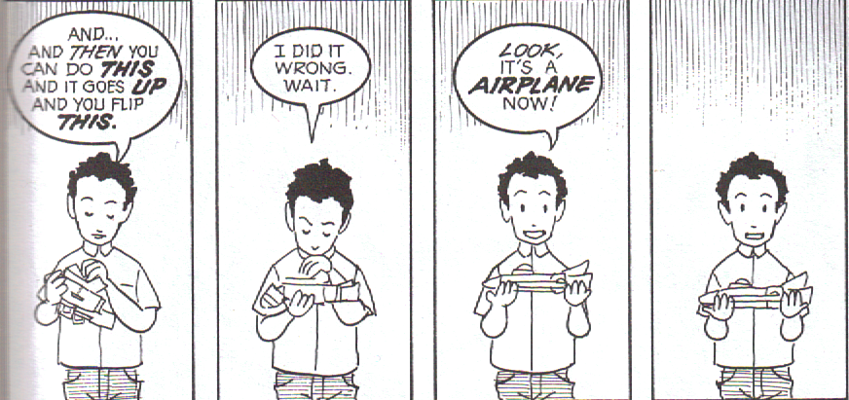

Slide 15
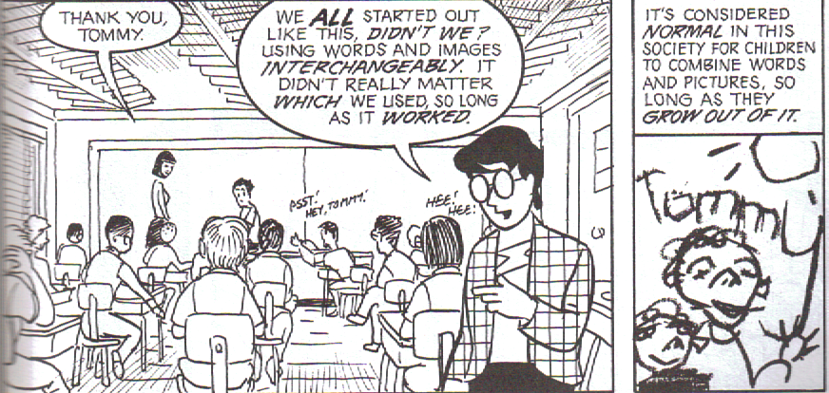

Slide 16
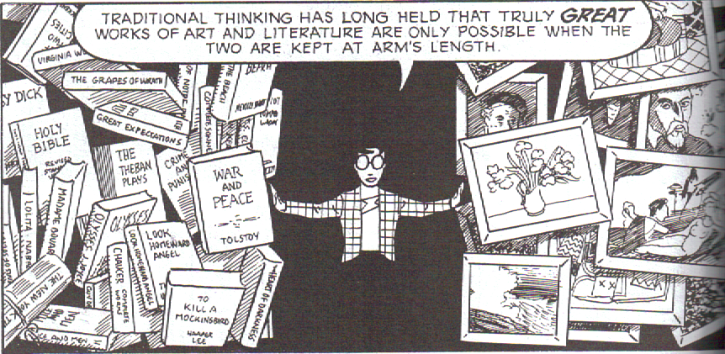
The End of Traditional Thinking

Slide 17
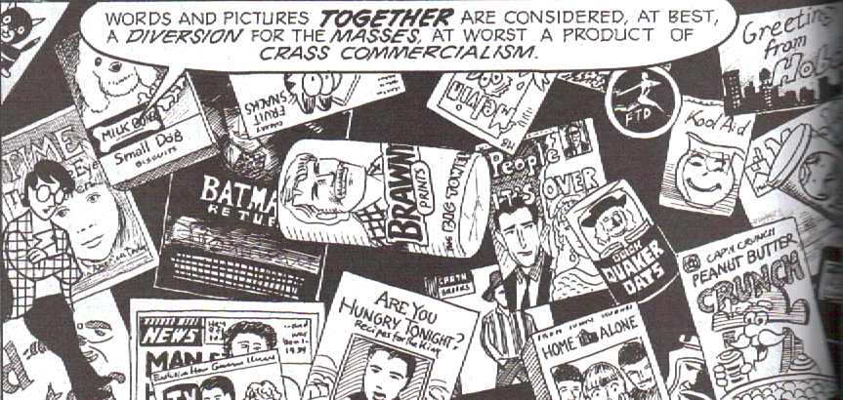

Slide 18
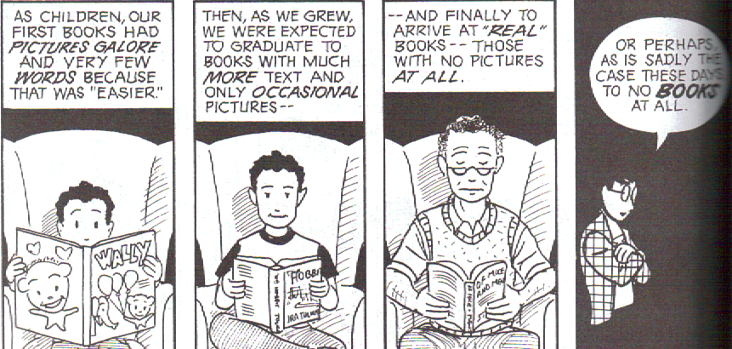
Why do we grow out of the
combination of words and pictures
and what does it mean for the future?

Slide 19
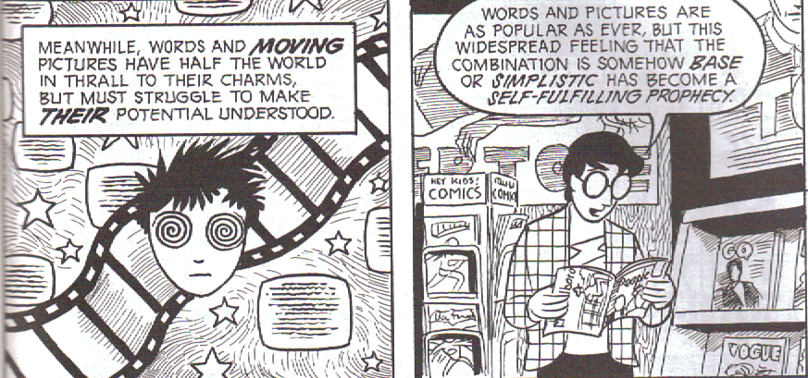

Slide 20
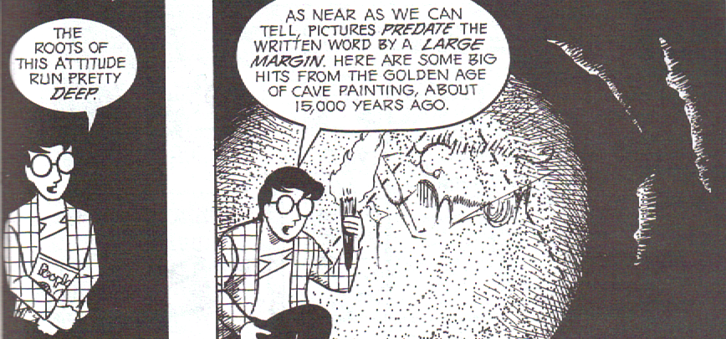

Slide 21

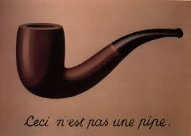
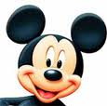
Why are we invested in the symbol or the icon?

Slide 22
Being “Drawn In”
  Complex → Simple
  Realistic→Iconic
  Objective→Subjective
  Specific→Universal

Slide 23
But Wait!
What is even more simple and iconic than pictures?
Words are the ultimate abstraction. But how different are words and pictures, really?
WORDS!

Slide 24
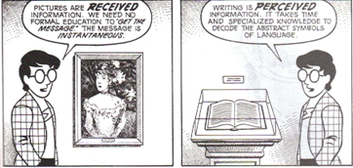
Received and Perceived
Notes:
This section comes from McCloud’s Understanding Comics, which is considered one of the definitive works on the subject. An informational textbook type, the text is written as a comic, revealing its own significance in its very media.

Slide 25
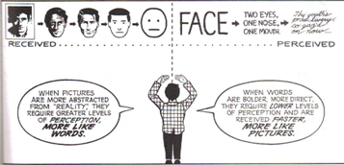

Slide 26
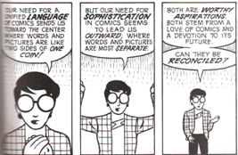

Slide 27
So how do we interpret?
Now that we know a bit about comics themselves, lets consider the elements of visual design that can help us interpret them. To do so, we can use Molly Bang’s principles of design from Picture This…

Slide 28
Scott McCloud and Line
Let’s take another look at what McCloud says about line and the way it impacts our understanding…
Check Out Chapter 5!

Slide 29
Principles of Space/Visual Design
  Smooth, flat, horizontal shapes: sense of stability and calm (can’t fall down)
  Vertical shapes: exciting and active, rebelling against earth’s gravity, implying energy, reaching toward heights of the heavens (energy to create, energy released if fall)
  Diagonal shapes: dynamic, imply motion or tension (as if falling)
Notes:
This section uses Molly Bang’s renowned text “Picture This” which provides information on visual design.

Slide 30
Principles of Space/Visual Design
  Upper Half (of frame): Freedom, happiness, triumph, “spirituality”; a stronger tactical position, escaping gravity- greater “pictorial weight”- draws attention, more important
  Lower Half: threatened, heavier, sadder, more constrained, grounded, less important

Slide 31
Principles of Space/Visual Design
  Center: most effective “center of attention” point of greatest attraction
    Shifting away from the center implies movement
    Rarely used unless figure is intended to be an object of meditation
  Edges and Corners (of the picture) = the edges and corners of the picture world
    Closer an object is to the edge, the greater the tension

Slide 32
Principles of Space/Visual Design
  Light/Dark: White or light backgrounds feel safer than dark backgrounds (reminding of daytime) while dark background symbolize the unknown

Slide 33
Principles of Space/Visual Design
  Pointed/Rounded Shapes: frightened by pointed, secure with rounded shapes and curves
  Larger/Smaller: larger objects feel stronger

Slide 34
Principles of Space/Visual Design
  Same or Similar Colors: associated more strong than same or similar shapes
    Repetition and confusion (regularity and irregularity, order and disorder)
    Some repetition gives security, but too much “perfection”- continual, relentless repetition-can be terrifying (isn’t that a metaphor for life!)

Slide 35
And Beyond Comics…
Use the same skills when working with picture books, such as these favorites…

Slide 36
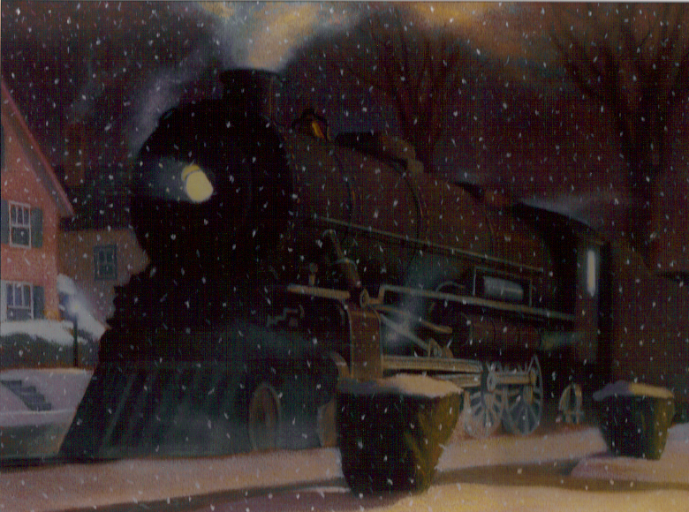

Slide 37
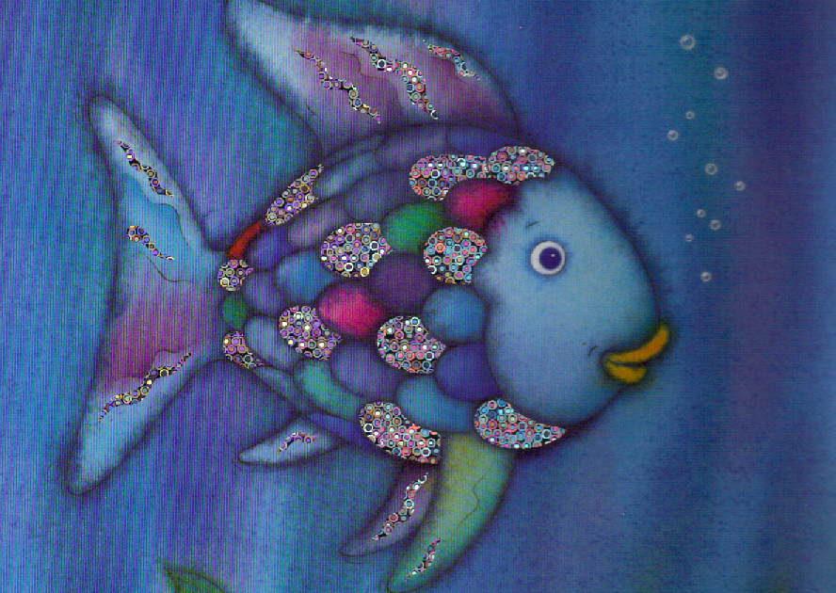

Slide 38
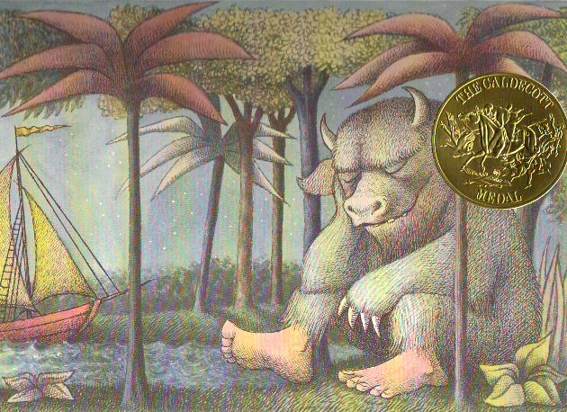

Slide 39
Ok, Test What You’ve learned…
Here are a few slides from popular comics. What elements of design can you pick out to determine something about what is happening in the story without even knowing the plotline?

Slide 40
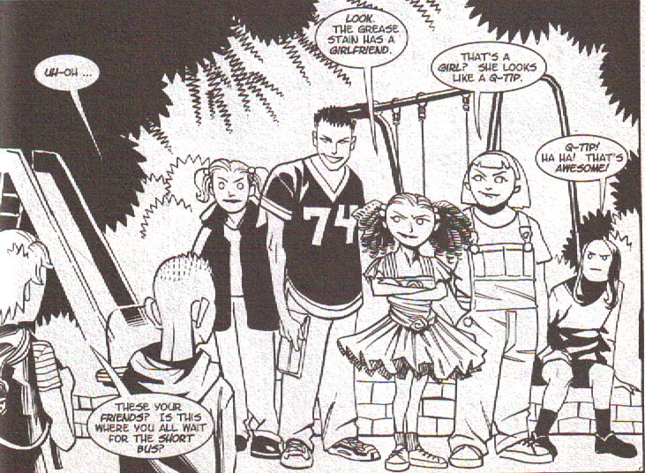
Notes:
Consider the placement of the gang, while those addressing a in the corner and not looking ahead. Perspective is key here. Also look at the way the gang are drawn- types of lines, shapes, silloette.

Slide 41
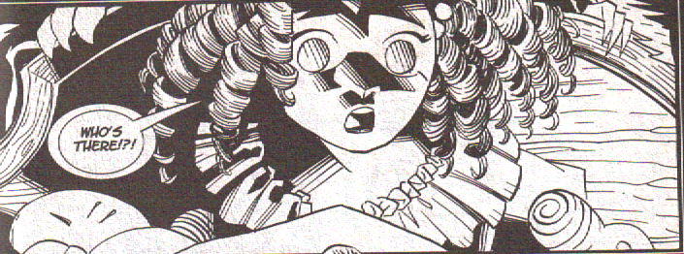
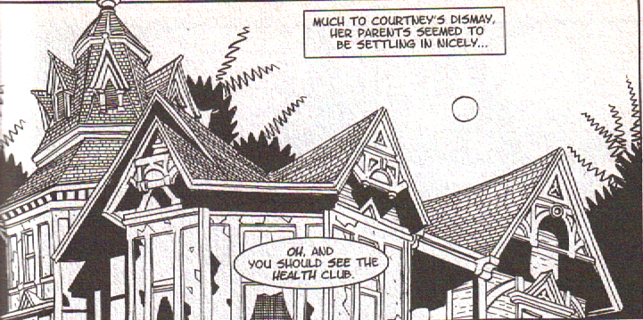
Notes:
Curly hair, diagonal lines. Look at how the girl’s eyes are different from the last slide.

Slide 42
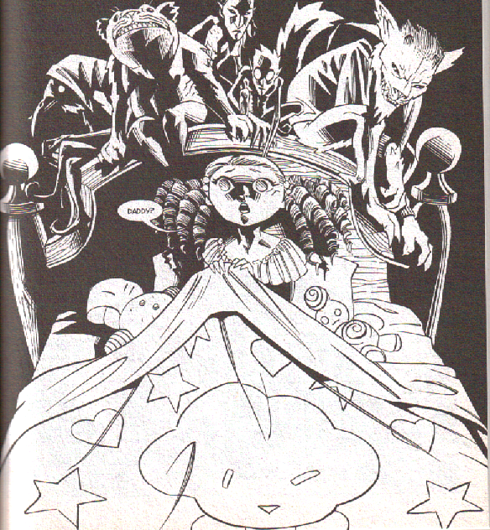
Notes:
Dark and light, above and below, the harsh lines of the monsters and the curvy lines of the safety blanket.

Slide 43
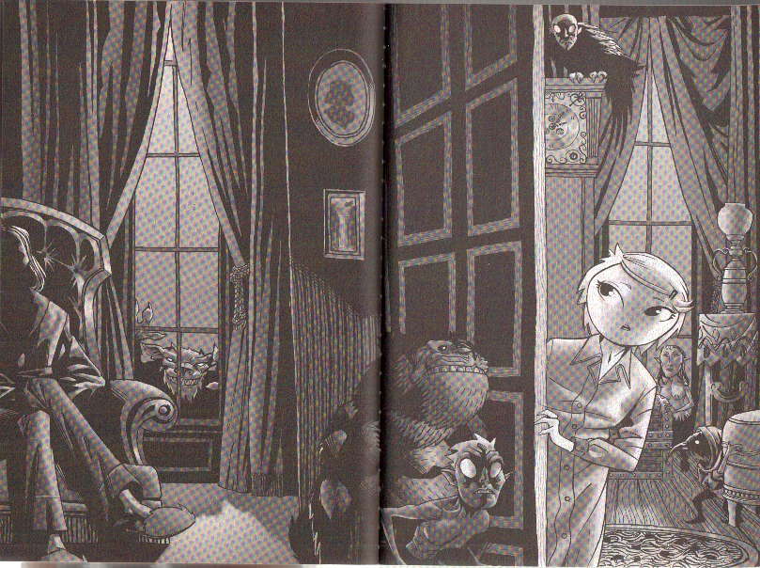
Notes:
Horizontal, vertical, diagonal, dark, light, shadow.

Slide 44
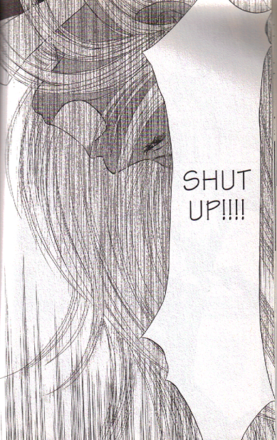
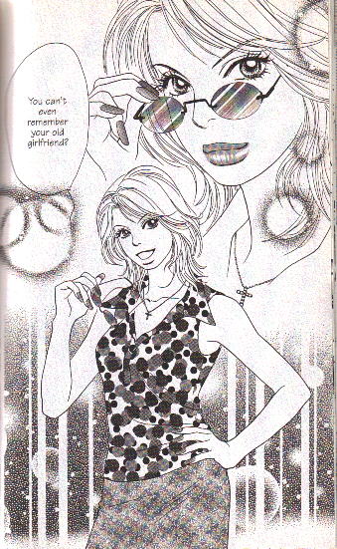
Notes:
Vertical lines in the first, circles in the second.

Slide 45
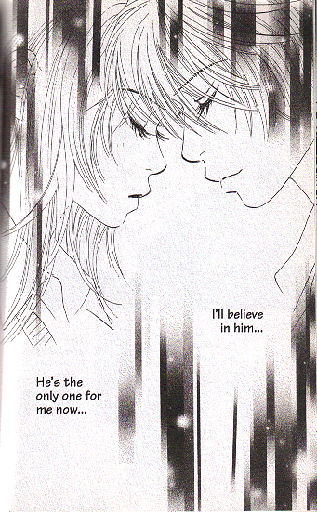
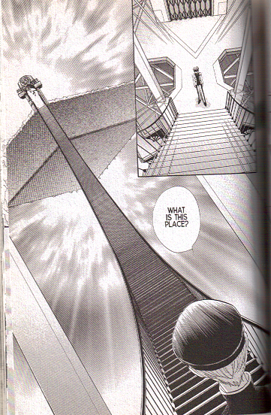
Notes:
Again- horizontal, diagonal, vertical, etc.

Slide 46
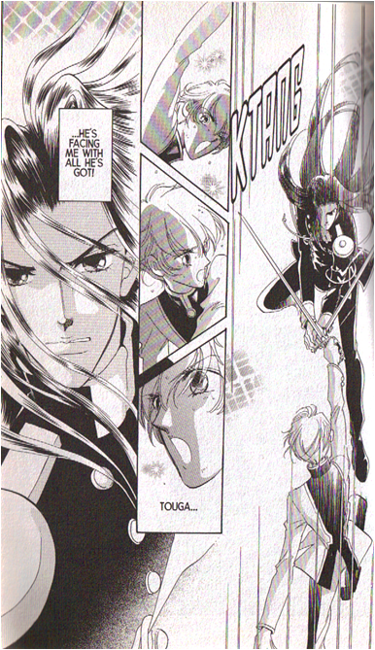
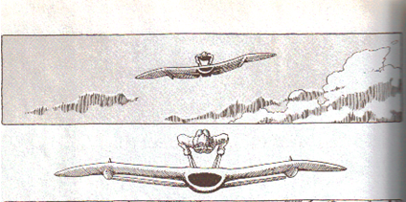
Notes:
Horizontal and vertical.

Slide 47
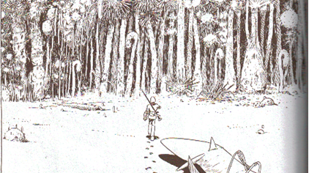
Notes:
Vertical lines. Dark of forest versus open sand. Size of character.

Slide 48
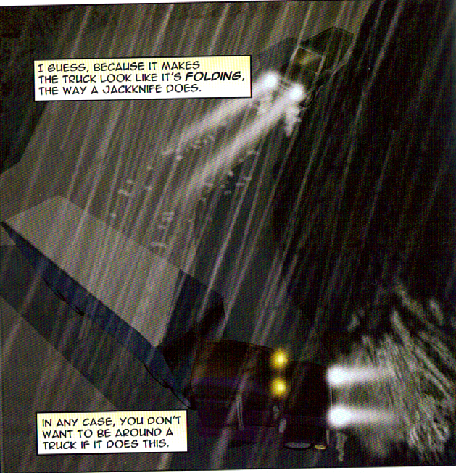
Notes:
Light and dark. Vertical lines of rain.

Slide 49
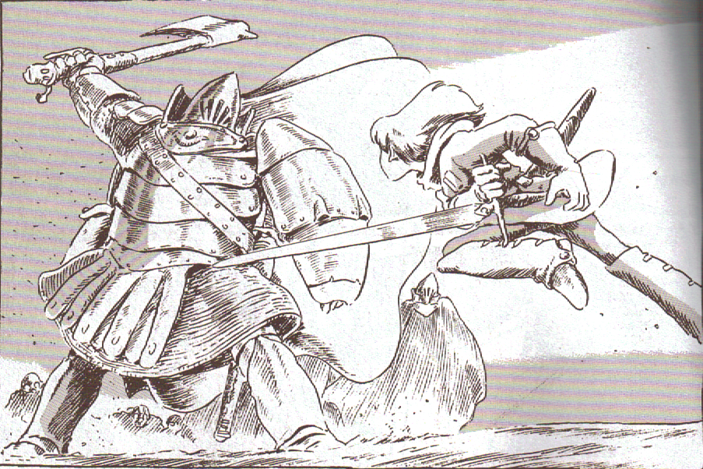
Notes:
Perfect for all the elements- find them all!

Slide 50
The world of Comics is changing and Growing…
Here are a selection of some of the more popular comic series of late. Consider the variance…

Slide 51
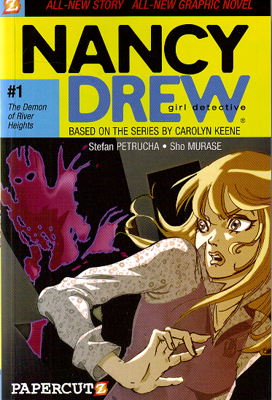
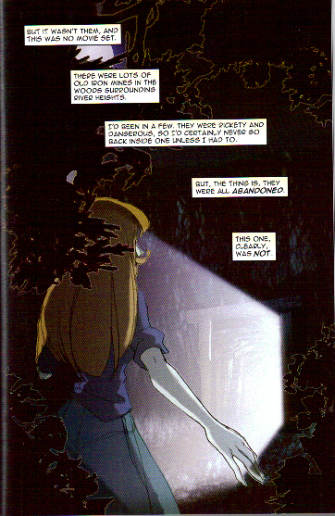
Old favorites are being transformed…

Slide 52
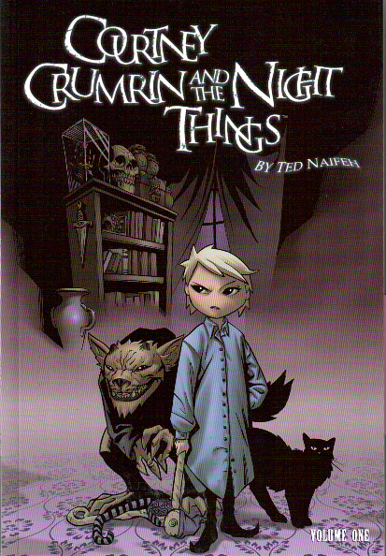
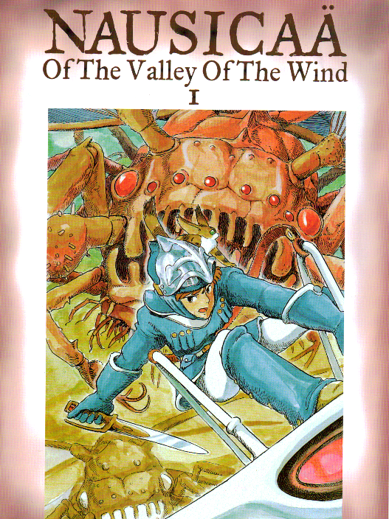
Horror and Adventure are widely popular…

Slide 53
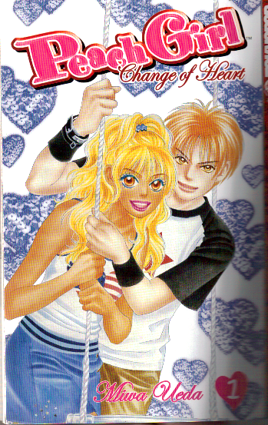
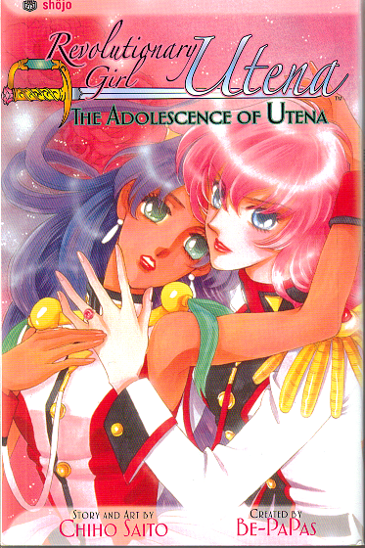
The teen romance and problem novel
are taking new form…

Slide 54
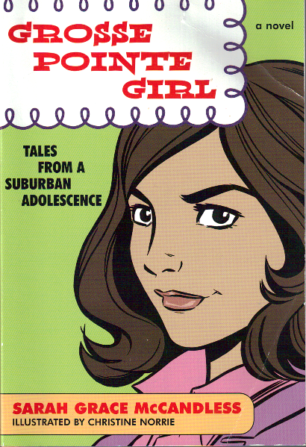
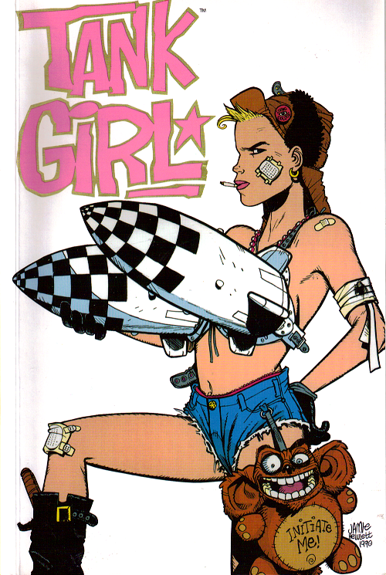
Girls emerge in all forms- from teen tales of suburbia to more adult representations not meant for teens…

Slide 55
So How does coraline use these principles

Slide 56
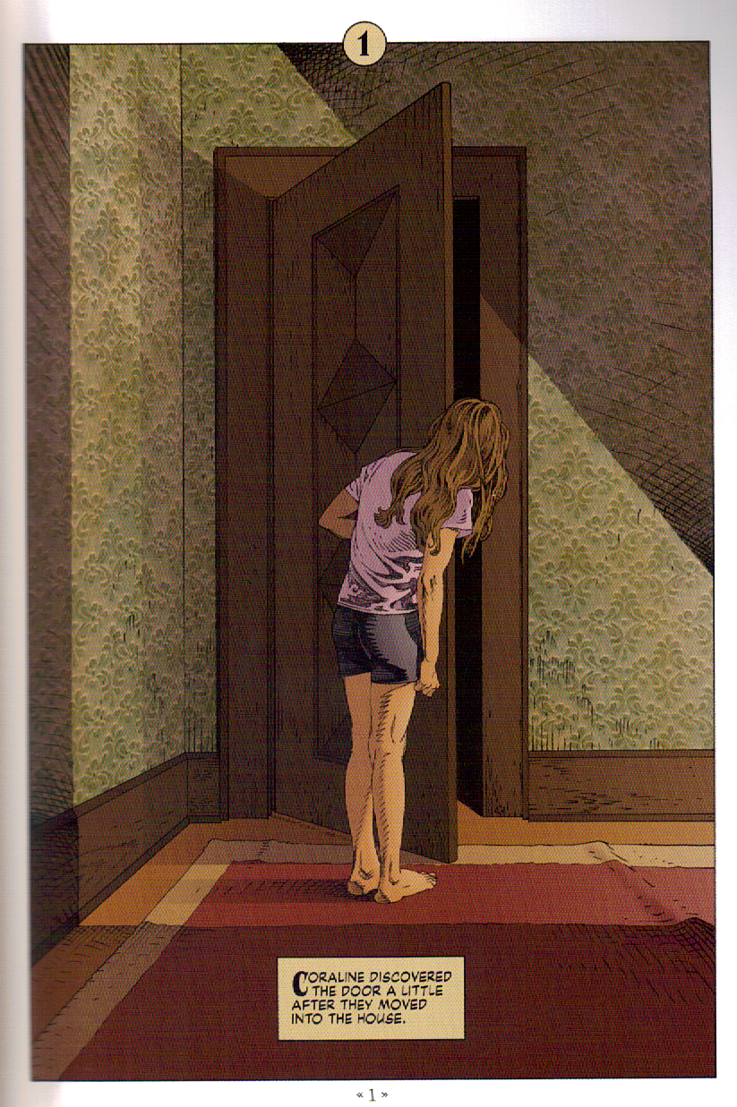
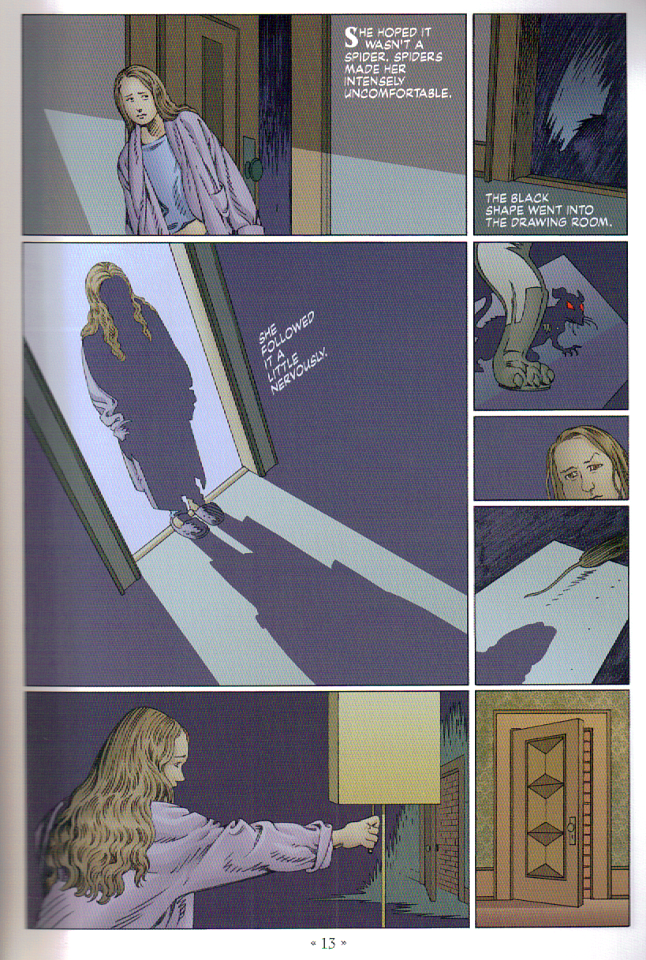

Slide 57



Slide 58



Slide 59



Slide 60


And do they have an application in film? Yes, but remember, these are moving pictures, so it is a little different. Nonetheless…

Slide 61


Slide 62


Slide 63


Slide 64


Slide 65


Slide 66


