Slide 1
Fairy Tale Terminology
ENG 170 Lecture
Meghann Meeusen

Slide 2
Definitions
Legends: based on events believed to be real
Myths: stories that take place outside of human time, often featuring supernatural heroes and gods/goddesses
Retellings or Revisions: Fairy tales are frequently retold and adapted to new contexts, whether to be more accessible to certain audiences, promote national pride, or fit with our understanding of a culture.
Intertextuality- relationship between a prior text and a new text created when an author borrows from the prior one or references it within the new text

Slide 3
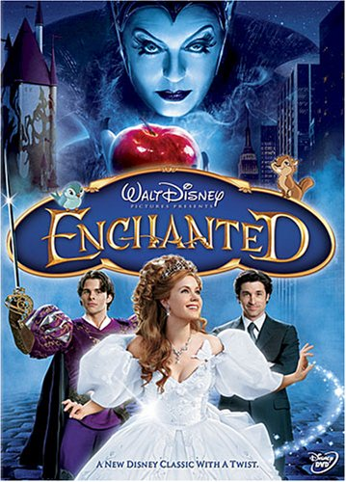
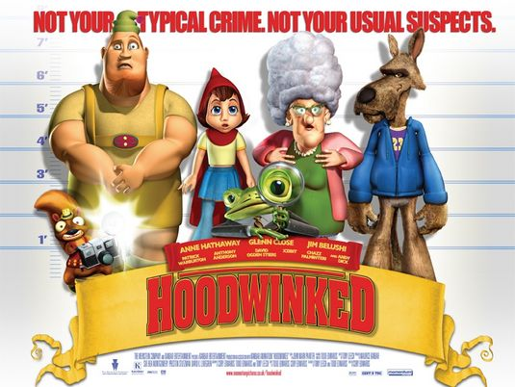
Postmodernism and Parody

Slide 4
Literary Fairy Tale and Oral Tale
A literary fairy tale is written down and has a definite author, and in the 16th, 17th, and 18th century, “experimented with and expanded upon the stock motifs, figures and plots of the fairy tale.
An oral folk tale is collectively authored and shared, “cultivated by non-literate and literate people to express the manner in which they perceived and perceive nature and their social order and their wish to satisfy their needs and wants” (Zipes 7).

Slide 5
Capture the Voice of a Culture
  Charles Perrault (1697)- France
    Aristocratic and courtly audience, sly asides and fashion details
    Always included a moral, both cautionary and flitatious/tongue-in-cheek
  Jakob and Wilhelm Grimm (1812-1815)- Germany
    Shift to make tales for children, which removed sexually explicit material
    Emphasized the traditional roles of women, enhanced violence
  Hans Christian Andersen (mid 19th century)- Denmark
    Original material
    Ugly Duckling, Emperor’s New Clothes, Little Mermaid and The Snow Queen (Disney’s Frozen)
  Andrew Lang (1880, 1892)- England
    “Color Books”
    Jack and the Beanstalk

Slide 6
Classic Versus Canon
Canon: those texts that by social and cultural consensus have been acknowledged as the most important or central works of a period, country or genre
Classic: text that has endured overall several generations and which is esteemed on both aesthetic and cultural grounds

Slide 7
Ideology
An ideology is a set of beliefs, values, or ways of seeing the world. It is a system of ideas or ideals, attitudes, and perceptions typical of a given class or group of people in a specific time and place.
Texts often reflect particular ideologies in the way they present certain elements as the norm, thus reinforcing a particular worldview that is frequently shared by many people in a society and/or reinforced by those in power.

Slide 8
Implicit/Explicit
implicit ideology- when an author is passing on cultural beliefs without even being aware of doing so
explicit ideology- the “theme” or message of the text
Ask:
  What does this story present as “normal”?
  What values or beliefs about society or people does it present?
  Does this story reinforce a dominant belief of a particular group?
  Does it complicate or question norms, beliefs or value systems of our society?
  Does the text reflect a pattern or offer a particular worldview or perspective that we see repeated in many texts?

Slide 9
References
This presentation is based in part on information in Chapter Four “Fairy Tales” of Reading Children's Literature: A Critical Introduction by Carrie Hintz and Eric Tribunella

